Slide 1

Lee Code and Plasma Focus Current
^{1,2}S H Saw & ^{2,3,4}S Lee
¹First City University College, 47800 Petaling Jaya, Malaysia
²Institute for Plasma Focus Studies, 32 Oakpark Drive, Chadstone VIC3148, Australia
³Physics Department, University of Malaya, 50603 Kuala Lumpur, Malaysia
⁴INTI International University, 71800 Nilai, Malaysia
saw.ipfs@gmail.com; leesing@optusnet.com.au

Slide 2
We discuss the development and wide usage of the Lee code, numerical experiments and the significant contributions in the plasma focus studies from our network and collaborations under Institute Plasma Focus Studies (IPFS) https: Plasmafocus.net
Briefly on Plasma Focus then Lee Code: Pinch Current, Scaling Laws, Radiative Cooling and Collapse; HED

Slide 3
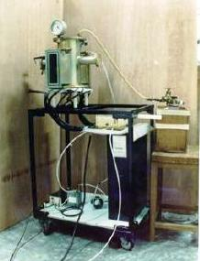
The original network machine of the
3 kJ UNU/ICTP PFF- placed at ICTP Trieste,Italy in 1988
Network: Malaysia, Singapore, Thailand, Pakistan, India, Egypt, Indonesia
Similar machines with designs based on or upgraded:
Zimbabwe, Syria, USA, Bulgaria, Iran

Slide 4
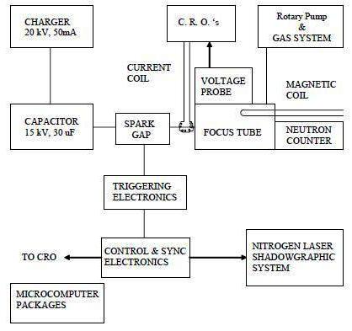
UNU ICTP PFF 3 kJ Plasma Focus Designed for International Collaboration within AAAPT

Slide 5
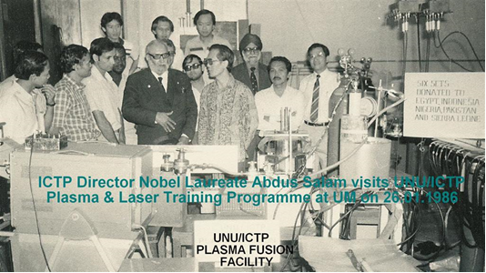
Nobel Laureate Abdus Salam visiting the UNU Training Programme on Plasma and Laser Technology at UM in January 1986
L-r: Widdi, Gholap, Sapru, Smith, Tou, Abdus Salam, K Eissa (almost hidden), Suryadi, Zakaullah, Kwek, Lee,Chatar Singh, Susetyo, Tan

Slide 6
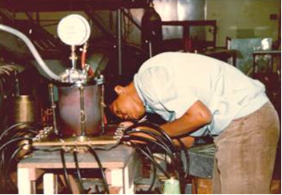
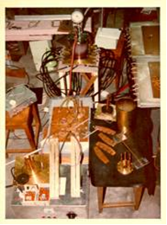
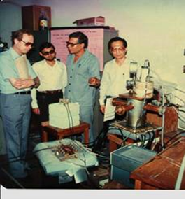

UNU Training Programme on Plasma and Laser Technology in 1985 to 1986
Widdi Usada assembling his UNU/ICTP PFF Parts of several UNU/ICTP PFF’s
Dr Walter Shearer (UNU), Zakaullah, Dr Eissa, Lee Warmate & Dr Smith with 1 set (in crates) of UNU/ICTP PFF-at Foyer Of UM Physics
Fellows

Slide 7
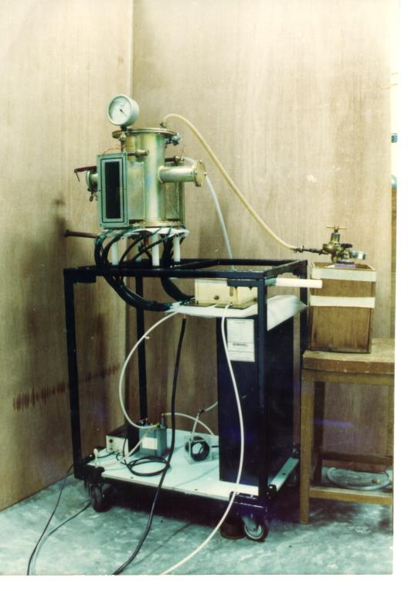
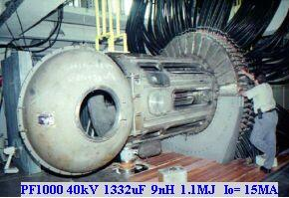
Range of Plasma Focus machines
3 kJ machine
(UNU ICTP PFF)
1000 kJ machine

Slide 8
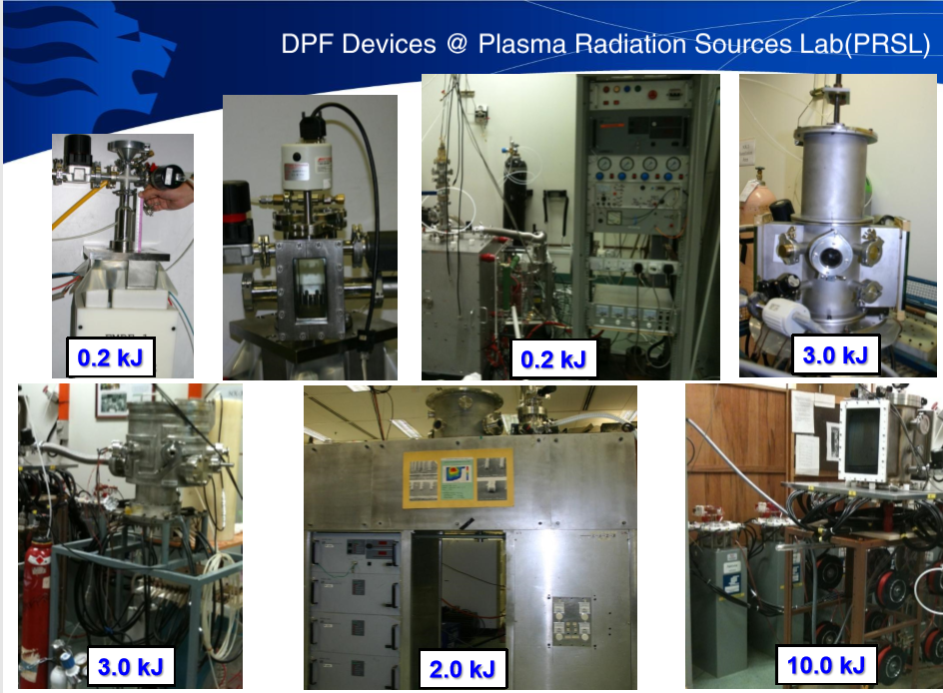
A range of PF’s in Singapore – Paul Lee & Rajdeep RS

Slide 9
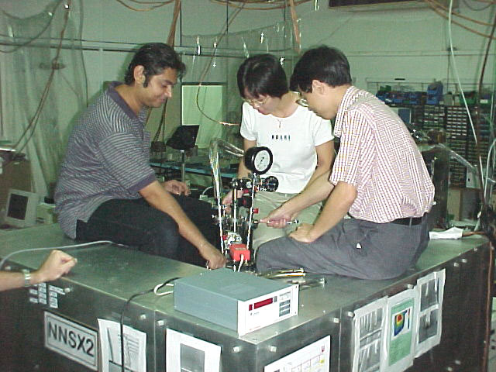
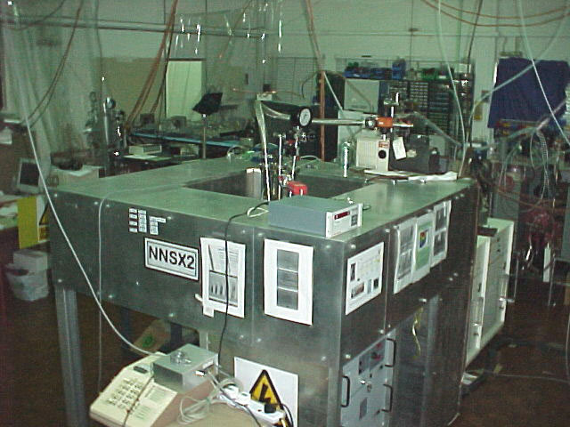
PRSL: NX2-Plasma SXR Source-Hi Rep
11.5kV, 2 kJ
16 shots /sec; 400 kA
20J SXR/shot (neon)
10⁹ neutrons/shot

Slide 10
The Parts for the Plasma Focus

Slide 11

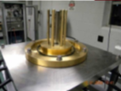

Slide 12
Plasma Dynamics in Plasma Focus
Radial Phase
Axial Accelaration Phase
Current lift-off
HV
30 μF, 15 kV

Slide 13
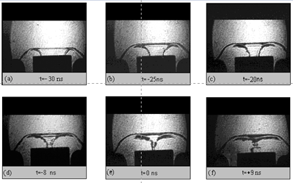
Radial Compression (Pinch) Phase of
the Plasma Focus

Slide 14
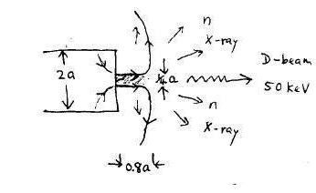
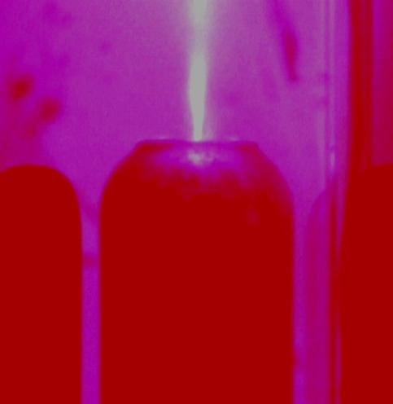
Emissions from the PF Pinch region
Mach500 Plasma stream
Mach20 anode material jet

Slide 15
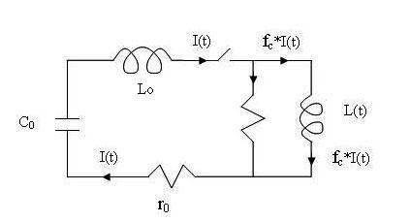
Plasma focus circuit
I total
I plasma

Slide 16
The Lee Code complements Plasma Focus Experiments
The code couples the electrical circuit with PF dynamics, thermodynamics and radiation.
Using standard circuit equations and equations of motion adapted for the axial and radial phases, the code is consistent in (a) energy (b) charge and (c) mass.
It was described in 1983 and used in the design and interpretation of experiments.
This evolved into a 5-phase code incorporating finite small disturbance speed, radiation and radiation-coupled dynamics.
It was web-published in 2000 and 2005. Plasma self-absorption was included in 2007

Slide 17
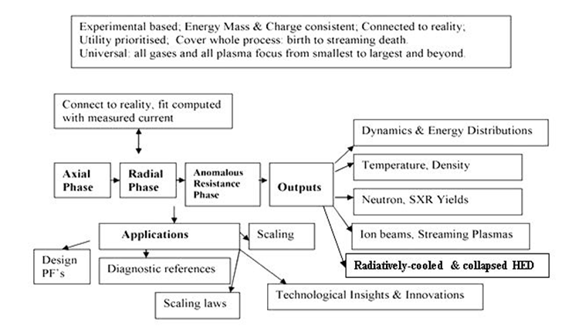
The Lee code - Philosophy, modelling, results & Applications

Slide 18
Plasma Focus - Numerical Experiments
Parameters of experiments
Capacitor bank parameters
Tube parameters
Operational parameters
Model parameters

Slide 19
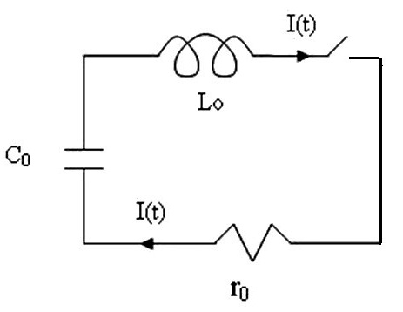
L₀-C₀-r₀ Discharge

Slide 20
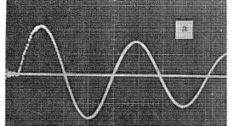
Capacitor bank discharged into short-circuit
Capacitor Discharge
Bank parameters: L₀, C₀, r₀ and V₀
Discharge characteristics:
L₀-C₀-r₀ circuit, generates
Damped sinusoidal current
T=2π(L₀C₀)^{0.5}
I₀=V₀/(L₀/C₀)^{0.5}

Slide 21
Plasma focus circuit
I total
I plasma

Slide 22
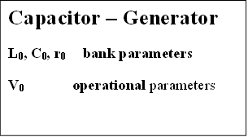
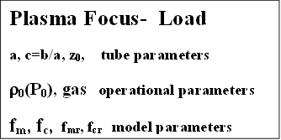
Capacitor bank discharged into PF tube

Slide 23
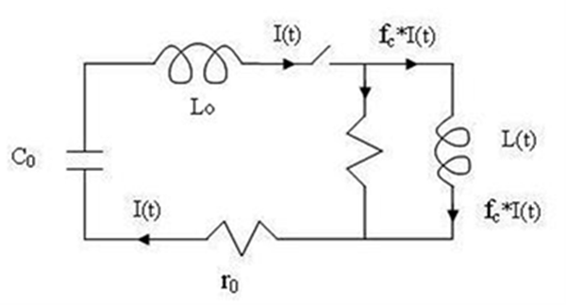
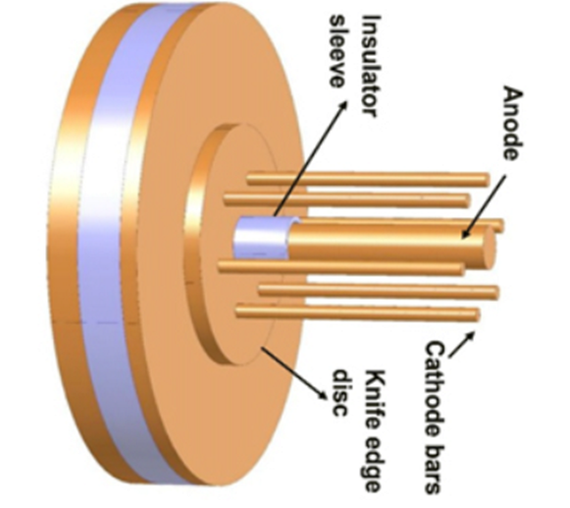
Bank Parameters & Tube Parameters
C₀
L₀
r₀
Anode radius ‘a’
Cathode radius ‘b’
Anode length z₀ = Uncovered length, subject to fitting

Slide 24
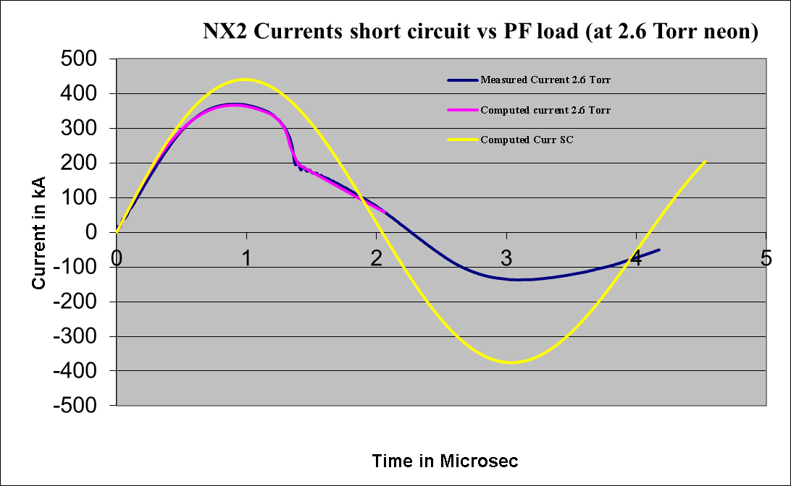
Capacitor bank- no load (SC) vs into PF tube

Slide 25
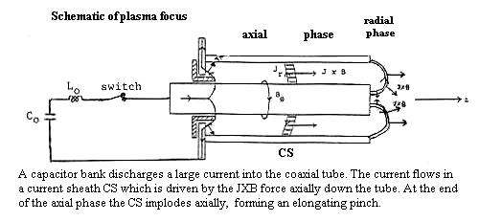
Diagnostics from modelling:
The Model Schematic
radially forming an elongating pinch.

Slide 26
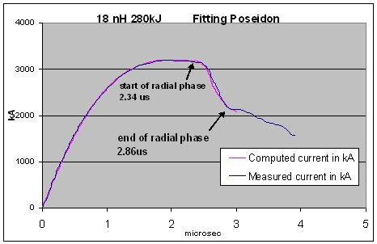
THE PLASMA FOCUS
The PF is divided into two sections.
Pre-pinch (axial) section: Delays the pinch until the capacitor discharge approaches maximum current.
The pinch starts & occurs at top of the current pulse.
Equivalent to driving the pinch with a super-fast rising current; without necessitating fast line technology.
The intensity which is achieved is superior to even the super fast pinch.

Slide 27
Two Main Phases of the Plasma Focus
Axial Phase
Radial Phase

Slide 28
Schematic of Lee Code
Computes:
Axial phase - snowplow model: 2 coupled equations-1 motion, coupled with 1 circuit. Incorporates mass swept-up fraction f_{m}, and plasma current fraction f_{c}. These model parameters account for all axial effects not specifically modelled.
Radial inward shock phase -, Shock Front-Current Sheet slug with thermodynamics: 4 coupled equations, 3 motion, coupled with 1 circuit; radial mass swept-up factor f_{mr} and current factor f_{cr}. These two model parameters are applied for the radial phases
Reflected Shock RS Phase
Pinch radiative phase, including plasma self-absorption & possibility of radiative collapse
Post-compression large radius axial phase

Slide 29
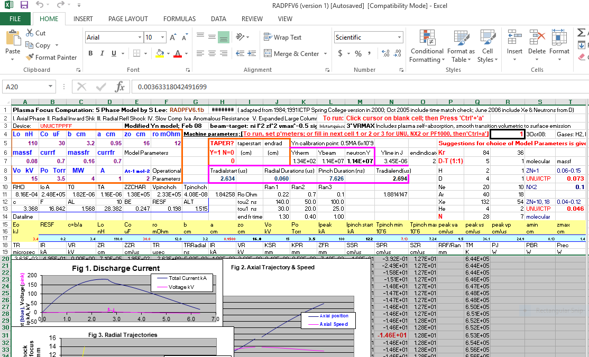
Lee code – http:www.plasmafocus.net

Slide 30
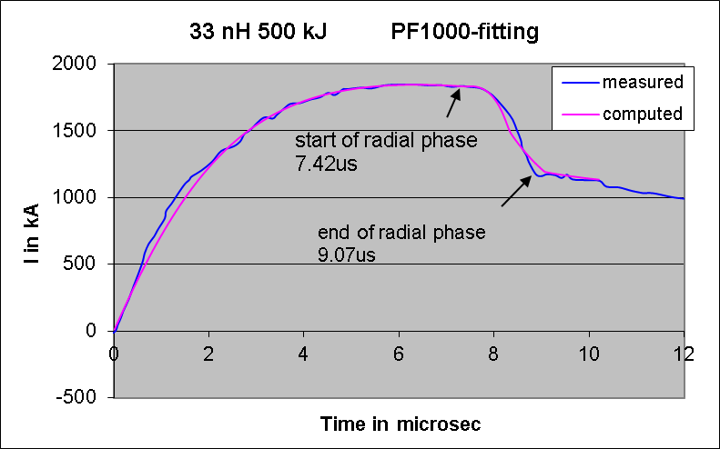
Connecting code and reality- fitting the computed current waveform to the measured current waveform
Fitting parameters:
axial phase: f_{m} and f_{c}
Radial phases: f_{mr} and f_{cr}

Slide 32
Significance of I_{total} current fitting
f_{m}: mass swept up factor, axial phase
accounts for all effects affecting mass swept up (structure inclination, porosity, boundary layer etc)
f_{c}: plasma current factor, axial phase
accounts for all effects affecting current flowing in the plasma (current leakage to backwall, shunting and fragmenting, CS inclination etc), defines the fraction of I_{total} effectively driving the magnetic piston
f_{mr}: mass swept up factor, radial phase
accounts for all effects affecting mass swept up (structure inclination, porosity, axial mass streaming etc)
f_{cr}: plasma current factor, radial phase
accounts for all effects affecting current flowing in the plasma (current leakage to backwall, CS bifurcation, current constriction/disruption etc) defines the fraction of I_{total} effectively driving the magnetic piston
We fit the computed I_{total} waveform to the measured because the I_{total} waveform is the one usually measured. Once the I_{total} waveform is fitted by adjusting the 4 model parameters, the I_{plasma} waveform is also implicitly fitted.

Slide 33
Fitting Procedure - the 5-point fit
The 5-Point Fit:
First, the axial model factors f_{m}, f_{c} are adjusted (fitted) until
  (1) computed rising slope of the I_{total} trace and
  (2) the rounding off of the peak current as well as
  (3) the peak current itself
  are in reasonable (typically very good) fit with the measured I_{total} trace.
Next, adjust (fit) the radial phase model factors f_{mr} and f_{cr} until
  (4) the computed slope and
  (5) the depth of the dip
agree with the measured I_{total} waveform.

Slide 34
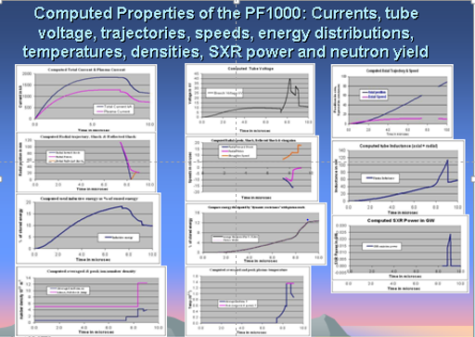
Once fitted, Lee code outputs the properties of the PF

Slide 35
Total Current and Plasma Current (1)
Total current (I total) waveform in a plasma focus discharge is easily measured using a Rogowski coil.
The peak value Ipeak of I total is commonly used to: 1) to measure of the drive efficacy and 2) scale the yield performance of the plasma focus.
However yields should be scaled to focus pinch current Ipinch (the value of the plasma sheath current Iplasma at time of pinch) which directly powers the emission processes.
Many researchers still use Ipeak instead of Ipinch for scaling because Ipinch is very difficult to measure even in large devices where it is possible to place magnetic probes near the pinch. This measurement is also inaccurate and perturbs the pinch. In a small device, there is no space for such a measurement.

Slide 36
Total Current and Plasma Current (2)
A simpler method is to compute the Iplasma waveform using measured waveforms of Itotal and tube voltage. This was achieved only up to the start of the radial phase thereby missing the crucial Ipinch.
Yet another group assumed Ipinch to be Itotal at pinch time.
To date, Ipinch is still one of the least measured and often misunderstood quantities.

Slide 37
I peak and I pinch (1)
The relationship between Ipinch and Ipeak has only been recently elaborated.
It primarily depends on the value of the static inductance L₀ compared to the dynamic inductances of the PF.
As L₀ is reduced, the ratio Ipinch/Ipeak drops.
Thus, yield laws scaled to Ipeak will not consistently apply when comparing two devices with all parameters equal but differing significantly in L₀.
Better consistency is achieved when yield laws are scaled to Ipinch.
S. Lee and S. H. Saw, Appl. Phys. Lett. 92, 021503 2008.

Slide 38
I peak and I pinch (2)
A numerical method using Lee Code is able to consistently deduce Ipinch from any measured trace of Itotal. This method will improve the formulation and interpretation of PF scaling laws.
Specifically, we define Ipinch as the value of Iplasma at the start of the pinch phase of the PF radial dynamics.
We now discuss the distinction between Itotal and the plasma sheath current Iplasma.
A measured trace of Itotal is commonly obtained with a Rogowski coil wrapped around the PF flange through which is fed Itotal discharged from the capacitor bank between the coaxial electrodes across the back wall.

Slide 39
I peak and I pinch (3)
A part of Itotal, being the plasma sheath current Iplasma, lifts off the backwall insulator and drives a shock wave axially down the coaxial space. At the end of the anode, the plasma sheath turns from axial into radial motion. The previously axially moving Iplasma becomes a radial inward moving cylindrical sheath, driving a radially collapsing cylindrical shock front.
When this shock front arrives on axis, because the plasma is collisional, a reflected shock RS moves radially outwards until it meets the incoming driving current sheath. The increased pressure of the RS region then rapidly slows down the sheath. This is the start of the pinch phase.
All the dynamics dominating the axial and radial phases is determined by Iplasma. A proportion of the current, the difference between Itotal and Iplasma, does not take part in the dynamics. This leakage current stays at the back wall, but parts of it may be diffusely distributed.

Slide 40
Current and Mass factors
We define for the axial phase fc as Ip / Itotal and distinguish it from fcr for the radial phase.
Likewise, only a fraction of the mass encountered by the axial sheath is swept up. This fraction we call fm, distinguishing the radial phase fraction as fmr. The rest of the mass either leaks through the sheath or is swept outwards due to the canting of the sheath.
The exact time profile of the Itotal trace is governed by the bank, tube, the operational parameters, and by the mass and current fractions and variation of these fractions through the axial and radial phases.
Although we may expect these fractions to vary, for simplicity, we average these model parameters as fm, fc and fmr and fcr.

Slide 41
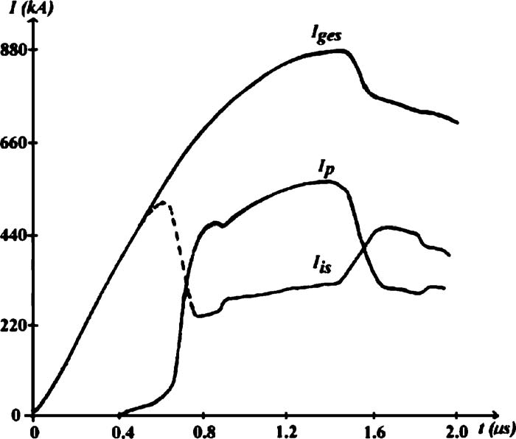
Experiment using the DPF78 (Stuttgart) -1
A Rogowski coil measured the Itotal, and magnetic probes measured the Iplasma waveforms.
Bank parameters: C0=15.6 F nominal; L0=45 nH nominal
Tube parameters: b=50 mm, a=25 mm, and z0=150 mm
Operating parameters were V0=60 kV, P0=7.6 Torr D2.
Measured Itotal (Iges) and Ip waveforms. (The third trace is the difference of Itotal and Ip)

Slide 42
Experiment using the DPF78 (Stuttgart) -2
DPF 78 Parameters of fitting
Lee code fitting of Measured I total
Bank parameters: C0=17.2 F; L0=55 nH; r0=3.5mΩ
Tube parameters: b=50 mm, a=25 mm, and z0=137 mm
Operating parameters were V0=60 kV, P0=7.6 Torr D2.
Model Parameters: fm=0.06, fc=0.57, fmr=0.08, and fcr
=0.51

Slide 43
Experiment using the DPF78 (Stuttgart) -3
From the computation results the start of the pinch phase was obtained as 1.551 µs. At this time Ipinch was computed as 0.51×778=396.8 kA.
From measured results: at 1.551 µs, Itotal=778 kA and Ipinch=381.2 kA.
The computed Ipinch was 4% larger than the measured Ipinch is better than the typical error of 20% estimated for Ipinch measurements using magnetic probes.
Appl. Phys. Lett. 92, 111501 (2008)

Slide 44
The value of Ipinch from the measured Iplasma trace was not immediately obvious since there was no striking feature that marked this moment on the measured Iplasma trace.
We used the following procedure to obtain it, at the same time to get further insight into fc and fcr.
The ratio Ip / Itotal digitized was plotted as a function of time. This difference was to be expected considering that the modeled fcr was an average value of 0.51; while the laboratory measurement showed Fig. 3 that in the radial phase Ip / Itotal varied from 0.63 to 0.4, and at the start of the pinch phase this ratio was 0.49 and rapidly dropping. Thus, one would expect the computed value of Ipinch to be somewhat higher than the measured, which turned out to be the case. Nevertheless, the difference of 4% is better than the typical error of 20% estimated for Ipinch measurements using magnetic probes.

Slide 45
The computed Ipinch was 4% larger than the measured Ipinch. This difference was to be expected considering that the modeled fcr was an average value of 0.51; while the laboratory measurement showed Fig. 3 that in the radial phase Ip / Itotal varied from 0.63 to 0.4, and at the start of the pinch phase this ratio was 0.49 and rapidly dropping.
Thus, one would expect the computed value of Ipinch to be somewhat higher than the measured, which turned out to be the case. Nevertheless, the difference of 4% is better than the typical error of 20% estimated for Ipinch measurements using magnetic probes.

Slide 46
The Lee code - Philosophy, modelling, results & Applications

Slide 47
Applications of the Code
Reference for diagnostics: dynamics, pinch size and lifetimes, SXR yields, neutron yields, ion beams and FPS; anomalous resistance, amplitudes and time scales-applied to many PF’s, including tapered PF, curved anodes and hemispherical anode
Design & optimization: UNU/ICTP PFF (network) , NX2, NX3, FMPF (Singapore), FNII (Mexico), UBA (Argentina), KSU (USA), FOFU (USA), other machines Chile, Iran, Syria etc, DuPF
Special designs: current-stepped PF, multi-MJ PF
ML: modification of code schematic to Filippov machines

Slide 48
Information derived from code http:www.plasmafocus.net
Scaling Properties:
Constancy of energy density (per unit mass) across range of machines
    Hence same temperature and density
    Constancy of drive current density I/a
    Constancy of speed factor (I/a)/ρ^{0.5}
Scaling of pinch dimensions & lifetime with anode radius ‘a’:
    pinch radius ratio r_{p}/a =constant
    pinch length ratio z_{p}/a=constant
    pinch duration ratio t_{p}/a=constant

Slide 49
Scaling Properties – specially important for energy applications
1 m
3 kJ machine
Small Plasma Focus
1000 kJ chamber only
Big Plasma Focus

Slide 50
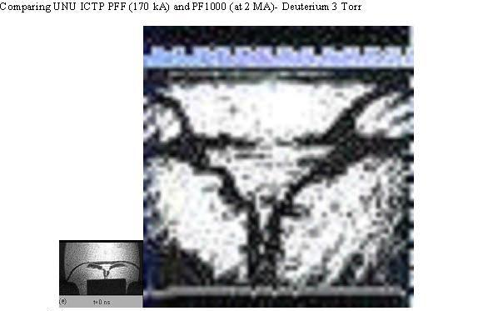
Comparing large and small PF’s- Dimensions and lifetimes- putting shadowgraphs side-by-side, same scale
Anode radius: 1 cm 11.6 cm
Pinch Radius: 1mm 12mm
Pinch length: 8mm 90mm
Lifetime ~10ns ~100 ns

Slide 51
Insights from code
Current and neutron limitations as inductance is reduced towards small values e.g. 10 nH
Scaling properties of PF: speed, T, density
Scaling properties for SXR , neutron, beam ions & FPS
Scaling laws of SXR , neutron, beam ions (FIB) & Fast Plasma Streams (FPS)
Deterioration of neutron and radiation yield scaling
SFM- advantageous for materials deposition
Radiative cooling and collapse for HED

Slide 52
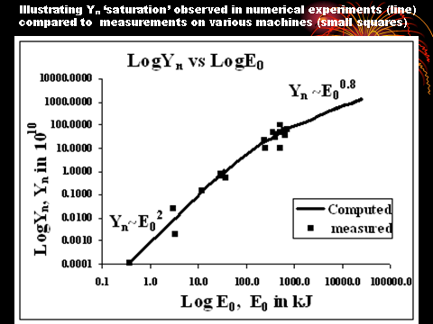
Dominance of dynamic resistance for very large capacitor banks causes current- scaling deterioration, leading to yield- scaling deterioration to Y_{n} ~ E₀^{0.8}– suggests no break-even unless capacitor voltages are greatly increased aided by increase in pressure.

Slide 53
Better to consider scaling with current: The following scaling law is developed with our code
Scaling from I_{pinch} using present predominantly beam-target :
Y_{n}=3.2x10¹¹I_{pinch}^{4.4} (I in MA)

Slide 54
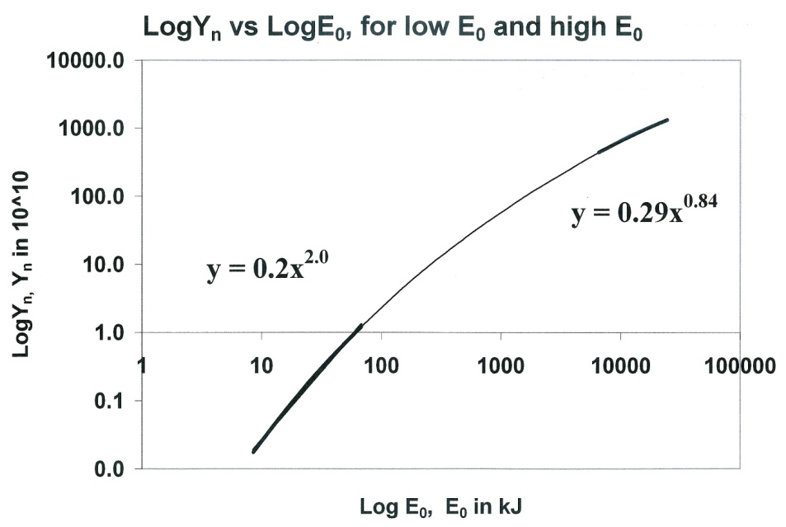
Scaling laws for neutrons from numerical experiments over a range of energies from
10kJ to 25 MJ
Voltage, V₀ = 35 kV; P₀ = 10 torr deuterium; RESF = 1.22; ratio c=b/a is 1.39.
Numerical experiments: C₀ ranging from 14 µF(8.5 kJ) to 39960 µF (24 MJ)
For each C₀, anode length z₀ is varied to find the optimum z₀.
For each z₀, anode radius a₀ is varied to get end axial speed of 10 cm/µs.
Yn scaling changes:
Y_{n}~E₀^{2.0} at tens of kJ
Y_{n}~E₀^{0.84} at the highest
energies (up to 25MJ)

Slide 55
Scaling laws for neutrons from numerical experiments over a range of energies from
10kJ to 25 MJ
Scaling of Y_{n} with I_{peak} and I_{pinch}:
  Y_{n}=3.2x10¹¹ I_{pinch}^{4.5}
  and
  Y_{n}=1.8x10¹⁰ I_{peak}^{3.8}
  where I_{peak} = (0.3-0.7)MA
  and I_{pinch} = (0.2 -2.4)MA.

Slide 56
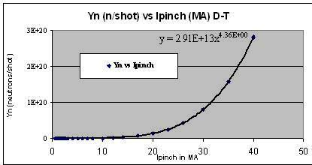
2

Slide 57
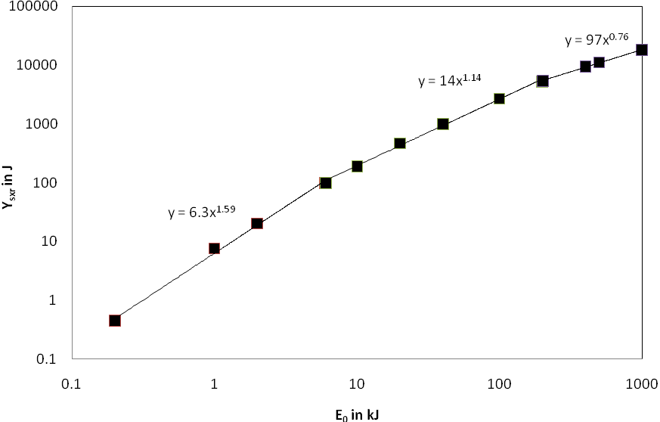
Scaling laws for neon SXR from numerical experiments over a range of energies from
0.2 kJ to 1 MJ
Y_{sxr} scales as:
E₀^{1.6} at low energies in the sub-kJ to several kJ region.
E₀^{0.76} at high energies
towards 1MJ.

Slide 58
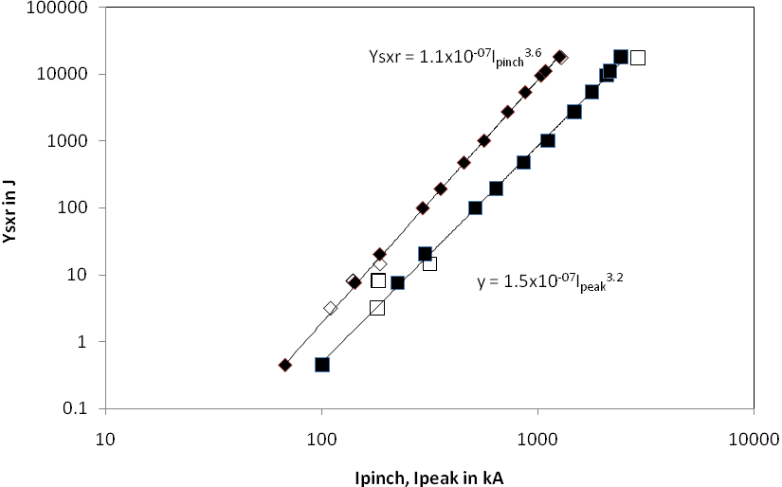
Scaling laws for neon SXR from numerical experiments over a range of energies from
0.2 kJ to 1 MJ
Scaling with currents
Y_{sxr}~I_{peak}^{3.2} (0.1–2.4 MA)
Y_{sxr}~I_{pinch}^{3.6} (0.07-1.3 MA)
Black data points with fixed parameters RESF=0.1; c=1.5; L₀=30nH; V₀=20 kV and model parameters f_{m}=0.06, f_{c}=0.7, f_{mr}=0.16, f_{cr}=0.7.
White data points are for specific machines with different values for the parameters :c, L₀, V₀ etc.

Slide 59
Argon SXR

Slide 60
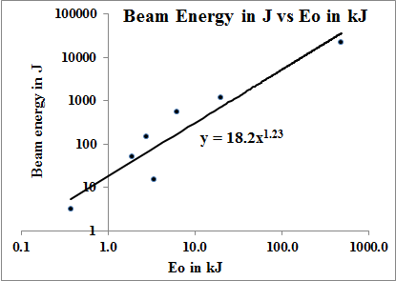
Scaling Laws for Deuteron Beams at DPF pinch exit

Slide 61
Scaling Laws for Deuteron Beams at DPF pinch exit
The following scaling:
Y_{beamions}=2.8x10⁻⁷I_{pinch}^{3.7} (current in kA)
Y_{beamions}= 8.4x10⁻⁷I_{peak}^{3.16} (current in kA)
Y_{beamions}= 18.2E₀^{1.23}
where Y_{beamions} is in J and E₀ is in kJ ranging from 1 kJ to 1MJ.

Slide 62
Reduced P-B limit for high Z gases
For higher Z gases such as neon, line radiation predominates and since line radiation is many times more in power than bremstrahlung at PF conditions, the P-B limit current is reduced to less than 100 kA in the case of argon, Kr and Xe.
The code demonstrates radiative collapse in small devices, including the INTI PF.

Slide 63
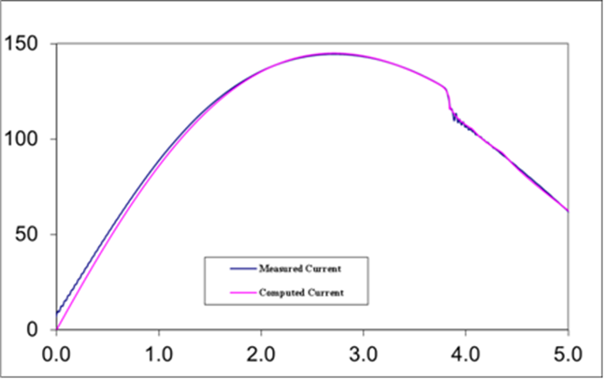
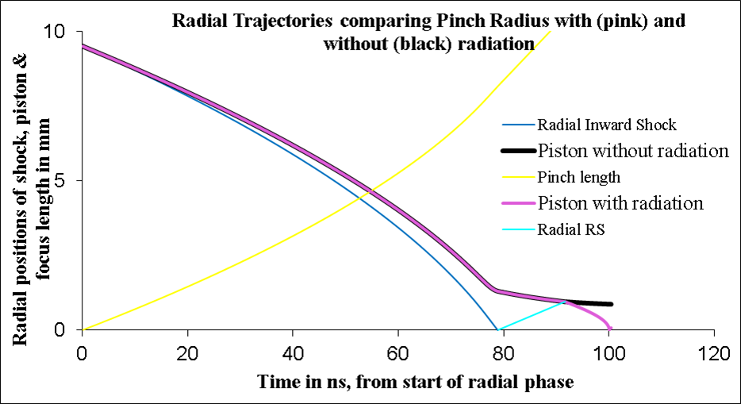
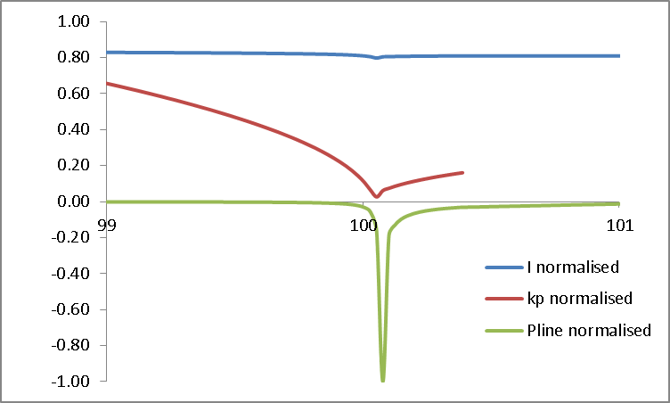
Radiative collapse in Kr, measured in the INTI PF on the basis of a current measurement (2 kJ operation)
250 J in PF plasma energy
40 J radiated away in 50 ps
0.8 TW, 40 kJ per mm³
INTI PF is a gift from PRSL NIE NTU Singapore

Slide 64
Correlating RC Trajectory with P_{line}
The pinch compresses to a radius of 0.0013 cm; kp = 0.0014.
The radiative collapse is ended when plasma self-absorption attenuates the intense line radiation.
The rebound of the pinch radius is also evident.
This intense compression, reaches 3.7 × 10²⁶ ions m⁻³, which is 15 times atmospheric density (starting from less than 1/1000 of an atmospheric pressure).
Energy pumped into the pinch is 250 J whilst 41 J are radiated away in several ns,
Most of the radiation occurs in a tremendous burst of 50 ps
Peak radiation power:- almost 4 × 10¹² W.
The energy density at peak compression is 4 × 10¹³ J m⁻³ or 40 kJ mm⁻³.
Thus even in this small plasma focus intense HED is achieved with immense radiation power.

Slide 65
Conclusion
Plasma Focus
Lee Code: phases, equations.
Lee Code Applications: pinch curent, dynamics and properties, reference for diagnostics, design & optimisation
Insights: - scaling properties & scaling laws for SXR, neutrons, FIB & FPS,
- deterioration of yield scaling
- Radiative cooling and collapse for HED
Download: http:www.plasmafocus.net

