Slide 1
Plasma Focus Ion beam Properties – Validation Of Lee Code Computations By Faraday Cup Measurements
V Damidehª, O H Chinª, S H Saw^{b,c,e}, P C K Lee^{c}, R S Rawat^{c}, A Singh^{d},
S Lee^{a,b,d,*}
ªPlasma Technology Research Centre, University of Malaya, 50603 Kuala Lumpur, Malaysia
^{b}Institute for Plasma Focus Studies, 32 Oakpark Drive, Chadstone, Vic 3148, Australia
^{c}Radiation Sources Laboratory, National Institute of Education, Nanyang Technological University, 637616 Singapore
^{d}INTI International University, 71800 Nilai, Malaysia
^{e}First City University College, Bandar Utama,47800 Petaling Jaya,, Malaysia
*corresponding author

Slide 2
Abstract/1
2012: paper by Lee et al [1]: proposed the fluence (number of beam ions m⁻²) and flux (number of beam ions m⁻²s⁻¹) as the reference quantities characterise ion beams. Also beam ion energy.
2013 paper [2]: extends concept to all gases. Also required effective charge number.
Variant Lee code [3]: produces results for PF’s in D, He, N, Ne, Ar, Kr and Xe.
The results are for Beam ions: at PF pinch source.

Slide 3
Abstract/2
Beam diverges and disperses as it moves away from the pinch towards any measurement devices e.g. FC (Faraday Cup).
To compare the Lee code results with FC measurements the divergence and dispersion need to be factored in.
This paper: The dispersion factor is measured. The divergence angle is treated as a free parameter to obtain computed beam ion fluence and flux at the FC position.
Computed values are compared with FC measurements in D, Ne & Ar.
Choice of half divergence angles within a reasonable range of 1.6- 6 degrees shows agreement for the fluence and flux versus pressure graphs of the code results compared to the measured results.
The agreement is in both trend and absolute values.
The results of these FC measurements are interpreted as validation of the Lee code computation of ion beam properties.

Slide 4
Review of work on ion beams
Many different experiments
Many different machines
Different gases
Many types of diagnostics
Many sets of data
Data- some total (FC), some sampling (track detectors) ie not all ions recorded
Different perspectives,
different units:
number sr⁻¹; bunch power in W;
beam power brightness in GW cm⁻² sr ;
ion current densities in A cm⁻² ; beam ion densities in m⁻³ ;
tracks m⁻² ; ions/sterad ; J/sterad ;
total ion numbers; flux in m⁻²s⁻¹ ; ion fluence in (MeV.sr)⁻¹
Correlation among experiments? Benchmarking? Scaling? Obvious errors of orders of magnitude!!Confusion more than correlation

Slide 5
Our numerical experiments on Ion Beams
The ion beam numerical experiments adds on as a branch to the integrated view which our numerical experiments strive to present of the plasma focus

Slide 6
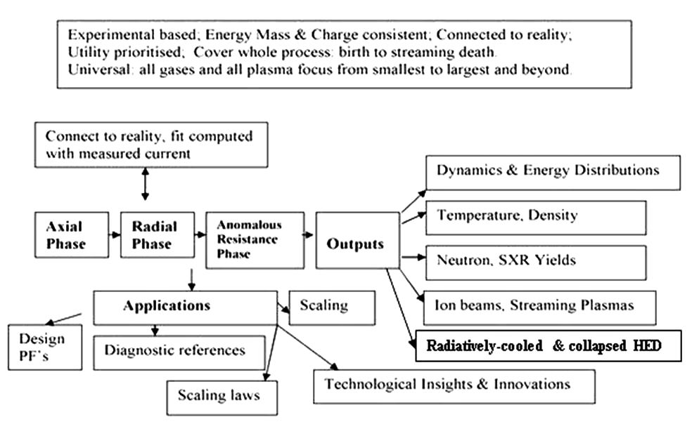
Chart of the code and Results

Slide 7
Benchmarking?
1. International Centre for Dense Magnetised Plasmas: ICDMP website www.icdmp.pl
code: Vargas-Gratton code recent papers by Prof Sunil Auluck: comparatively limited outputs, e.g. no neutron x-ray ion beam, radiation outputs
2. Fully Kinetic simulation by A Schmidt et al: most fundamentally based code: vast computing power required, excellent results for 1 machine. Wrong current waveform.

Slide 8
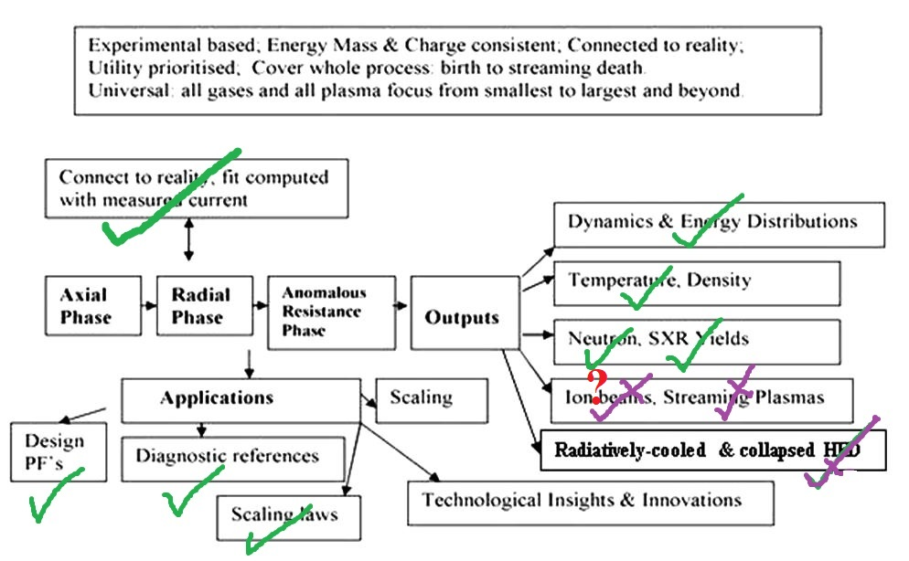
Before these Present Experiments

Slide 9
Agreement between experimental results and code results
Axial and radial speeds
Neutron yields and neutron scaling laws
Ne SXR yields and scaling laws
Radiative collapse
General plasma stream dynamics
Ion beams?- this study

Slide 10
Summary of basic physical picture

Slide 11
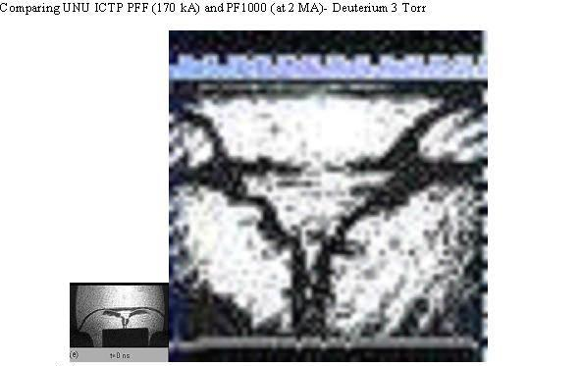
Comparing large and small PF’s- Dimensions and lifetimes- putting shadowgraphs side-by-side, same scale
Anode radius: 1 cm 11.6 cm
Pinch Radius: 1mm 12mm
Pinch length: 8mm 90mm
Lifetime ~10ns order of ~100 ns

Slide 12
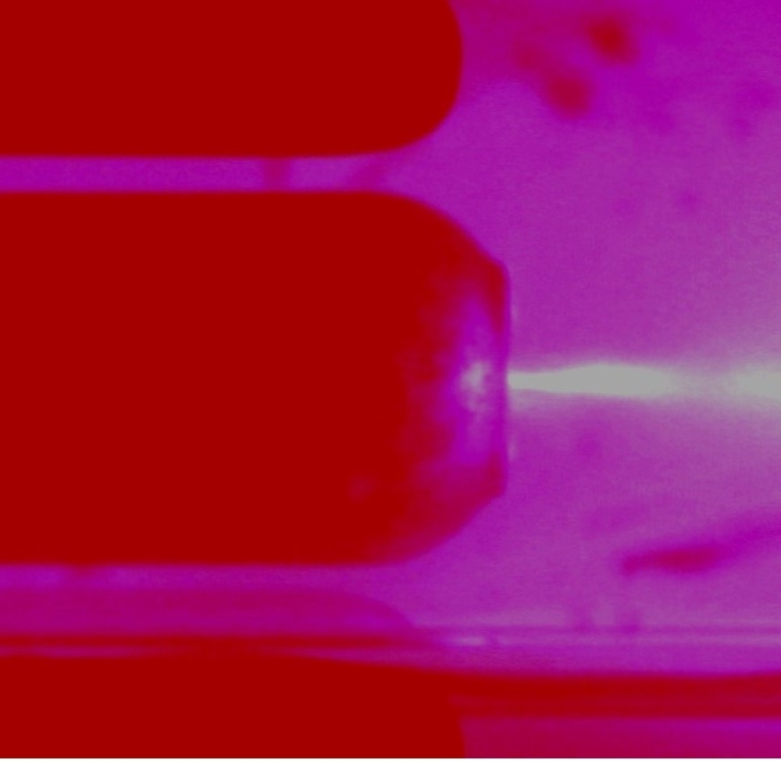
Plasma Focus Pinch with plasma stream
(Paul Lee- INTI PF)

Slide 13
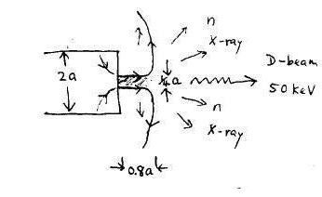
Emissions from the PF Pinch region
Mach500 Plasma stream
Mach20 anode material jet

Slide 14
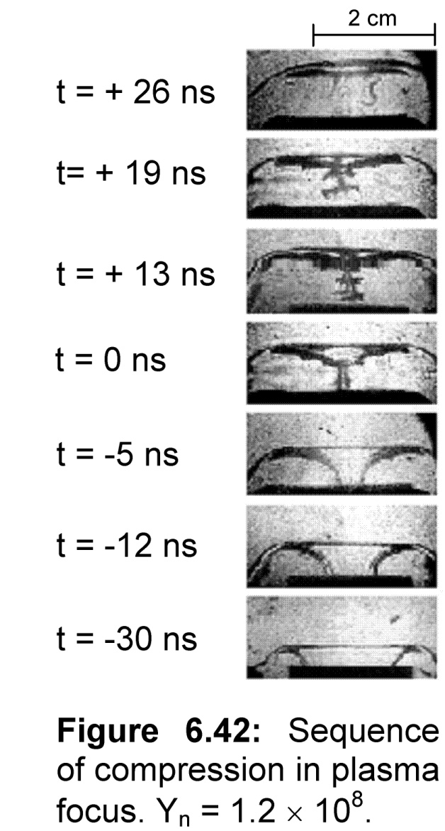
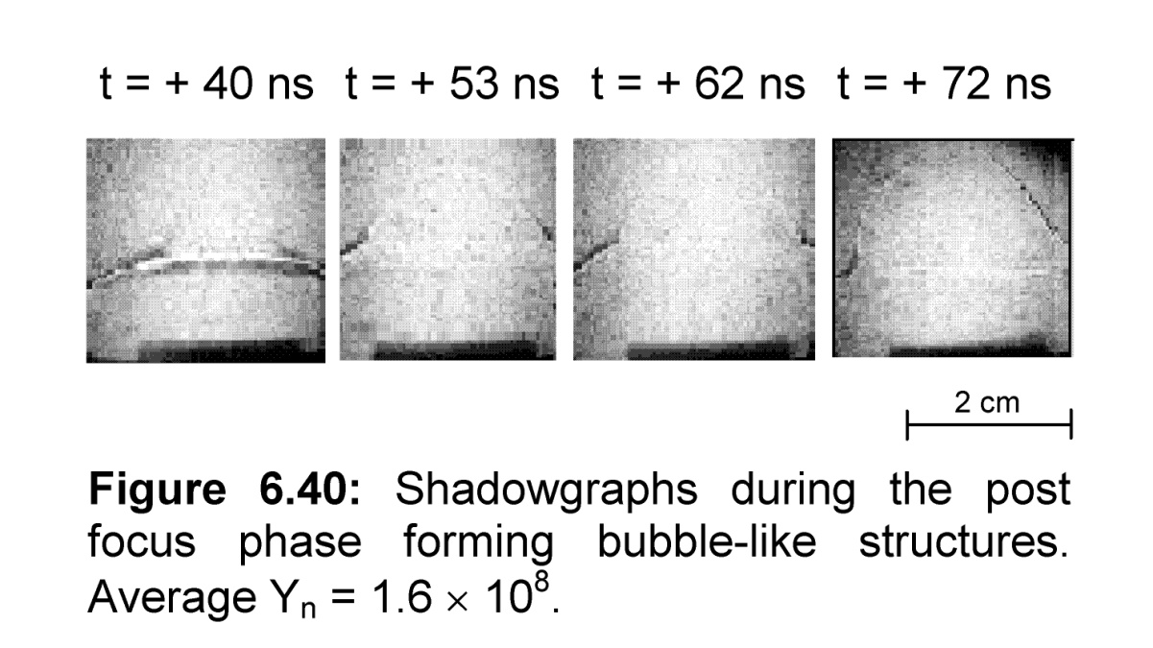
Sequence of shadowgraphs of PF Pinch-
(M Shahid Rafique PhD Thesis NTU/NIE Singapore 2000)
Highest post-pinch axial shock waves speed ~50cm/us M500
Highest pre-pinch radial speed>25cm/us M250

Slide 15
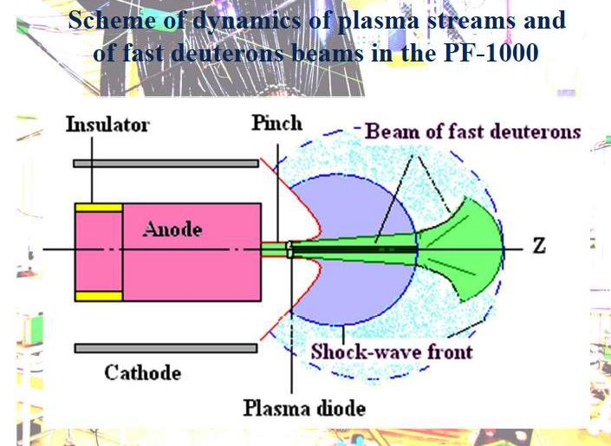
Extracted from V A Gribkov presentation: IAEA Dec 2012-
V N Pimenov 2008 Nukleonika 53: 111-121

Slide 16
Basic Definition of Ion Beam characteristics
Beam number fluence F_{ib} (ions m⁻²)
Flux =fluence x pulse duration
Beam number flux F_{ib}τ (ions m⁻²s⁻¹)

Slide 17
Ion beam flux and fluence equations
Starting point: Ion beam flux J_{b} =n_{b}v_{b} where
n_{b}= number of beam ions N_{b} divided by volume of plasma traversed
v_{b} = effective speed of the beam ions.
All quantities in SI units, except where otherwise stated.
Note that n_{b}v_{b} has units of ions per m⁻² s⁻¹.

Slide 18
We derive n_{b} from pinch inductive energy considerations.
Assumption: A fraction f_{e} of inductive pinch energy converts to KE of beam
The voltage driving the beam is U derived from inductive considerations
Result:
Flux = J_{b} = 2.75x10¹⁵ (f_{e}/[M Z_{eff}]^{1/2}) {(ln[b/r_{p}])/(r_{p}²)}(I_{pinch}²)/U^{1/2} ions m⁻²s⁻¹
Fluence = J_{b}τ ions m⁻²
Details of derivation in:
Plasma Focus Ion Beam Fluence and Flux –for various gases
S Lee and S H Saw Phys. Plasmas 20, 062702 (2013); doi: 10.1063/1.4811650.

Slide 19
Value of f_{e}
The parameter f_{e} is fraction of energy converted into beam energy from the inductive energy of the pinch.
By analyzing neutron yield data^{1,3,4} and pinch dimensional and temporal relationships¹⁵ we estimate a value of f_{e} =0.14.
This is equivalent to ion beam energy of 3%-6% E₀ in the case when the pinch inductive energy holds 20% -40% of E_{0.} This estimate of f_{e} is consistent with data.

Slide 20
the assumptions:
Ion beam flux J_{b} is n_{b}v_{b} with units of ions m⁻² s⁻¹.
Ion beam is produced by diode mechanism (ref).
The beam is produced uniformly across the whole cross-section of the pinch
The beam speed is characterized by an average value v_{b}.
The beam energy is a fraction f_{e} of the pinch inductive energy, taken as 0.14 in the first instance; to be adjusted as numerical experiments indicate.
The beam ion energy is derived from the diode voltage U
The diode voltage U is proportional to the maximum induced voltage V_{max}; with U=3V_{max} (ref) taken from data fitting in extensive earlier numerical experiments.

Slide 21
The Experiment

Slide 22
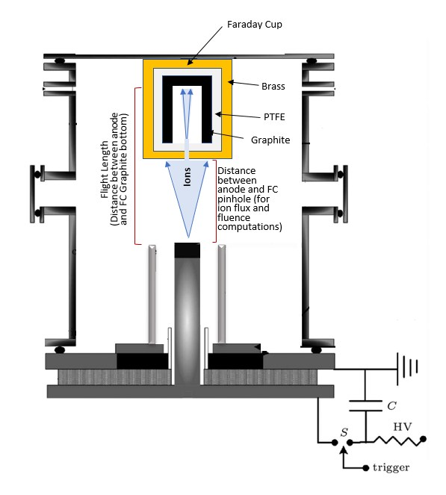
Faraday Cup (FC) mounted to measure INTIPF beam ions

Slide 23
Experimental procedure
Measurements needed for the shot:
peak ion current I_{ion} in A;
ion pulse duration taken as FWHM in ns
Calculations from the FC measurements:
Current density J_{FC}= I_{ion}/(πx10⁻⁸) Am⁻²
FC aperture is 200 micron, radius = 10⁻⁴ m
Ion Flux from FC measurement:
Ion Flux at FC = J_{FC} x 6.24 x 10¹⁸/Z_{eff} ions m⁻²s⁻¹.

Slide 24
Quantities from code
From Code: Required quantities for that shot
Flux at Pinch exit Flux_{PE} and z_{eff}, r_{min} in cm and t_{pinch} in ns; and Z_{eff}.and maximum induced voltage V_{max}.
Ion Beam diverges and disperses as it traverses from pinch exit to position of FC.

Slide 25
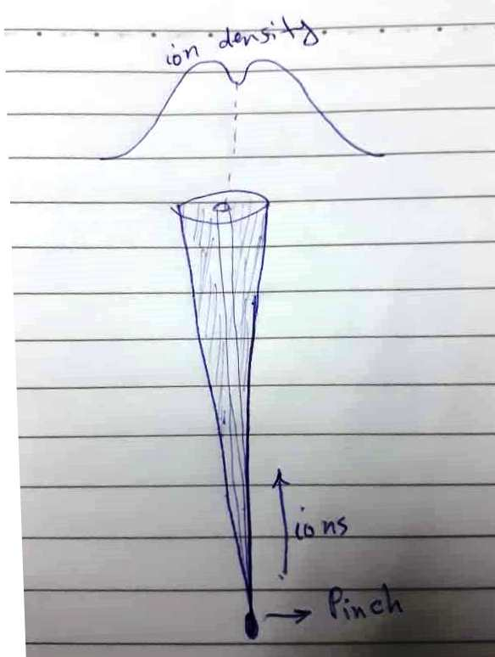
A representation of ion beam divergence and density profile from published data

Slide 26
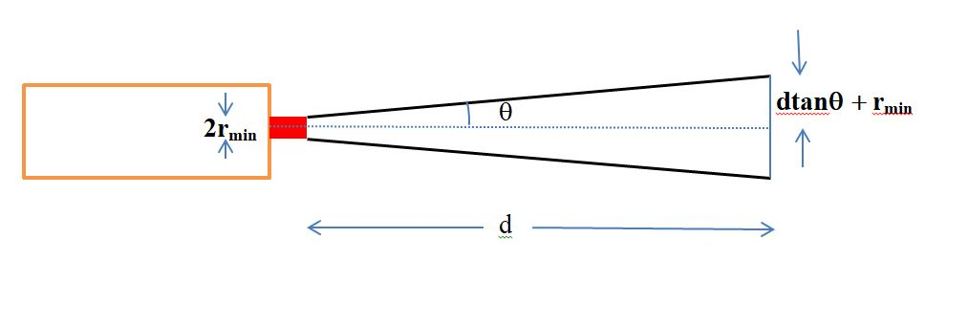
Geometry of ion beam divergence

Slide 27
Convert code results to position of FC:
Flux at pinch exit Flux_{FC} = Flux_{PE} x f_{A} x f_{t} where
beam area ratio f_{A} = [r_{min}/(r_{min} +dtanθ)]² θ is the half angle of beam divergence .
beam dispersion ratio f_{t} = (t_{at pinch} /t_{at FC})
the times are ion beam pulse length estimated at pinch and measured at FC.

Slide 28
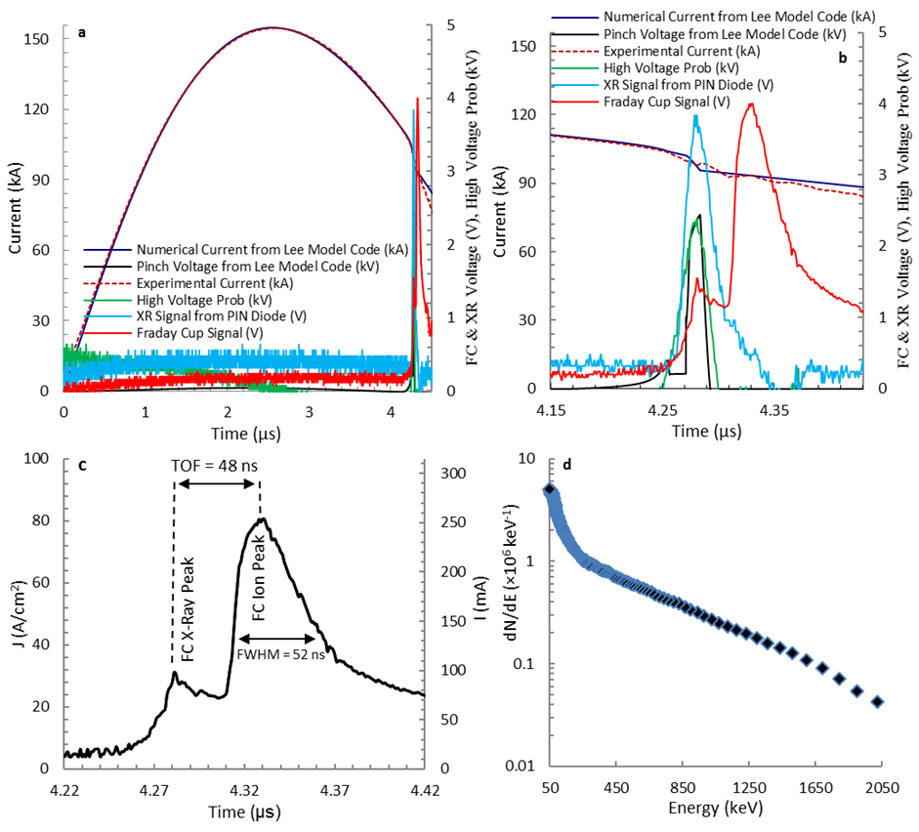
Experimental data sample: current fitted by Lee Code: Current, PIN diode, FC & high voltage probe signals;
3a: Current fitting,
3b: Expanded experimental and numerical signals, INTIPF 12 kV Ar 1 Torr
3c: FC signal,
3d: dN/dE versus ion energy

Slide 29
RESULTS
Beam ion:
Energy
Fluence
Flux

Slide 30
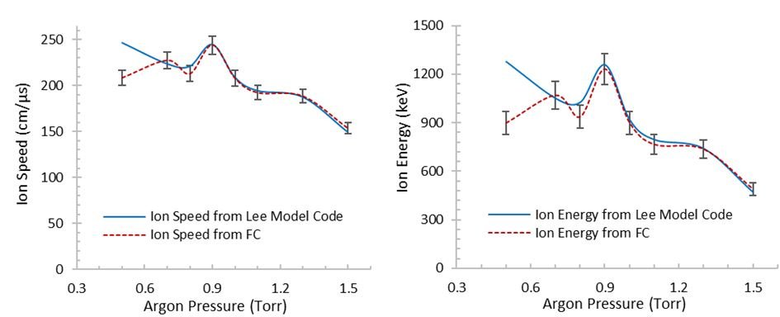
Ar Ion Speed and Energy:
Compare FC ToF Measured values with Code values

Slide 31
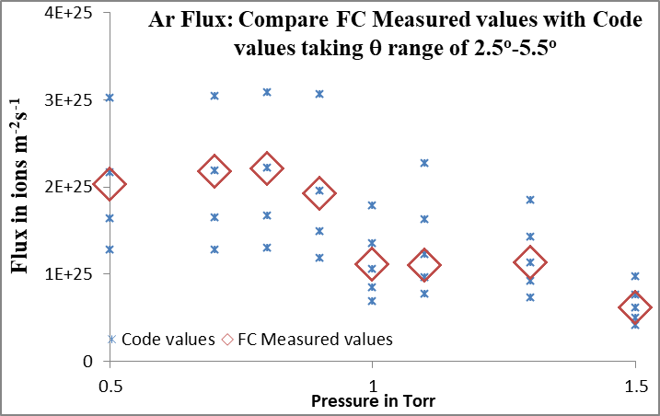
Ar ion flux: Measured values compared with code values, both at FC; using a range of θ of 2.5º- 5.5º

Slide 32
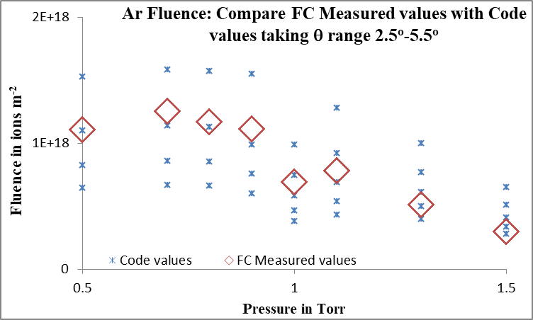
Ar ion fluence: Measured values compared with code values, both at FC; using a range of θ of 2.5º- 5.5º

Slide 33
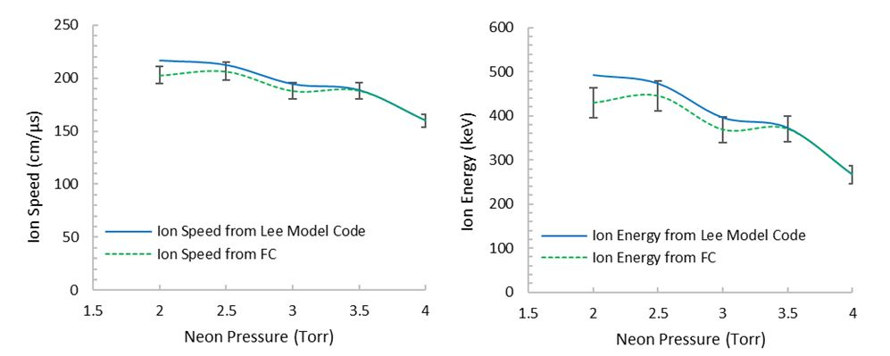
Ne Ion Speed and Energy:
Compare FC ToF Measured values with Code values

Slide 34
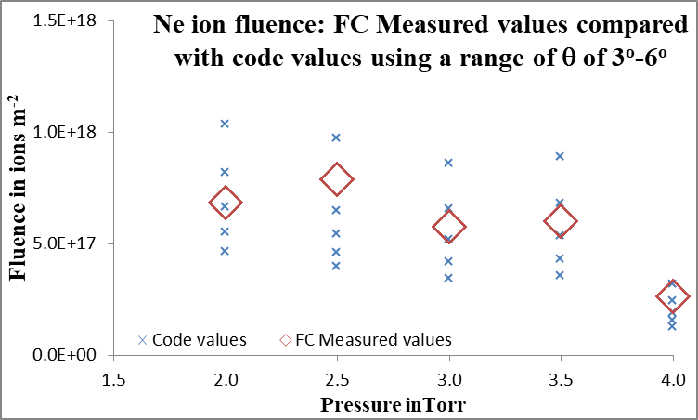
Ne ion fluence: Measured values compared with code values, both at FC; using a range of θ of 3º-6º

Slide 35
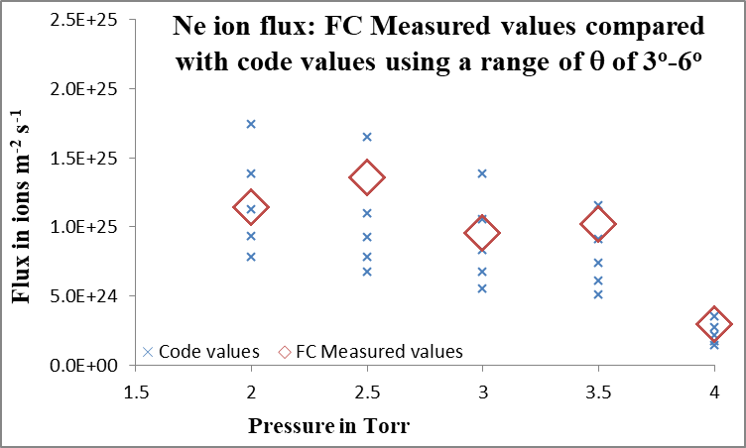
Neon Ion Flux: Compare Measured values with code values, both at FC, using a range of θ of 3º-6º

Slide 36
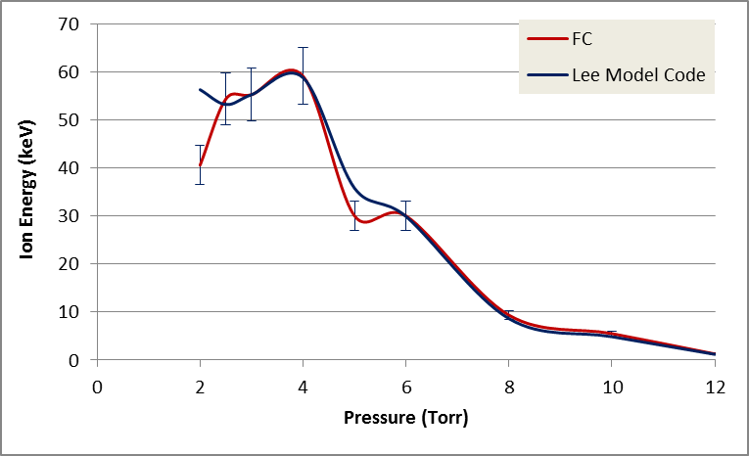
D Ion energy: Compare FC ToF measured values and code values

Slide 37
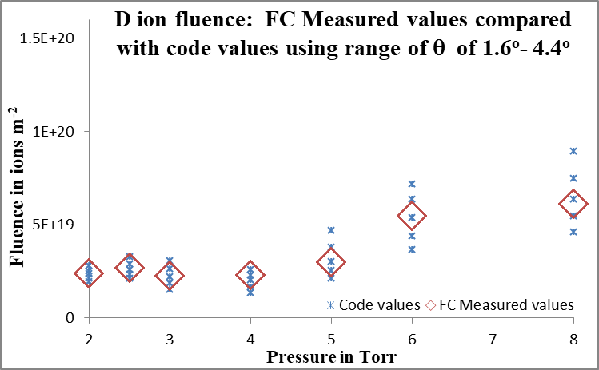
D ion fluence: Measured values compared with code values, both at FC; using a range of θ of 1.6º- 4.4º

Slide 38
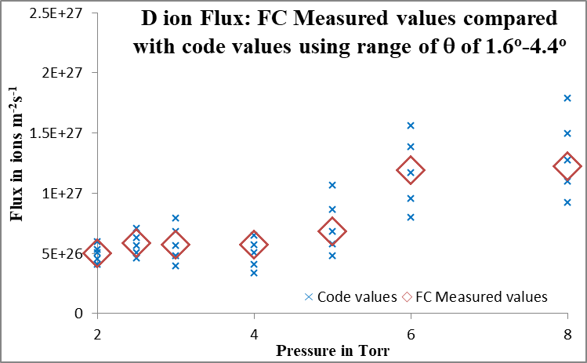
D ion flux: Measured values compared with code values, both at FC; using a range of θ of 1.6º- 4º

Slide 39
Summary for all 3 gases:
For the FC measured results to be comparable with the code results, θ is selected in the range: 1.6 – 6 degree
This range of θ is reasonable when compared to published experimental observations which typically quotes measured θ to be less than 20 degrees.

Slide 40
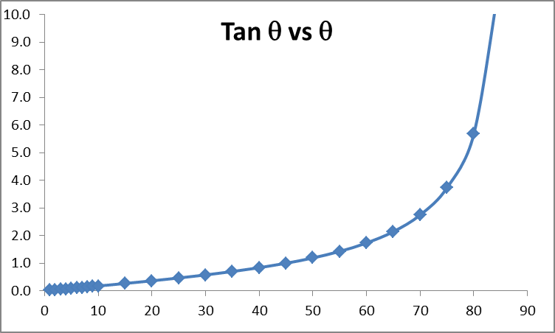
Error Analysis:
Over range 0-20 degrees, tanθ proportional to θ

Slide 41
Error Analysis:
So an angular range of 1.6 to 6 degrees implies a range of factor of 4. Thus the scatter in those graphs of flux and fluence is within factor of 4 from edge to edge of each band.
Moreover the FC measured values falls in each case close to the centre of the band. This implies that the code computed values fall within a factor of much less than 4 (likely agreement is better than factor of 2) when compared to the measured values.
In terms of PF shot-to-shot variability, the INTI PF (which is one of the UNU/ICTP PFF machines) has a shot-to shot variability of the order of 2.
Thus these results may be interpreted as agreement between our code computed fluence and flus and the measured FC values.

Slide 42
Conclusion
The FC ToF measurements agree with the code results for ion speed and energy
The FC measured fluence and flux in various gases D, Ne and Ar agree with the code results
These results validate the Lee code for estimation of gross beam ion properties for various gases.

Slide 43
Before these Present Experiments

Slide 44
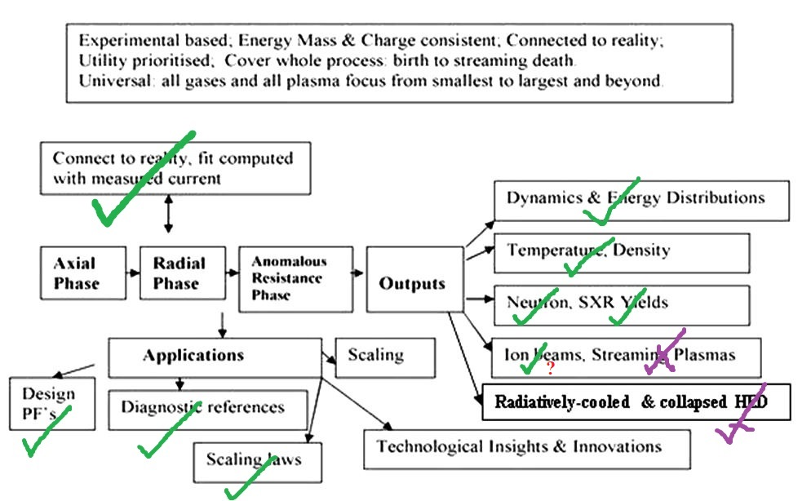
After these Present Experiments

