Slide 1
Early Days of UM Plasma and the Lee Code Today
S H Saw^{1,2} and S Lee^{2,3,4}
¹Nilai University, 71800 Nilai, Malaysia
²Institute for Plasma Focus Studies, Chadstone, VIC3148, Australia
³University of Malaya, Kuala Lumpur, Malaysia
⁴INTI International university, 71800, Malaysia

Slide 2
LaoZi (604-531 BC)
A Journey of a Thousand Miles
Begins with a Single Step
So it was with Plasma UM

Slide 3
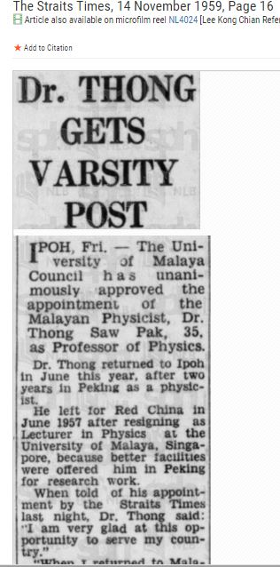
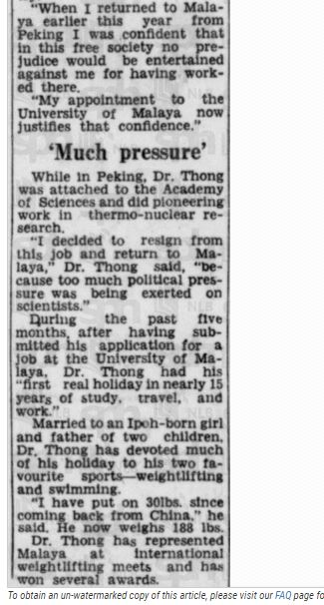
The all-important
First Step of UM Plasma

Slide 4
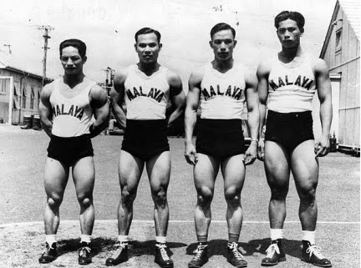
Thong Saw Pak (3rd from left)- with weightlifting team to British Empire Games, Auckland 1950; TSP won silver in lightweight division.
(He also represented Singapore in Helsinki Olympics 1952)

Slide 5
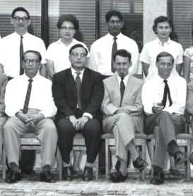
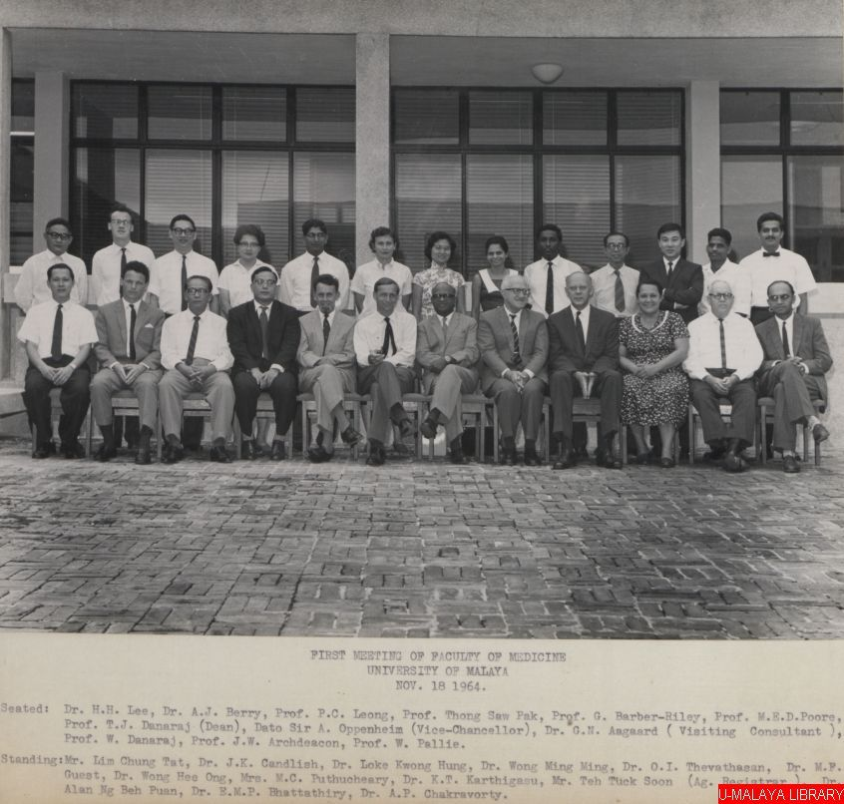
Ref: University of Malaya Archive, "First Meeting of Faculty of Medicine, University of Malaya, November 18, 1964," in UM Memory, Item #5564, http://ummemory.um.edu.my/ummemory/index.php/items/show/5564
(accessed March 20, 2016)- photo provided by O H Chin.
Prof. Thong Saw Pak: Left Image Seated second from left. Left image is extracted from main photo on right.

Slide 6
The remaining photos are taken from the personal collection of S Lee

Slide 7
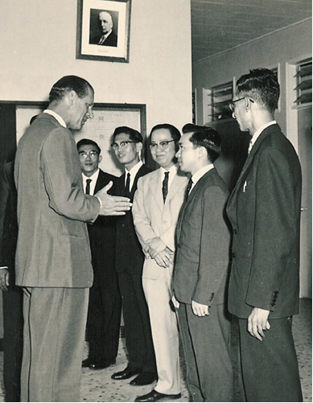
HRH Prince Philip of Great Britain visits UM Physics Department, 1965, in conjunction with gift of large capacitor bank to start Plasma Physics Laboratory under Colombo Plan
(R-L: Dr A Husain, Dr Lee Kuen On, Dr Teh Hock Heng, Lee Sing and Dr Lim Chuan Poh)

Slide 8
1966 First M.Sc. UM Plasma:
S.Lee Some Shock Wave Phenomena in a Ring Electrode System. MSc thesis. UM, Malaysia, 1966- Supervisor: Assoc Prof Dr The Hock Heng

Slide 9
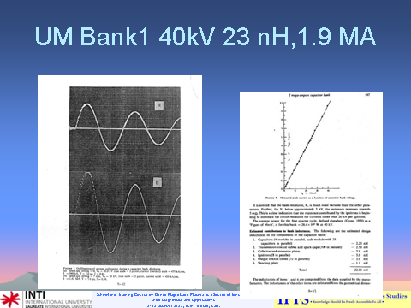
Full test of UM Bank1 recorded 1.92 MA in 1972
S.P. Thong and S. Lee. A simplified method of switching a 2 mega-ampere capacitor bank using a voltage-division technique. Malaysian J. Science, Malaysia (1973), 2(B): 157-169
Technicians: Raju and Ho Tet Soon

Slide 11
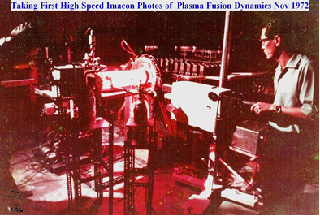
UM PF in Fusioning Self Light

Slide 12
Time of Flight Measurement, D-D neutrons: UM PF- Oct 1973-
S. Lee and Y.H. Chen. Measurements of neutrons from a focussed plasma. Malaysian J. Science, Malaysia (1975), 3(B): 159-163

Slide 13
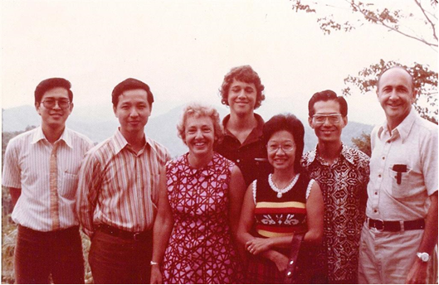
Professor Robert Gross (and Wife and Sons) from Columbia University, with UM Plasma Physics Group on an outing during a visit to Plasma Physics Lab in 1973 (Bob’s other son took this photo)

Slide 14
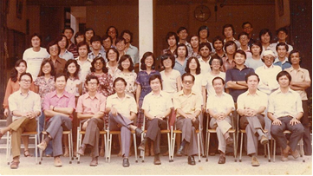
Some Staff and students of Physics Department in 1974

Slide 15
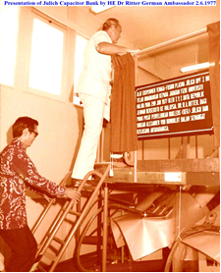
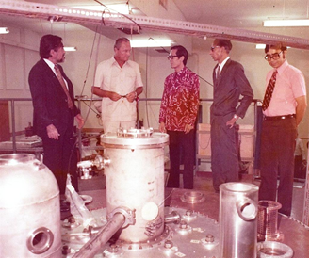
HE Ambassador Dr Ritter of West Germany on the experiments platform of the Juelich I (UM’s second 2 MegaAmp facility) in 1977 on the occasion of Presentation of the million-dollar Juelich PF II to UM as follow-up grant to
Alexander von Humboldt Fellowship of Dr Lee Sing (with VC Royal Prof Ungku A Aziz [left] and Prof Abid Husain Head Physics [second from right])

Slide 16
Coming of Age of Physics in Malaysia: -First Physics PhD Thesis produced by a Malaysian University in 1978.
Chen You Hor. Parametric Study of Focus Optimization. PhD thesis. UM, Malaysia, 1978-
Supervisor: Assoc Prof Lee Sing
**: A university needs to produce its first PhD before it comes of age- Abdus Salam
Followed by plasma PhD theses by:
Wong Chiow San (1983), Tou Teck Yong (1987), Kwek Kwan Hiang (1989), [Low Sew Ming- 1989?] Saw Sor Heoh (1991), Chew Ah Chuan (1991), and a continuing stream till today.

Slide 17
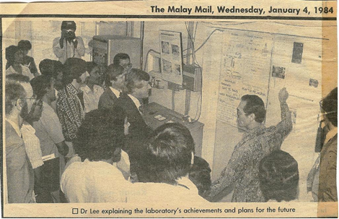
UM Plasma went international in 1984:
Distinguished scientists from India, China, Pakistan, UK, US, Australia Visiting UM Plasma Research Lab during First Tropical College on Applied Physics In 1984

Slide 18
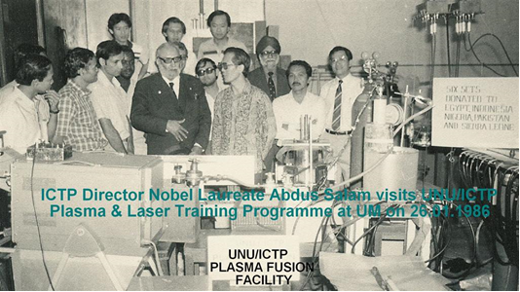
Nobel Laureate Abdus Salam visiting the UNU Training Programme on Plasma and Laser Technology at UM in January 1986
L-r: Widdi, Gholap, Sapru, Smith, Tou, Abdus Salam, K Eissa (almost hidden), Suryadi, Zakaullah, Kwek, Lee,Chatar Singh, Susetyo, Tan

Slide 19
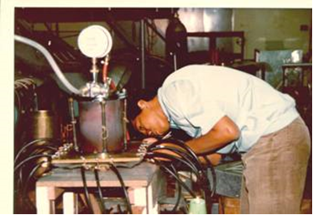
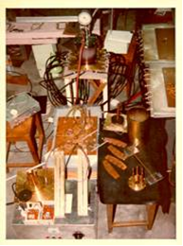
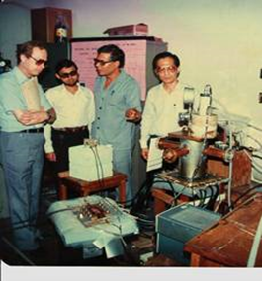
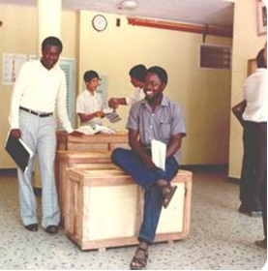
UNU Training Programme on Plasma and Laser Technology in 1985 to 1986
Widdi Usada assembling his UNU/ICTP PFF Parts of several UNU/ICTP PFF’s
Dr Walter Shearer (UNU), Zakaullah, Dr Eissa, Lee Warmate & Dr Smith with 1 set (in crates) of UNU/ICTP PFF-at Foyer Of UM Physics
Fellows

Slide 20
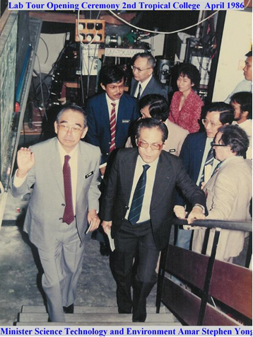
YB Menteri Sains Teknologi dan Alam Sekitar Dato Amar Stephen Yong (front-L) Visiting Plasma Lab on occasion of his Opening of Second Tropical College on Applied Physics, 1986

Slide 21
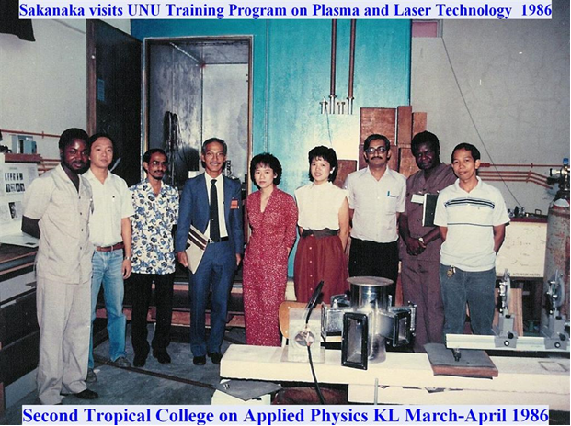
Professor Paolo Sakanaka of Brazil visits UM Plasma Research Lab during Second Tropical College on Applied Physics, 1986
L-r: Smith, Kwek, Jalil, Sakanaka, Saw, Chin. Jasbir, Warmate, Widdi

Slide 22
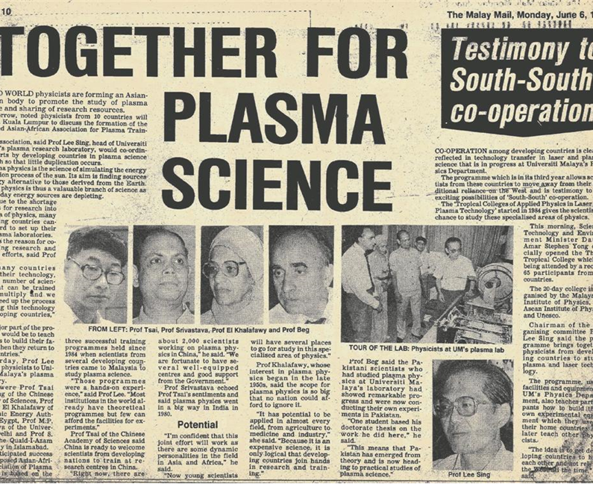
News-UM Provides leadership in South-South scientific collaboration in the formation of the Asian African Association for Plasma Training, 1988- at Third Tropical College on Applied Physics

Slide 23
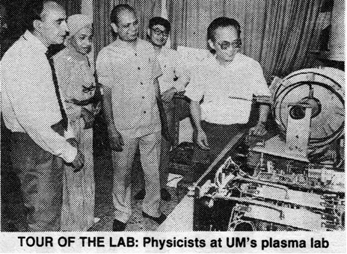
AAAPT Leaders visiting UM Plasma Lab in 1988 - Malay Mail photo

Slide 24
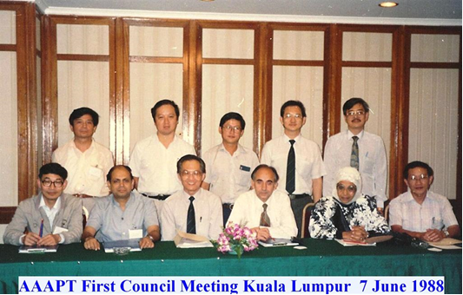
AAAPT Inaugural Council Meeting on 7.6.1988 in Kuala Lumpur.
L-r: Li Yin-an, Chen You Hor, Chaivitya Silawatshananai, Wong Chiow San, Chew Ah Chuan
Tsai Shih Tung, M Srivastava, Lee Sing, Beg (representing G Murtaza,) T El Khalafawy, Moo Siew Pheng

Slide 25
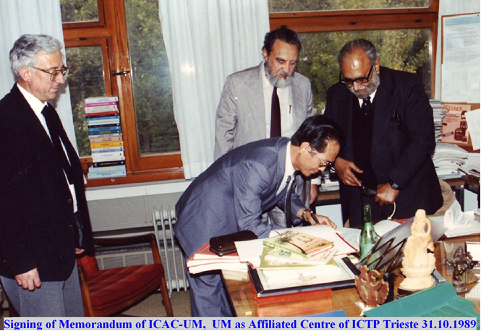
Prof Syed Hussein Alatas (middle), VC UM; Prof Abdus Salam (right) (Nobel Laureate), Director, ICTP Trieste, Italy and Prof Lee Sing Head Physics UM at ICTP Trieste- signing the memorandum, 1989 forming the ICAC-UM (ICTP Affiliated Centre-Universiti Malaya) sited at Physics Department UM (for period 1989-1994). Looking on is Professor Gallieno Denardo, Head, Office of External Activies, ICTP.
(Citation for signing: Physics Department UM provides outstanding leadership in South-South plasma training and research)

Slide 26
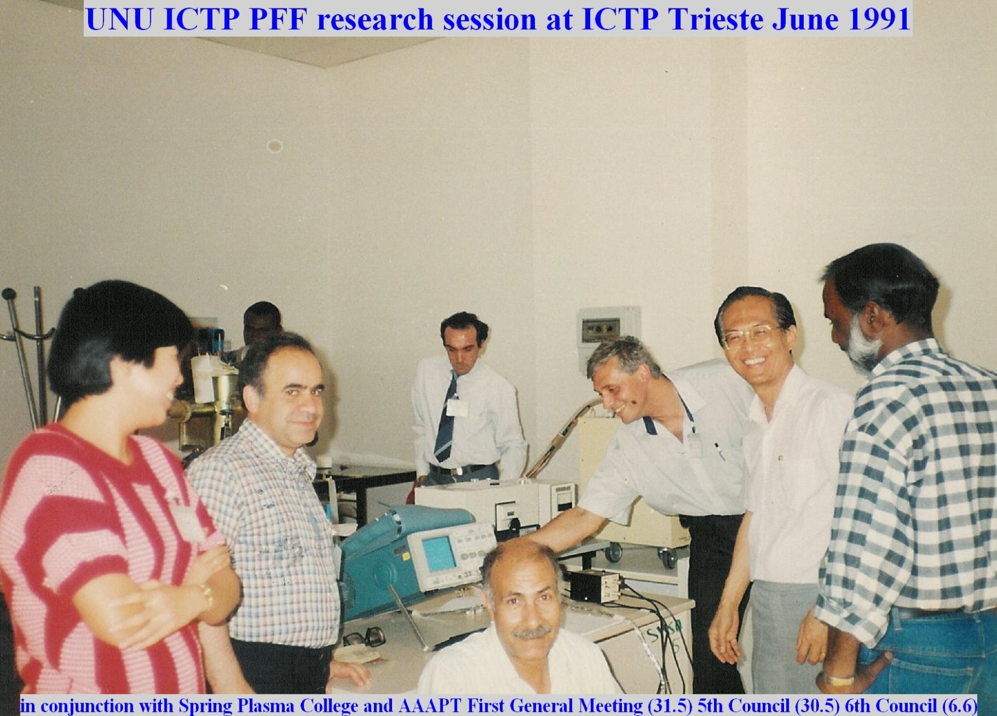
One of first ICAC-UM activities was the placement of UNU ICTP PFF as a ICTP Training Facility in 1991
L-r: Chin,(Malaysia) Sobhanian (Iran) , Warmate (mostly hidden) Moreno (Argentina), Masoud (Egypt) , Serban (Romania), Lee (Malaysia), ?
Jasbir Singh (not in photo) installed the UNU ICTP PFF in ICTP Trieste, and maintained it in operation for initial period

Slide 27
Part 2: The Lee Code Today
UNU/ICTP PFF [7] was developed during the UNU Training Programme in Plasma and Laser Technology in 1985;
Complementing this [7-9] a 2-phase code was developed [10,11] to describe and optimize PF design.
The code [12] couples the electrical circuit with PF dynamics, thermodynamics and radiation.
It is energy-, charge- and mass- consistent.
It was used in the design and interpretation of experiments [7,13,14].
An improved 5-phase code [12] incorporating finite small disturbance speed [15], radiation and radiation-coupled dynamics was used [16-18], and was web-published [19] in 2000.
Plasma self-absorption was included [12,19] in 2007.
It is used extensively as a complementary facility in several machines, for example: UNU/ICTP PFF [7,14,16-18], NX2 [18,20], NX1 [18], DENA [21].
It has been used in other machines for design and interpretation including sub-kJ PF machines [22], FNII [23], the UBA hard x-ray source [24], KSU PF [25] and a cascading plasma focus [26].

Slide 28
Information computed includes
Axial and radial dynamics [7,13,14,16,17,25],
SXR emission characteristics and yield [17-20,27-33] for various applications including as a source for microelectronics lithography [18],
Optimization of machines [7,12,16-20,28] and adaptation in the form of ML (Modified Lee) to Filippov-type plasma focus devices [21].
Plasma focus neutron yield calculations [34,35],
Extraction of diagnostic data [33,42-46] and anomalous resistance data [47-49] from current signals
Computation of reference numbers for deuteron and other ion beam number &energy fluence & flux [50,51].
Applications to production of Short-Lived Radioisotopes , advanced and nano-materials and to damage studies in relation to plasma-facing walls in fusion reactiors.

Slide 29
Insights obtained from numerical experiments using the code include
Scaling properties
Speed-enhancement of yields [16].
Pinch current and yield limitation as static inductance is reduced [36,37]
Radiation & particle yields scaling laws [30,32,34,38,39,50-55].
Deterioration of neutron scaling (neutron saturation) [38,39],
Current-stepped PF [41],
A slow-focus mode (SFM) for optimisation of fast plasma streams for nano-materials fabrication
Radiative cooling and collapse [40] and creation of high energy density HED states of matter
Regimes of operation of PFdevices; e.g radiative and Joule, Joule-dominated, radiation-dominated etc. The study of regimes will lead to optimisation of plasma focus for specific purposes.
The range and scope of this Model code is shown in the following figure.

Slide 30
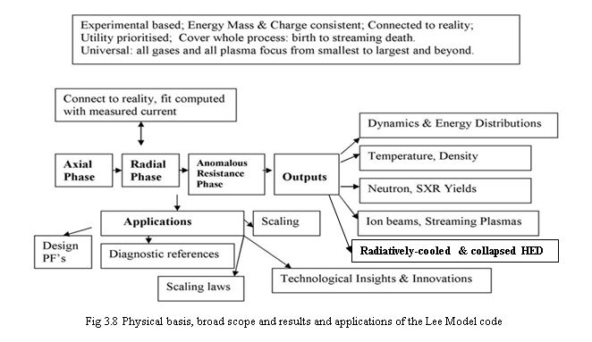
The Lee Code Today

Slide 31
We discuss 3 examples of results from the Lee Code

Slide 32
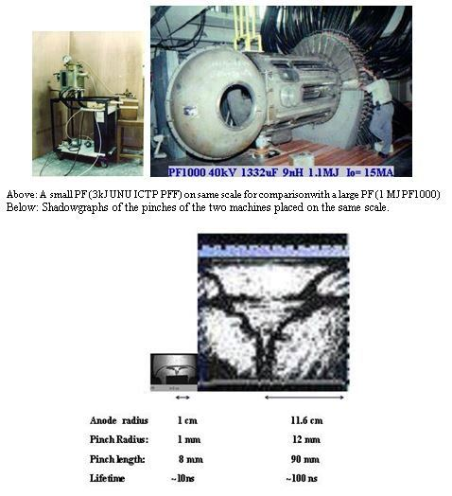
I: Illustrating Scaling Properties- insights obtained from N E using the code and confirmed by laboratory measurements

Slide 33
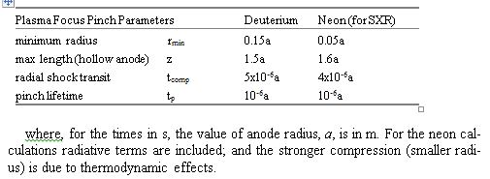
Dimensions and lifetime of PF- code and measurements are in reasonable agreement

Slide 34
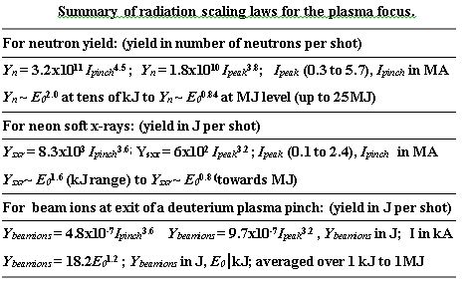
II Scaling Laws deduced from code

Slide 35
III: Measuring the Radiative Compression in the INTI PF – from measured current waveform

Slide 36

The radiation-coupled dynamics for the magnetic piston during pinch phase
where I is the total discharge current in the circuit, f_{c} is the fraction of current flowing into the pinch, z_{f} is the time-varying length of the PF pinch and 𝛾 is the specific heat ratio (SHR) of the plasma. When dQ/dt is negative, energy is lost from the plasma adding a negative component to dr_{p}/dt which tends to reduce the radius r_{p}. dQ/dt = P_{line}+ P_{brem}+ P_{J}; where P_{line} and P_{brem} (power radiated away from plasma, after moderation by plasma self-absorption) are negative and P_{J} is positive (power produced by Joule heating in plasma).

Slide 37
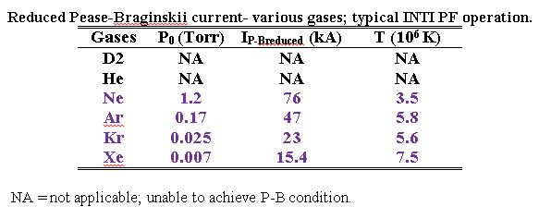
Computing the P-B reduced current in INTI PF

Slide 38
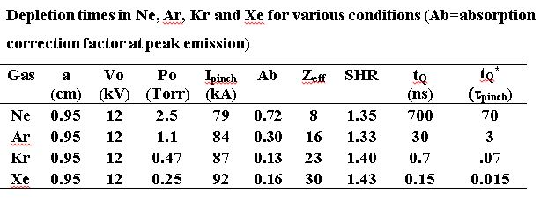
Computing the radiation depletion time of pinch energy to show that INTI PF will exhibit radiative collapse in which gas

Slide 39
Measuring radiative collapse in INTI PF- Shot 631 taken in October 2015- ae kV 0.5 Torr Kr
The computed current trace is fitted to the measured current trace). (Note the two curves have a close fit except after the bottom of the current dip. Fitting is done only up to the bottom of the dip, so any agreement or divergence of the computed and measured traces after the bottom of the dip has no significance.)

Slide 40
On successful fitting the computed results show the corresponding radial trajectory.
Computed radial dynamics on INTI PF at 12 kV, 0.5 Torr Kr.

Slide 41
The trajectory is magnified in the time of maximum compression in the two ns from 99 – 101 ns. The radiation power and the current are also displayed in the same chart.
Magnified view of the peak compression period correlating normalised pinch current, piston radius ratio and P_{line} at peak compression region; horizontal scale is in nanosecond. The current values are normalized by 145 kA, the P_{line} is normalized by 3.7 × 10¹² W and the radius ratio k_{p}=r_{p}/a is multiplied by 20.

Slide 42
High Energy State achieved in INTI PF
The pinch compresses to a radius of 0.0013 cm corresponding to a radius ratio (pinch radius normalized to anode radius) of 0.0014.
The radiative collapse is ended when plasma self-absorption⁵⁹ attenuates the intense line radiation.
The rebound of the pinch radius is evident in the figure.
The line radiation leaving the plasma is correlated to the trajectory and shows the effect of the radiation on the compression.
This intense compression reaches 3.7 × 10²⁶ ions m⁻³, -15 times atmospheric density (starting from less than 1/1000 of atmospheric pressure).
The energy pumped into the pinch is 250 J whilst 41 J are radiated away in several ns, most of the radiation occurring in a tremendous burst of 50 ps at peak compression with a peak radiation power of almost 4 x10¹² W.
The energy density at peak compression is 4 x 10¹³ J m⁻³ or 40 kJ mm⁻³.
Thus even in this small plasma focus intense HED is achieved with immense radiation power.

Slide 43
Conclusion
We looked at early days of UM Plasma- from its founding by Prof Thong Saw Pak, through its coming of age with first Physics PhD in Malaysia, achieving international status and recognition by ICTP as ICAC-UM.
We looked at the Lee code, initiated as part of the 3 kJ UNU ICTP PFF (one of UM Plasma’s major science transfer packages) in the 80’s and achieving international standing in its own right today as a major PF facility.

Slide 44
Congratulations
We congratulate all members of UM Plasma for participation and success from 1959 to 2016- an eventful journey of 57 years!
We wish UM Plasma strong enterprise to build on the strength of the past for greater success into the future.

Slide 45
References
[7] S Lee, T Y Tou, S P Moo, M A Eissa, A V Gholap, K H Kwek, S Mulyodrono, A J Smith, Suryadi, W Usada, M Zakaullah. Amer J Phys 56, 62 (1988)
[8] S Lee Twelve Years of UNU/ICTP PFF—A Review IC, 98 (231) Abdus Salam ICTP, Miramare, Trieste; ICTP OAA: http://eprints.ictp.it/31/ (1998)
[9] Sing Lee & Chiow San Wong “Initiating and Strengthening Plasma Research in Developing Countries; Physics Today (USA), pg 31-36; May 2006
[10] S Lee in Radiation in Plasmas Vol II, Ed B McNamara, Procs of Spring College in Plasma Physics (1983) ICTP, Trieste, p. 978-987, ISBN 9971-966-37-9, Published : World Scientific Pub Co, Singapore (1984)
[11] S. Lee, B.C. Tan, C.S. Wong and A.C. Chew (Eds). Laser and Plasma Technology. Procs. of First Tropical College on Applied Physics 26th Dec 1983 - 14th Jan 1984, World Scientific Publishing Co., Kuala Lumpur (1985), ISBN 9971-978-27-X, p 38-62].
[12] S Lee, Radiative Dense Plasma Focus Computation Package: RADPF. http://www.plasmafocus.net; http://www.intimal.edu.my/school/fas/UFLF/(archival websites) (2014)
[13] T.Y.Tou, S.Lee & K.H.Kwek. IEEE Trans Plasma Sci 17, 311-315 (1989)
[14] SP Moo, CK Chakrabarty, S Lee - IEEE Trans Plasma Sci 19, 515-519 (1991)
[15] D E Potter 1978. Nuclear Fusion 18, 813-823
[16] A Serban and S Lee, Plasma Sources Sci and Tehnology 6, 78 (1997)

Slide 46
[17] M H Liu, X P Feng, SV Springham & S Lee, IEEE Trans Plasma Sci. 26, 135 (1998)
[18] S Lee, P.Lee, G.Zhang, X.Feng, V.A.Gribkov, M.Liu, A.Serban & T.Wong. IEEE Trans Plasma Sci, 26, 1119 (1998)
[19] S.Lee in http://ckplee.home.nie.edu.sg/plasmaphysics/ (archival website) (2013)
[20] D.Wong, P.Lee, T.Zhang, A.Patran, T.L.Tan, R.S.Rawat & S.Lee. Plasma Sources, Sci & Tech 16, 116 (2007)
[21] V. Siahpoush, M.A.Tafreshi, S. Sobhanian, & S. Khorram. Plasma Phys & Controlled Fusion 47, 1065 (2005)
[22] L. Soto, P. Silva, J. Moreno, G. Silvester, M. Zambra, C. Pavez, L. Altamirano, H. Bruzzone, M. Barbaglia, Y. Sidelnikov & W. Kies. Brazilian J Phys 34, 1814 (2004)
[23] H.Acuna, F.Castillo, J.Herrera & A.Postal. Int Conf on Plasma Sci, 3-5 June 1996, Conf record Pg127
[24] C.Moreno, V.Raspa, L.Sigaut & R.Vieytes, Applied Phys Letters 89(2006)
[25] A E. Abdou, M I. Ismail, Amgad E. Mohamed, S. Lee, S H Saw, R Verma. IEEE Trans on Plasma Sci, Volume: 40 , Issue: 10 Page(s): 2741- 2744 (2012) DOI: 10.1109/TPS.2012.2209682
[26] S. Lee. A sequential Plasma Focus. IEEE Trans. Plasma Science. USA (1991) 19: 912-919.
[27] S. H. Saw, M. Akel, P. C. K. Lee, S. T. Ong, S. N. Mohamad, F. D. Ismail, N. D. Nawi, K. Devi, R. M. Sabri, A H Bajian, J Ali, S Lee. J Fusion Energ (2012) 31:411–417. DOI 10.1007/s10894-011-9487-z
[28] S H Saw, P C K Lee, R S Rawat, S Lee, IEEE Trans Plasma Sci, 37, 1276-1282 (2009)
[29] S. Lee, R S Rawat, P Lee and S H Saw, J. Appl. Phys. 106, 023309 (2009)

Slide 47
[30] S. H. Saw and S. Lee, Energy and Power Engineering, 2 (1), 65-72 (2010)
[31] M. Akel, Sh Al-Hawat, S H Saw and S Lee, J Fusion Energy, 29, 3, 223-231 (2010)
[32] M Akel, S Lee, S H Saw, IEEE Trans Plasma Sci, 40, 3290-97 (2012)
[33] S Lee, S H Saw, R S Rawat, P Lee, A.Talebitaher, A E Abdou, P L Chong, F Roy, A Singh, D Wong and K Devi, IEEE Trans Plasma Sci 39, 3196-3202 (2011)
[34] S Lee and S H Saw, J Fusion Energy, 27, 292-295 (2008)
[35] S.Lee, S.H.Saw, L..Soto, S V Springham, S P Moo, Plasma Phys and Control. Fusion, 51 075006 (11pp) (2009)
[36] S. Lee and S H Saw, Appl. Phys. Lett., 92, 021503 (2008)
[37] S Lee, P Lee, S H Saw and R S Rawat, Plasma Phys. Control. Fusion 50 065012 2008
[38] S Lee. Plasma Physics Controlled Fusion 50 10500 (2008)
[39] S Lee. Appl. Phys. Lett. 95 151503 (2009)
[40] S Lee, S. H. Saw and Jalil Ali, J Fusion Energy 32: 42–49 DOI 10.1007/s10894-012-9522-8 (2013)
[41] S Lee and S H Saw, J Fusion Energy 31, 603-610 (2012) DOI: 10.1007/s10894-012-9506-8

Slide 48
[42] S Lee, S H Saw, P C K Lee, R S Rawat and H Schmidt, Appl Phys Lett 92, 111501 (2008)
[43] S H Saw, S Lee, F Roy, PL Chong, V Vengadeswaran, ASM Sidik, YW Leong & ASingh, Rev Sci Instruments, 81, 053505 (2010)
[44] S Lee, S H Saw, R S Rawat, P Lee, R Verma, A.Talebitaher, S M Hassan, A E Abdou, Mohamed Ismail, Amgad Mohamed, H Torreblanca, Sh Al Hawat, M Akel, P L Chong, F Roy, A Singh, D Wong and K K Devi, J Fusion Energy 31,198–204 (2012)
[45] S Lee, S H Saw, P C K Lee, R S Rawat, K Devi. J Fusion Energ (2013) 32:50–55 DOI 10.1007/s10894-012-9521-9
[46] SXR measurements in INTI PF operated in neon to identify typical (Normal N) Profile for shots with good yield- S H Saw, R S Rawat, P Lee, Alireza Talebitaher, Ali E. Abdou, P L Chong, F. Roy Jr, Jalil Ali, S Lee; IEEE Trans Plasma Sci 41 (11) 3166-3172 (2013) ISSN :0093-3813 ; online 26 September 2013 10.1109/TPS.2013.2281333
[47] S Lee, S H Saw, A E Abdou and H Torreblanca, J Fusion Energy 30, 277-282 (2011)
[48] R A Behbahani, F M Aghamir, J Appl Phys 111 (4), 043304-5 (2012)
[49] R A Behbahani, F M Aghamir, Phys. Plasmas 18, 103302 (2011); http://dx.doi.org/10.1063/1.3647958
[50] S Lee and S H Saw, Phys. Plasmas 19, 12703(2012); http://dx.doi.org/10.1063/1.4766744
[51] S Lee and S H Saw Phys. Plasmas 20, 062702 (2013); doi: 10.1063/1.4811650.

