Slide 1
Exceeding 10¹² D-D neutrons/shot from 1 MJ Dense Plasma Focus FAETON-X
Sing Lee*, Vahid Damideh*, JC Btaiche, Isaac Hassen, Sophie Faliero
Fuse Energy Technologies Corp., San Leandro, CA, USA
Fuse Energy Technologies Inc., Napierville, QC, Canada
*E-mail: leesing111@yahoo.com
To be presented at ISVSP/ICPSA, Batangas City, Philippines, September 16-18, 2026

Slide 2
The 50-Year Problem - Myth of Saturation
Notable large and MA-class Dense Plasma Focus DPF:
SPEED 2, Poseidon, the Frascati 1 MJ, DPF 6.5, PF-1000, Gemini , Sodium (ZEUS) and Verus DPF.
Published: D-D neutron yields 1.2E11 - 4.8E11 n/pulse; MA/MJ 2.35 to 3.25.
1974: LANL DPF6.5, 0.72 MJ, 2.2 MA = 1.2E12 DD (claimed)
2024: MJOLNIR, LLNL, 1.3 MJ, 3.8 MA = 1.2E12 DD (published)
50 YEARS to equal the record -> belief of SATURATION
Result: Cancellation of large focus projects (USSR, Europe, USA)
2009 Lee: APL 95 151503 - Misnomer, not saturation, but arithmetics of diminishing returns- total impedances tending to load impedance as capacitances become increasingly larger, exceeding hundreds of mF.
Cure: Increase operational voltage -> Faeton X design principle
FX also has the highest current energy efficiency of 4.5 MA/MJ

Slide 3
Operating under time matched conditions: Lee code yields the following scaling
The neutron yield of a DPF scales Yn = 1.8 × 10¹⁰ I_{peak}^{3.8} I_{peak} is in MA.
.

Slide 4
- Indications that FX will Recover Scaling
Faeton X - Highest current efficiency MA PF’s: 4.5 MA /MJ
Three enabling conditions:(a) High voltage: 65 kV operation(b) Fast synchronized multi-module triggering(c) Reduced inductance
Diagnostics: photodiodes, PCDs, B-dots, nToF, In-foil, bubble detectors
Key indicator: Dynamically-induced voltage pulse peaks >400 ns BEFORE pinch - sharpens with conditioning
Integrated analysis of diagnostics with Lee Code

Slide 5
- New Record: 1.8E12/Shot
14 Aug 2026 - : 65 kV, 1 MJ, 4.5 MA -> 1.8 x 10^12 DD neutrons (Bubble detectors confirmed by integrated analysis)
EXCEEDS PF DD RECORD 1.2E12 set 52 years ago
Consistency:
Series of 10 shots: avg 1.02E12 - surpasses design goal 5E11
Effective current fraction fc is only 0.52, should progress towards typical value of 0.7; then will optimize yield at higher pressure to reach scaled yield of 5E12.

Slide 6
FX: Fig. 1 (a) view showing diagnostic layout: (1) photodiode array, (2) photodiode 1, (3) PCD 1, (4) PCD 2, and (5) B-Dot probes; and (b) cross-sectional view of the D-T

Slide 7
Fuse FX: Design & operational characteristics
Anode radius 15 cm
Cathode radius 21 cm
Cathode length 61.5 cm
Effective anode length 41.2 cm
Insulator sleeve length 9 cm
Insulator sleeve thickness 1.5 cm
System capacitance 500 μF
Capacitor bank energy 1 MJ
Operating voltage 65 kV
Static inductance ∼55 nH
Operating gas D2, D2+Kr, D2+T2
Operating gas pressure 1-20 Torr
Peak current 5 MA

Slide 8
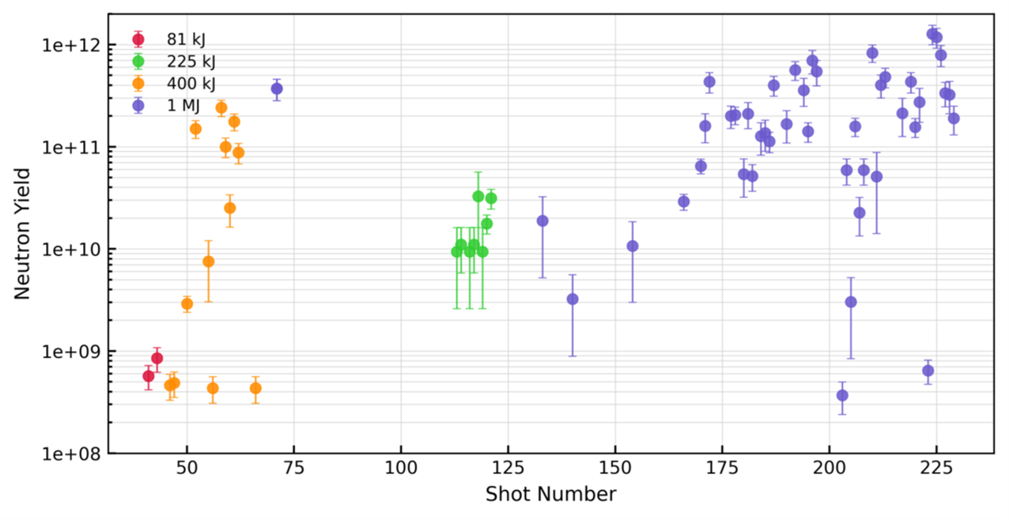
Measured Neutrons per shot (to be updated)

Slide 9
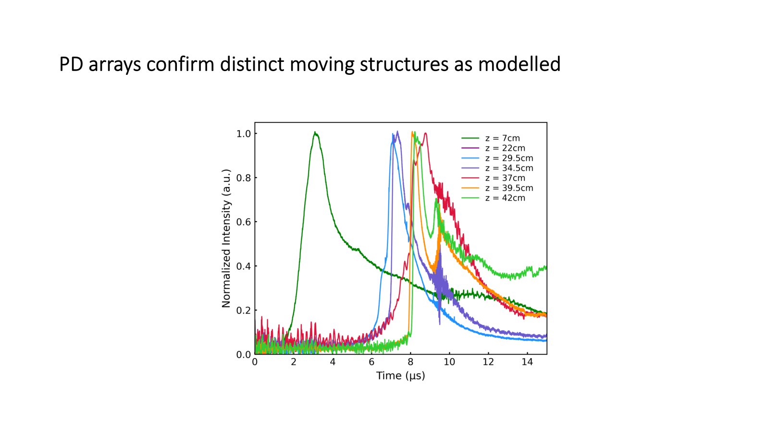
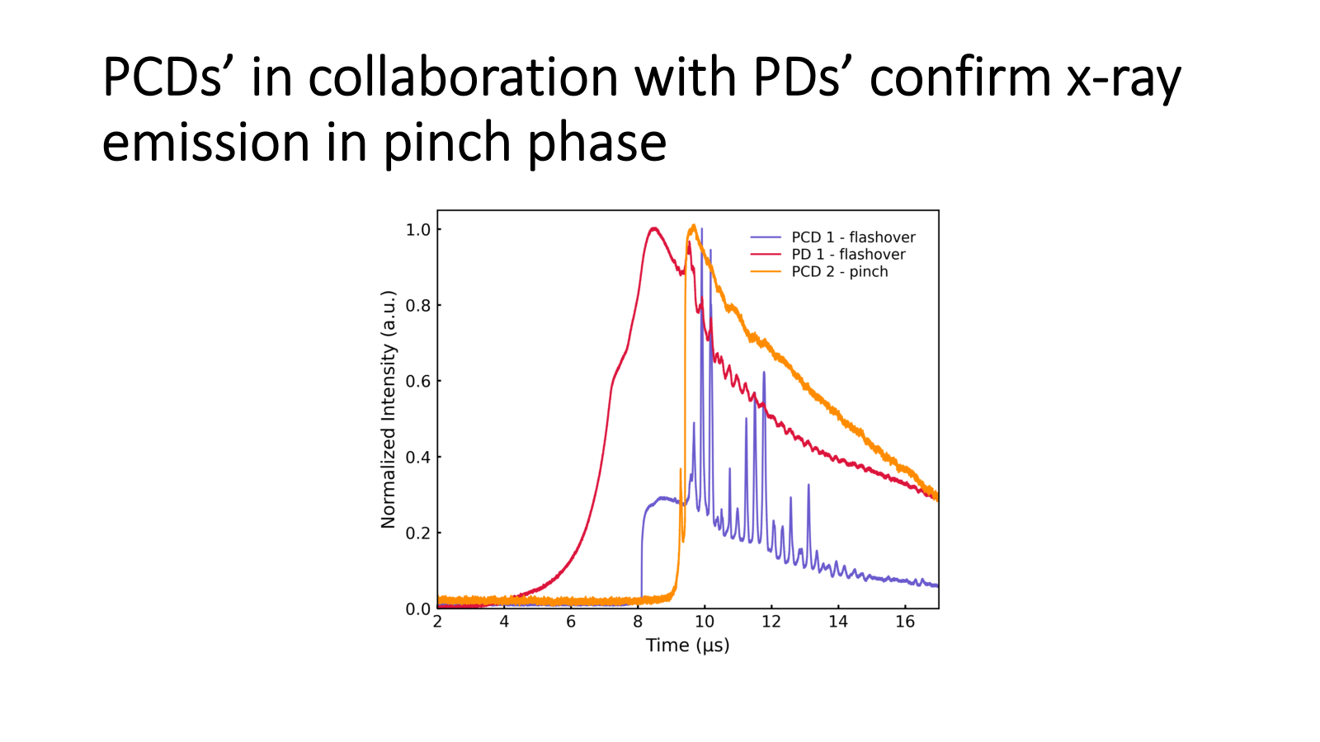
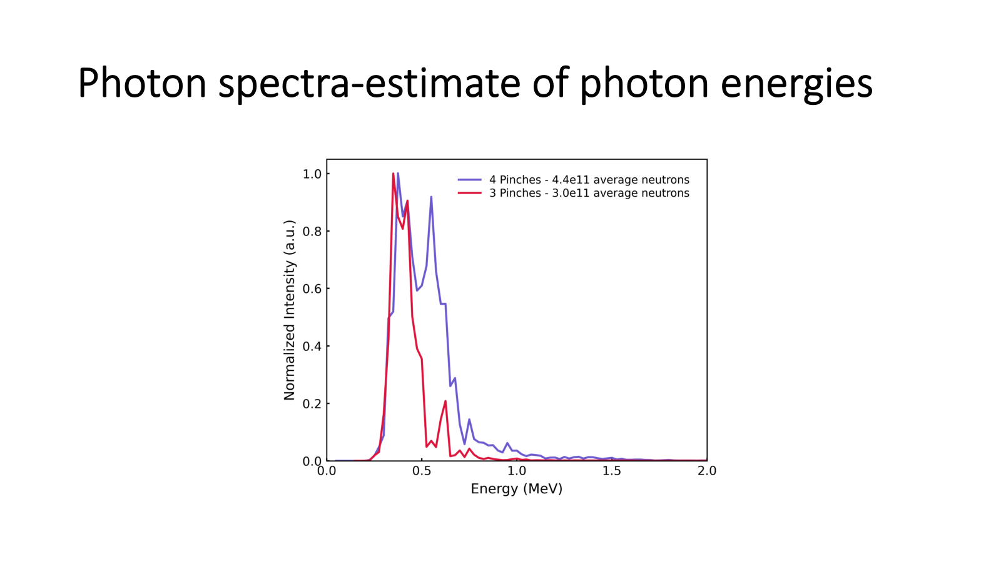
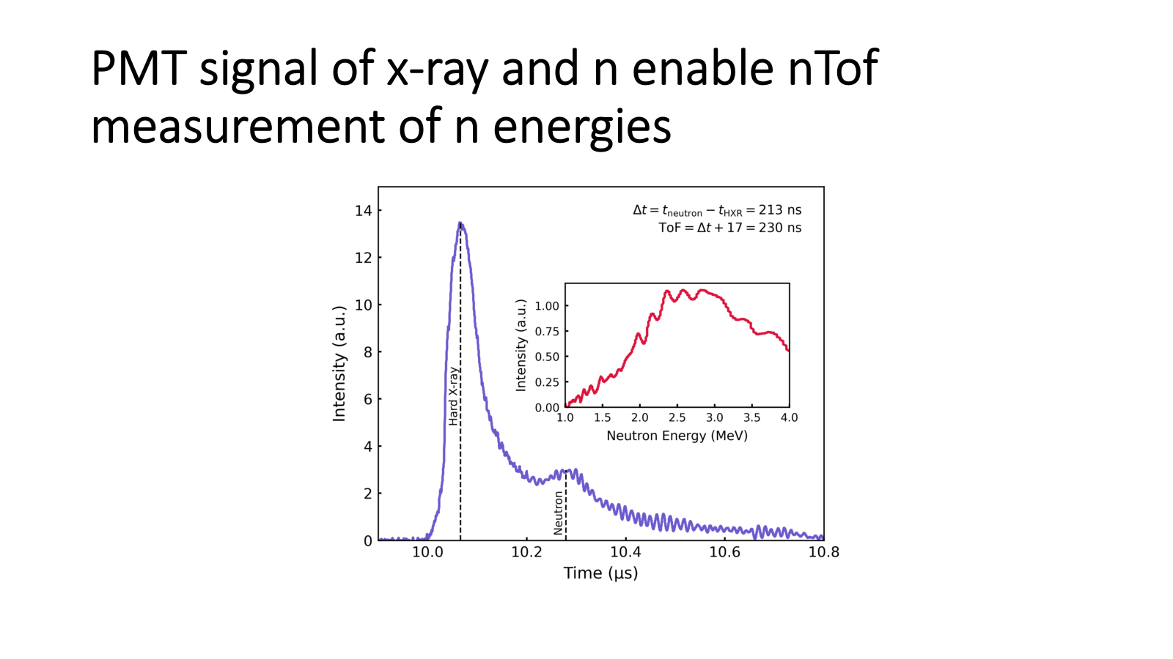
Various Diagnostics

Slide 10
Lee Code Validation - Shot #245; 1.8E12 measured, verified by integrated analysis
Lee Code configured to FX geometry & bank, fitted to measured current; check against measured voltage (excellent agreement), computed axial & radial dynamics
Fit parameters: current fraction fc = 0.52, mass swept fm=0.15, Results: Yn = 1.7E12 vs 1.8E12 measured - beam-target origin

Slide 11
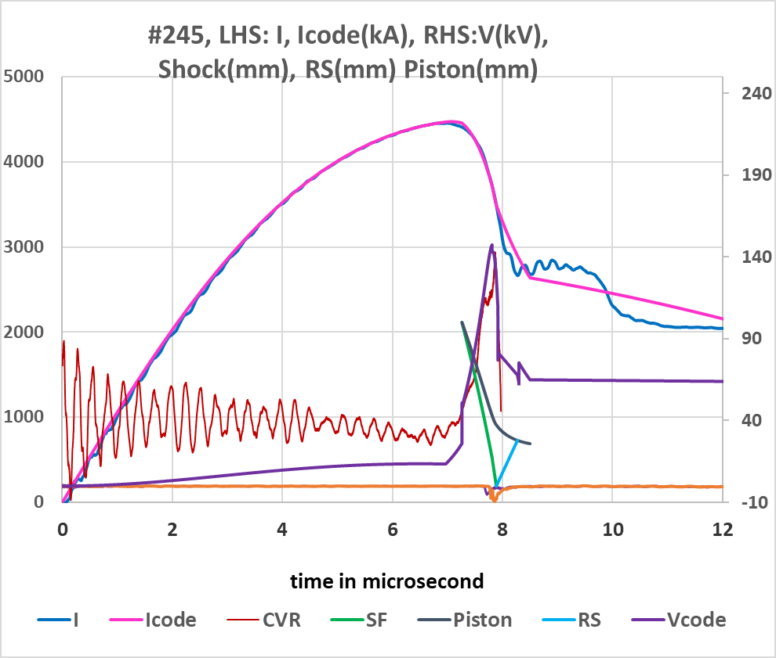
Integrated analysis: correlation of code with diagnostics enable to identify & optimise mechanism for fast ion beam production

Slide 12
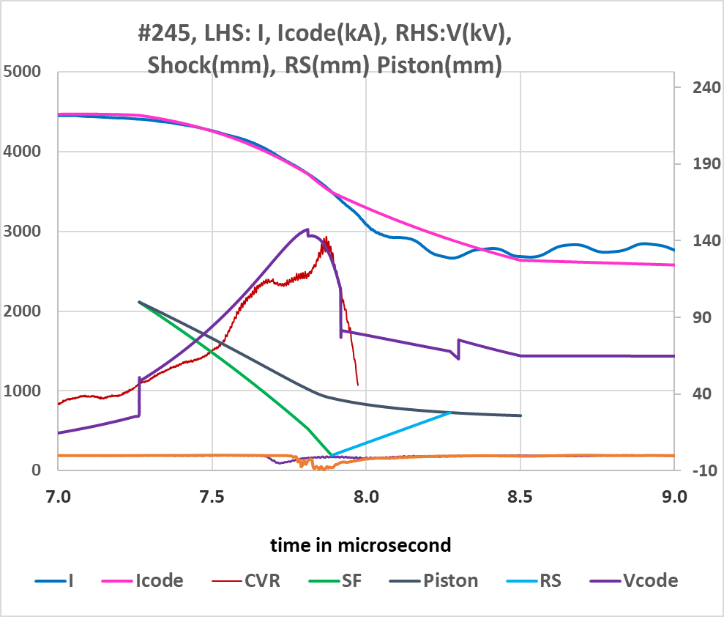
Examine the Details of the radial phase

Slide 13
Road to 5E12 DD
Present fc = 0.52
As series progresses expect effective current fraction to improve towards 0.7 of typical well-conditioned DPF; can operate at higher pressure
Projection: Yn = 5E12 DD (properly scaled yield).
This will CLEARLY dispel myth of saturation, confirm non-saturation of scaling

Slide 14
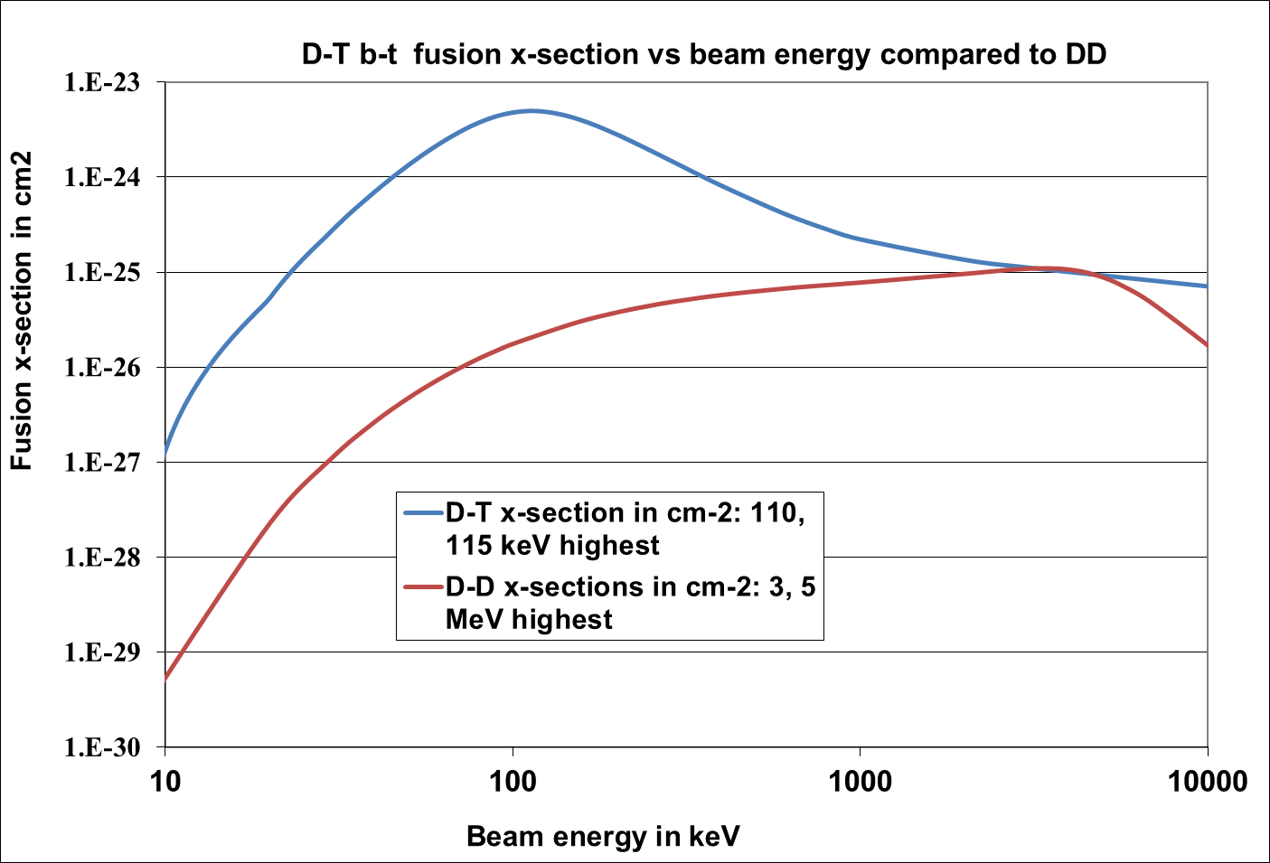
FX Engineered for DT Peak reactivity
DD: dynamic voltage spike driving D+ ~150 kV at 10 Torr
DT: would scale to 115 kV at ~15Torr
Hit peak of D-T cross-section
Gain of more than 100x
Fine tuning pressure and charging voltage, expect go beyond 5xE14 D-T neutrons

Slide 15
Faeton X projection
FX: present: consistent E12/shot; best 1.8E12
Expect progression to best 5E12 DD.
Switch to D-T, tune pressure, operational voltage to hit dynamically induced peak voltage of 115 kV to reach > 5E14 neutrons/shot.
From SAME 1 MJ Faeton X - no new machine, just switch gas to D-T 50:50. >5E14 from 1 MJ DPF redefines compact fusion neutron source
Applications: fusion research and radiation-effects, laboratory-scale evaluation of electronics, materials, and components against displacement damage, single-event effects, and dose-rate phenomena that would otherwise require reactor irradiation or underground nuclear testing; positioning the FX platform as a compact, controllable fast-neutron source for survivability qualification and radiation-hardness assurance..

Slide 16
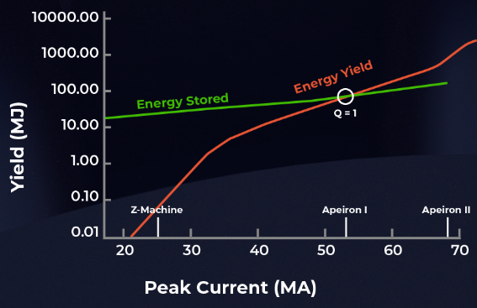
Yield Progression (DPF) extended by FX …& a glimpse beyond of FUSE
LANL 1974 1.2E12
MJOLNIR 2024 1.2E12
FX DD Aug 2026 1.8E12
FX DD projected 5E12
FX DT projected E15
A glimpse of FUSE (development of MAGLIF systems):
www.f.energy: MAGLIF systems, Z-Star, Apeiron: E18-E21
Vacuum 216 (2023) 112471; S Lee, V Damideh, JC Btaiche
“MagLIF: Dynamics and energetics of liner and fuel“

Slide 17
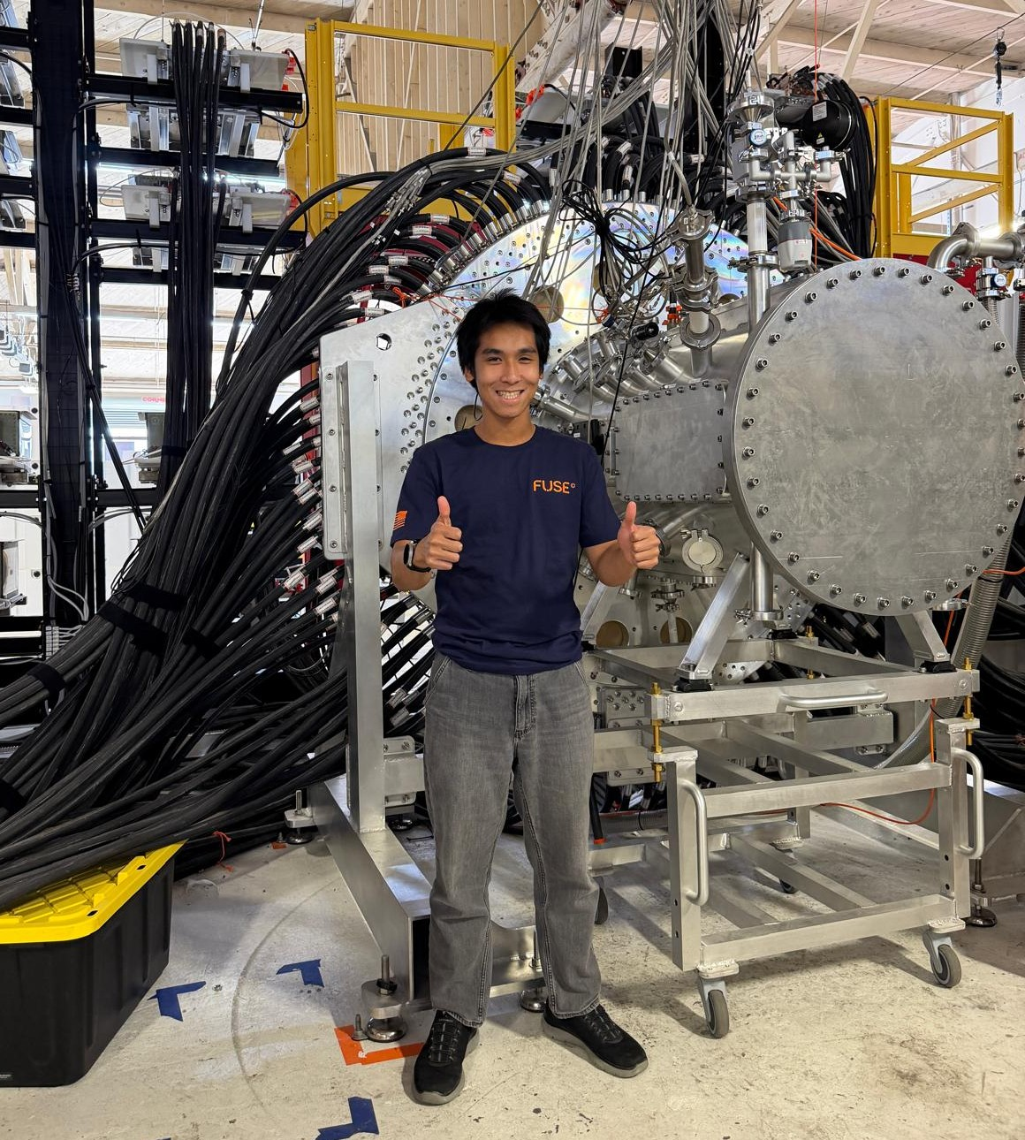
Faeton X (FX) facility at Fuse Energy Technologies

Slide 18
Conclusion
FX has exceptional current efficiency: of 4.5 MA/MJ,
FX has well-defined plasma structures and dynamics validating the correlation of measured and simulated results for effective integrated analysis.
Consistent series of e.g.10 shots averaging 1.02E12, best measured yield of 1.8x10¹² - exceeding the record of 1.2x10¹² set 52 years ago.
Shots statistics continue improving. The current fraction f_{c} driving the critical processes is expected to improve from its present 0.52 towards 0.7, allowing higher pressure operation to reach the scaled yield of 5x 10¹² ; which will clearly dispel the myth of neutron saturation.
An exciting feature of FX: fast ion beams are close to 115 keV, peak of D-T reactivity- facilitates production of D-T neutrons approaching 10¹⁵/shot.

Slide 19
Thank You- Questions
Acknowledgements: FUSE Team,

