Slide 1
Knowing the Dense Plasma Focus – The Coming of Age (of the PF) with Broad-ranging Scaling Laws
S H Saw^{1,2} & S Lee^{1,2,3}
¹Nilai University, 1 Persiaran Universiti, Putra Nilai, 71800 Nilai, Malaysia
²Institute for Plasma Focus Studies, Chadstone, VIC 3148, Australia
³University of Malaya, Kuala Lumpur, Malaysia
E-mail: dvcnilaiuniversity@nilai.edu.my; saw.ipfs@gmail.com

Slide 2
Abstract
The dense plasma focus is blessed not only with copious multi-radiations ranging from electron and ion beams, x-rays both soft and hard, fusion neutrons D-D and D-T but also with the property of enhanced compression from radiative collapse leading to HED (high energy density) states. The Lee code has been used in extensive systematic numerical experiments tied to reality through fitting with measured current waveforms and verified through comparison of measured and computed yields and measurements of multi-radiation. The studies have led to establishment of scaling laws with respect to storage energy, discharge current and pinch currents for fusion neutrons, characteristic soft x-rays, all-line radiation and ion beams. These are summarised here together with a first-time presentation of a scaling law of radiatively enhanced compression as a function of atomic number of operational gas. This paper emphasises that such a broad range of scaling laws signals the coming of age of the DPF and presents a reference platform for planning the many potential applications such as in advanced SXR lithography, materials synthesizing and testing, medical isotopes, imaging and energy and high energy density (HED).

Slide 3
The 4 phases of study of a device
The study of a device starts with:
Demonstration of production of some desirable property or yield, moves on to
Systematic study to link the desired property with operating parameters, on to
Ideas of optimisation of the desired property and culminates the knowledge phase of study with
A scaling law for the desired property or yield.
The dense plasma focus has undergone all the above four phases. We already have established scaling laws for fusion neutron yield, soft x-ray yields, ion beam yields.
In this paper we add to our list a scaling law for plasma focus pinch compression as a function of the atomic number of the operational gas. Such a broad range of scaling laws serves as a platform to launch applications.

Slide 4
General scaling rule-of-thumb
The yield of a radiation Y of hot and dense plasma depends on the radiation volume and the radiation time of that plasma.
Consideration of any coupled set of equation of motion and circuit applied to the DPF indicates that each of the four dimensions of the radiating plasma pinch (ie the three spatial dimensions and the temporal dimension) is proportional to the anode radius ‘a’.
This results immediately in the rule-of-thumb that Y ~ a⁴.
A further observation: value of ‘a’ is proportional to the discharge current.
Thus the well-known general scaling rule-of-thumb that yield
Y ~ I⁴.

Slide 5
The Plasma Focus 1/2
Plasma focus: small fusion device, complements international efforts to build fusion reactor
Multi-radiation device: x-rays, particle beams and fusion neutrons
Neutrons for fusion studies
Soft XR applications include microelectronics lithography and micro-machining
Large range of device-from J to thousands of kJ
Experiments: dynamics, radiation, instabilities and non-linear phenomena

Slide 6
The Plasma Focus 2/2
Axial Phase Radial Phases

Slide 7
The 5-phases of Lee Model code
Includes electrodynamical- and radiation- coupled equations to portray the REGULAR mechanisms of the:
axial (phase 1)
radial inward shock (phase 2)
radial RS (phase 3)
slow compression radiation phase (phase 4)
the expanded axial post-pinch phase (phase 5)
Crucial technique of the code: Current Fitting

Slide 8
Philosophy of Current fitting
We relate to reality through a measured current trace.
Computed current waveform is adjusted to fit measured current waveform.
Adjustment by model parameters fm, fc, fmr, fcr account for all factors affecting mass flow and force field flows not specifically modelled including all KNOWN and UNKNOWN effects.
When adjustments are completed so that the computed waveform fits the measured waveform, the computed system is energetically and mass-wise equivalent to the real system.

Slide 9
Computation of Neutron yield (1/2)
Adapted from Beam-target neutron generating mechanism
(ref Gribkov et al)
A beam of fast deuteron ions close to the anode
Interacts with the hot dense plasma of the focus pinch column
Produces the fusion neutrons
Given by:
Y_{b-t}= C_{n} n_{i}I_{pinch}²z_{p}²(ln(b/r_{p}))σ /U^{0.5}
where
n_{i} = ion density
b = cathode radius,
r_{p} = radius of the plasma pinch column with length z_{p},
σ = cross-section of the D-D fusion reaction, n- branch,
U= beam energy, and
C_{n} = calibration constant
S Lee and S H Saw, “Pinch current limitation effect in plasma focus,” Appl. Phys. Lett. 92, 2008, 021503

Slide 10
Computation of Neutron yield (2/2)
Note:
The D-D cross-section is sensitive to the beam energy in the range 15-150 kV; so it is necessary to use the appropriate range of beam energy to compute σ.
The code computes induced voltages (due to current motion inductive effects) V_{max} of the order of only 15-50 kV. However it is known, from experiments that the ion energy responsible for the beam-target neutrons is in the range 50-150keV, and for smaller lower-voltage machines the relevant energy could be lower at 30-60keV.
In line with experimental observations the D-D cross section σ is reasonably obtained by using U= 3V_{max}.
The model uses a value of C_{n} =2.7x10⁷ obtained by calibrating the yield at an experimental point of 0.5 MA.
S Lee and S H Saw, “Pinch current limitation effect in plasma focus,” Appl. Phys. Lett. 92, 2008, 021503

Slide 11
Computation of Neon SXR yield (1/2)
Neon SXR energy generated Y_{SXR} = Neon line radiation Q_{L}
Q_{L} calculated from:
where :
Z_{n} = atomic number,
n_{i} = number density ,
Z = effective charge number,
r_{p} = pinch radius,
z_{f} = pinch length and
T = temperature
Q_{L} is obtained by integrating over the pinch duration.
S Lee, S H Saw, P Lee and R S Rawat, “Numerical experiments on plasma focus neon soft x-ray scaling”
Plasma Physics and Controlled Fusion 51, 105013 (8pp) (2009)

Slide 12
Computation of Neon SXR yield (2/2)
Note:
The SXR yield is the reduced quantity of generated energy after plasma self-absorption which depends primarily on density and temperature
The model computes the volumetric plasma self-absorption factor A derived from the photonic excitation number M which is a function of the Z_{n}, n_{i}, Z and T.
In our range of operation the numerical experiments show that the self absorption is not significant.
Liu Mahe (1999) first pointed out that a temperature around 300 eV is optimum for SXR production. Shan Bing’s (2000) subsequent work and our experience through numerical experiments suggest that around 2x10⁶ K (below 200 eV) or even a little lower could be better.
Hence for SXR scaling there is an optimum small range of temperatures
(T window). [200-500 eV]
S Lee, S H Saw, P Lee and R S Rawat, “Numerical experiments on plasma focus neon soft x-ray scaling”
Plasma Physics and Controlled Fusion 51, 105013 (8pp) (2009)

Slide 13
Computation of Ion beam flux and fluence (1/5)
Ion beam flux J_{b} =n_{b}v_{b} where
n_{b}= number of beam ions N_{b} divided by volume of plasma traversed
v_{b} = effective speed of the beam ions.
All quantities in SI units, except where otherwise stated.
Note that n_{b}v_{b} has units of ions per m⁻² s⁻¹.

Slide 14
We derive n_{b} from pinch inductive energy considerations
Computation of Ion beam flux and fluence (2/5)
Total number of beam ions N_{b} (each ion mass Mm_{p}, speed v_{b}) has
KE= (1/2) N_{b} Mm_{p}v_{b}² where m_{p} =1.673x10⁻²⁷ kg is proton mass; M=mass number of ion e.g. neon ion has mass number M=20.
Assume this KE is imparted by a fraction f_{e} of the inductive pinch energy (1/2) L_{p} I_{pinch}² where L_{p} =(μ/2π)(ln[b/r_{p}])z_{p}; where μ=4p x10⁻⁷ Hm⁻¹, b=outer electrode of PF carrying the return current, r_{p}= pinch radius and z_{p}= length of the pinch. The pinch current I_{pinch} is the value taken at start of pinch.
Thus: (1/2) N_{b} Mm_{p} v_{b}² = (1/2) f_{e} (m/2π) (ln[b/r_{p}]) z_{p} I_{pinch}² ; n_{b}= N_{b}/(pr_{p}²z_{p})
n_{b} = (m/[2π² m_{p}]) (f_{e} /M) {(ln[b/r_{p}])/(r_{p}²)} (I_{pinch}² / v_{b}²) – (1)

Slide 15
We derive v_{b} from the accelerating voltage taken as the diode voltage U
Computation of Ion beam flux and fluence (3/5)
Each ion mass Mm_{p}, speed v_{b} , effective charge Z_{eff} is given KE (1/2) Mm_{p}v_{b}² by diode voltage U.
Thus: (1/2) Mm_{p}v_{b}² = Z_{eff} eU where e is the electronic (or unit) charge 1.6x10⁻¹⁹ C
v_{b}= (2e/m_{p})^{1/2} (Z_{eff} /M)^{1/2} U^{1/2} – (2)

Slide 16
From (1) multiplying both sides of equation by v_{b}, we have
Computation of Ion beam flux and fluence (4/5)
Algebraic manipulations:
n_{b} v_{b} = (m/[2π² m_{p}]) (f_{e} /M) {(ln[b/r_{p}])/(r_{p}²)} (I_{pinch}² / v_{b})
Eliminate v_{b} on RHS of this equation by using Eqn (2) gives
J_{b} =n_{b} v_{b} = (m/[2π² m_{p}])(f_{e} /M){(ln[b/r_{p}])/(r_{p}²)}(I_{pinch}²)(m_{p}/2e)^{1/2}(M/Z_{eff})^{1/2}/U^{1/2}
= (m/[2.83p² (em_{p})^{1/2}])(f_{e}/[M Z_{eff}]^{1/2}){(ln[b/r_{p}])/(r_{p}²)}(I_{pinch}²)/U^{1/2}
Noting that: (m/[2.83p² (em_{p})^{1/2}]) = 2.74x10¹⁵. We have:
Result:
J_{b} (ions m⁻²s⁻¹) = 2.75x10¹⁵ (f_{e}/[M _{eff}]^{1/2}){(ln[b/r_{p}])/(r_{p}²)}(I_{pinch}²)/U^{1/2}
- (3)

Slide 17
The fluence is the flux multiplied by pulse duration τ; Thus:
Computation of Ion beam flux and fluence (5/5)
Fluence J_{b}τ (ions m⁻² ) :
2.75x10¹⁵ τ (f_{e}/[M Z_{eff}]^{1/2}){(ln[b/r_{p}])/(r_{p}²)}(I_{pinch}²)/U^{1/2}
(4)

Slide 18
Assumptions
Ion beam flux J_{b} is n_{b}v_{b} with units of ions m⁻² s⁻¹.
Ion beam is produced by diode mechanism (ref).
The beam is produced uniformly across the whole cross-section of the pinch
The beam speed is characterized by an average value v_{b}.
The beam energy is a fraction f_{e} of the pinch inductive energy, taken as 0.14 in the first instance; to be adjusted as numerical experiments indicate.
The beam ion energy is derived from the diode voltage U
The diode voltage U is proportional to the maximum induced voltage V_{max}; with U=3V_{max} (ref) taken from data fitting in extensive earlier numerical experiments.
S Lee and S H Saw, “Plasma Focus Ion Beam Fluence and Flux –Scaling with Stored Energy”, Phys. Plasmas 19, 112703 (2012);
S Lee and S H Saw, “Plasma Focus Ion Beam Fluence and Flux –for various gases”, Phys. Plasmas 20, 062702 (2013)

Slide 19
Results: Scaling laws for neutrons from numerical experiments over a range of energies from 10kJ to 25 MJ (1/4)
To study the neutrons emitted by PF1000-like bank energies from 10kJ to 25 MJ.
1) Apply the Lee model code to fit a measured current trace of the PF1000:
C₀ = 1332 μF, V₀ = 27 kV, P₀ = 3.5 torr D₂; b = 16 cm, a = 11.55 cm or
c=1.39; z₀ = 60 cm; external (or static) inductance L₀= 33.5 nH and;
damping factor RESF= 1.22 (or stray resistance r₀=6.1 mΩ).
2) Apply the Lee code over a range of C₀
ranging from 14 µF (8.5 kJ) to 39960 µF (24 MJ):
Voltage, V₀ = 35 kV; P₀ = 10 torr deuterium; RESF = 1.22; ratio c=b/a is 1.39.
For each C₀, anode length z₀ is varied to find the optimum z₀.
For each z₀, anode radius a₀ is varie to get end axial speed of 10 cm/µs.

Slide 20
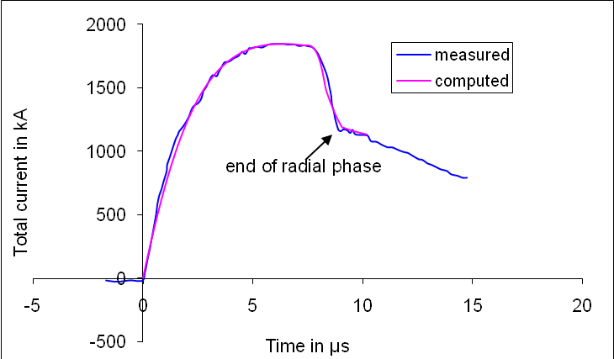
Scaling laws for neutrons from numerical experiments over a range of energies from 10kJ to 25 MJ (2/4)
Fitted model parameters : f_{m} = 0.13, f_{c} = 0.7, f_{mr} = 0.35 and f_{cr}=0.65.
Computed current trace agrees very well with measured trace through all the phases: axial and radial, right down to the bottom of the current dip indicating the end of the pinch phase as shown below.
PF1000:
C₀ = 1332 μF; V₀ = 27 kV;
P₀ = 3.5 Torr D₂; b = 16 cm;
a = 11.55 cm; z₀ = 60 cm;
L₀= 33.5 nH; r₀ = 6.1 mΩ or RESF=1.22.

Slide 21
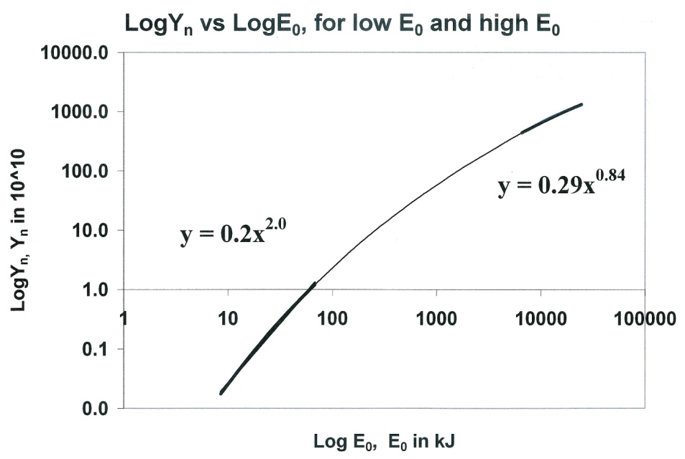
Scaling laws for neutrons from numerical experiments over a range of energies from 10kJ to 25 MJ (3/4)
Voltage, V₀ = 35 kV; P₀ = 10 torr deuterium; RESF = 1.22; ratio c=b/a is 1.39.
Numerical experiments: C₀ ranging from 14 µF(8.5 kJ) to 39960 µF (24 MJ)
For each C₀, anode length z₀ is varied to find the optimum z₀.
For each z₀, anode radius a₀ is varied to get end axial speed of 10 cm/µs.
Yn scaling changes:
Y_{n}~E₀^{2.0} at tens of kJ
Y_{n}~E₀^{0.84} at the highest
energies (up to 25MJ)

Slide 22
Scaling laws for neutrons from numerical experiments over a range of energies from 10kJ to 25 MJ (4/4)
Scaling of Y_{n} with I_{peak} and I_{pinch}:
Y_{n}=3.2x10¹¹ I_{pinch}^{4.5}
and
Y_{n}=1.8x10¹⁰ I_{peak}^{3.8}
where I_{peak} = (0.3-0.7)MA
and I_{pinch} = (0.2 -2.4)MA.

Slide 23
Scaling laws for neon SXR from numerical experiments over a range of energies from 0.2 kJ to 1 MJ (1/4)
To study the neon SXR emitted by a modern fast bank energies from 0.2 kJ to 1 MJ.
Apply the Lee model code to a proposed modern fast plasma focus machine:
1) With optimised values:
c=b/a =1.5; V₀ = 20 kV; L₀= 30 nH; RESF = 0.1
Model parameters : f_{m}=0.06, f_{c}=0.7, f_{mr}=0.16, f_{cr}=0.7.
2) For C₀ varying from 1 μF (0.2 kJ) to 5000 μF (1MJ):
For each C₀, vary P₀, z₀, and a₀ to find the optimum Y_{sxr}

Slide 24
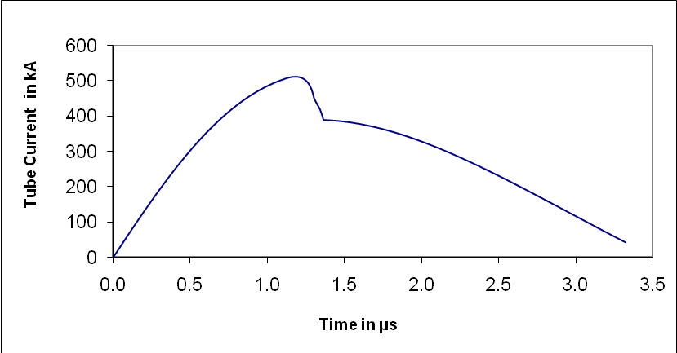
Scaling laws for neon SXR from numerical experiments over a range of energies from 0.2 kJ to 1 MJ (2/4)
Computed Total Current versus Time
For L₀ = 30nH; V₀ = 20 kV; C₀ = 30 uF; RESF = 0.1; c=1.5
Model parameters : f_{m} = 0.06, f_{c} = 0.7, f_{mr} =0.16, f_{cr} = 0.7
Optimised a=2.29cm; b=3.43 cm and z₀=5.2 cm.

Slide 25
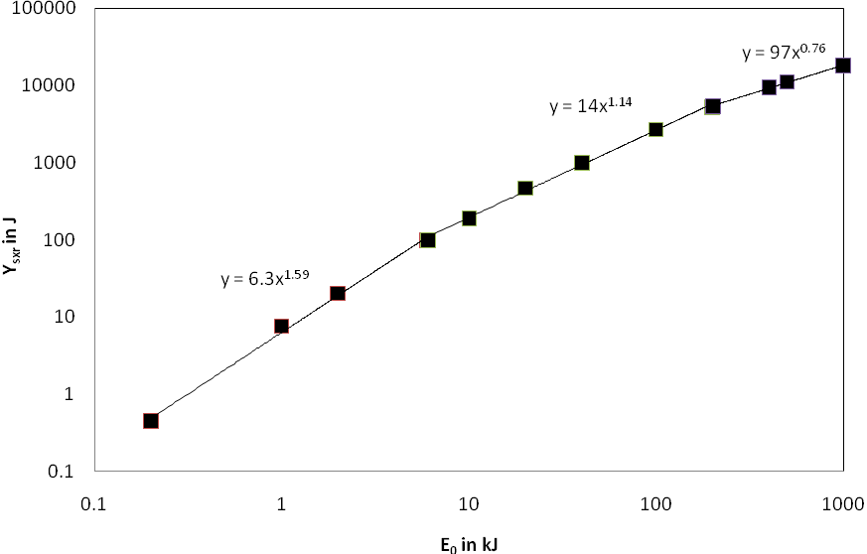
Scaling laws for neon SXR from numerical experiments over a range of energies from 0.2 kJ to 1 MJ (3/4)
Y_{sxr} scales as:
E₀^{1.6} at low energies in the sub-kJ to several kJ region.
E₀^{0.76} at high energies
towards 1MJ.

Slide 26
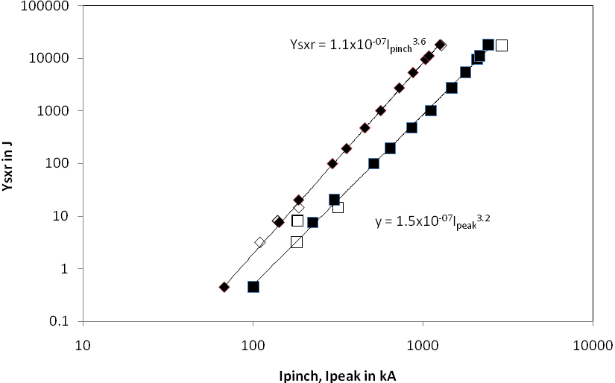
Scaling laws for neon SXR from numerical experiments over a range of energies from 0.2 kJ to 1 MJ (4/4)
Scaling with currents
Y_{sxr}~I_{peak}^{3.2} (0.1–2.4 MA)
Y_{sxr}~I_{pinch}^{3.6} (0.07-1.3 MA)
Black data points with fixed parameters RESF=0.1; c=1.5; L₀=30nH; V₀=20 kV and model parameters f_{m}=0.06, f_{c}=0.7, f_{mr}=0.16, f_{cr}=0.7.
White data points are for specific machines with different values for the parameters :c, L₀, V₀ etc.

Slide 27
Nitrogen SXR – Similar to Neon SXR
Experiments were carried out with a configuration with c = 1.5, V₀ = 20 kV, L₀= 30 nH, RESF = 0.1, and with model parameters respectively of 0.06, 0.7, 0.15 and 0.7. Storage energy E₀ was varied in the range 1 – 200 kJ by varying C₀ (5 – 1000 mF).
Parametric variation followed the order P₀, z₀ and ‘a’, systematically covering all realistic combinations P₀, z₀ and ‘a’ for each E₀; until for each E₀, the optimum combination (P₀, z₀ and ‘a’) was found.
The resulting scaling laws of yield versus currents were found to be:
Y_{sxr,N} = 1100 I_{pinch}^{3.4},
Y_{sxr,N} = 163 I_{peak}^{3.0}.
The temperature window for characteristic nitrogen SXR is very close to that of neon. Thus similarly to neon, DPF operation in nitrogen also favourably creates pinch temperatures falling neatly within the temperature window for characteristic nitrogen SXR production.

Slide 28
Argon SXR (1/3)
For argon, because of the much larger atomic number (18) when compared to nitrogen (7) and neon (10), the temperature window is shifted almost 10 times higher.
Thus despite its heavier atomic weight (twice that of neon), for argon to reach its temperature window in the pinch requires rather higher speeds (higher by about a factor of 2), which is beyond typical DPF operation due to the associated unfavourable higher dynamic resistance.
Thus typical DPF operation hardly attains the temperature window in argon and characteristic (soft) XR is hardly measured from argon DPFs.

Slide 29
Argon SXR (2/3)
Numerical experiments were carried out in a similar way to that described for neon. The parameters kept constant are: RESF = 0.1, c = 3.4, and V0 = 15 kV at 1 Torr and model parameters fm, fc, fmr, fcr at 0.05, 0.7, 0.15 and 0.7 respectively.
The yield data is from two sets of experiments using a high performance DPF (L0 = 10 nH) and a low performance DPF (L0 = 270 nH).
The high performance machine produces more current per unit storage energy than the low performance machine. Mixing data from DPFs with such drastic differences in performance makes the yield vs storage energy not meaningful since the low performance machine requires much more storage energy to generate the same current as a high performance machine.
However the yield scaling with respect to Ipinch remains intact (Ysxr,argon = 4x10-11 Ipinch 4.2 J with Ipinch in kA)with only a slight separation of the two sets of data and good R2 of 0.99 (see Fig 5 – upper line).
The yield scaling with respect to Ipeak (Ysxr,argon = 3 x 10-11 Ipeak 4.0 J with Ipeak in kA) shows a clear separation of the two sets of data (high performance set is clearly lower) though still usable as shown by an R2 of 0.96.

Slide 30
Argon SXR (3/3)

Slide 31
Experimental Confirmation
NX2 was designed for neon SXR.
In an experiment with argon designed to produce characteristic argon (soft) XR for micromachining Gribkov et al [56] found that driving the argon plasma shock waves to twice the speed of that achieved in neon operation yielded up to 1 J of characteristic (soft) XR around 0.4 nm with an I_{peak} of 400 kA.
This is consistent with the scaling law for yield vs Ipeak obtained from the Figure.

Slide 32
Argon all-line yield
In neon and nitrogen operation, conditions of optimised energy input favours the simultaneous attainment of the temperature window for characteristic SXR, however in argon its corresponding temperature window is hardly ever reached.
Thus for neon and nitrogen typical operations are easily tuned to optimum conditions for characteristic SXR. The SXR scaling laws are hence useful for predicting or designing DPFs for yields in neon and nitrogen.
In argon the SXR scaling laws are hardly so useful. Typically operating the argon DPF at around 10 cm/μs, no characteristic (soft) XR are produced and what is measured is all-line radiation, ie radiation of all-lines, all or almost all of which is NOT the characteristic H-like or He-like emission of argon.
Moreover for consideration of radiative collapse, the radiation-enhanced compression invariably involves more cooling than heating resulting in pinch temperatures below that required for H-like and He-like argon ion states.
So for argon it may be useful (more so than for neon or nitrogen) to develop scaling laws for line (ie all-line) radiation.

Slide 33
Argon All-line yield- scaling law
A beginning of this has been done by Arwinder [57] for a range of small (kJ) DPFs. The resulting scaling laws are:
Y_{all-lines} = 4000 I_{pinch}^{1.9} and
Y_{all-lines} = 1000 I_{peak}^{1.63}; I_{peak} and I_{pinch} in MA. (applicable to currents around sub-0.1 to 0.2 MA).

Slide 34
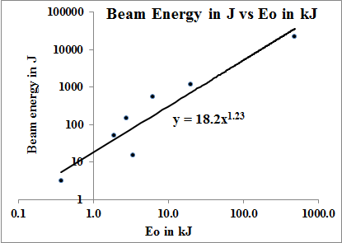
Scaling Laws for Deuteron Beams at DPF pinch exit (1/2)

Slide 35
Scaling Laws for Deuteron Beams at DPF pinch exit (2/2)
The following scaling:
Y_{beamions}=2.8x10⁻⁷I_{pinch}^{3.7} (current in kA)
Y_{beamions}= 8.4x10⁻⁷I_{peak}^{3.16} (current in kA)
Y_{beamions}= 18.2E₀^{1.23} where Y_{beamions} is in J and E₀ is in kJ ranging from 1 kJ to 1MJ.

Slide 36
We note the considerable scatter in the scaling law in this initial attempt to present quantitative ideas of ion beams to provide reference data for laboratory measurements. More numerical experiments and laboratory measurements are needed to put the ion beam scaling laws on a firmer footing.

Slide 37

Scaling law for radiative compression
Piston motion in the plasma focus pinch is modelled with this equation, which includes the effect of rate of change of current dI/dt, pinch column elongation dzf/dt, the specific heat ratio g and the nett energy input into the plasma (from Joule heating and radiation) dQ/dt

Slide 38
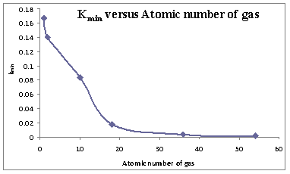
Systematic computation for gases including hydrogen, helium, neon, argon, krypton and xenon suggests a scaling law of κ_{min} = r_{min}/a as a function of atomic number

Slide 39
The enhancement of compression as a function of gas is indicated in Fig 7. Plotting Fig 7 on log-log scale shows (Fig 8), that the chart should be separated into two regions with distinctive power laws. The lower compression region from hydrogen to neon has κ_{min} =0.17 A^{-0.30} with neon with κ_{min} just below 0.1. The higher compression region from neon to xenon has κ_{min}=18.14A^{-2.37}. We can attribute the increase of compression with atomic number A from hydrogen to neon primarily to specific heat ratio compressibility effects; whereas from neon onwards the effect is primarily due to net radiation effect. The transition gas in neon which exhibits in significant proportions of thermodynamic enhancement and radiation- enhancement

Slide 41
Summary of scaling laws compiled in this paper (1/2)
1) The neutron yield scaling laws:
Y_{n} = 3.2 × 10¹¹ I_{pinch}^{4.5} and
Y_{n} = 1.8 × 10¹⁰ I_{peak}^{3.8} current in MA
Y_{n} ~ E₀^{2.0} at tens of kJ to Y_{n} ~ E₀^{0.84} at MJ level (up to 25MJ)
2) The characteristic neon SXR scaling laws are:
Y_{sxr} = 8.3 × 10³ × I_{pinch}^{3.6}
Y_{sxr} = 600 × I_{peak}^{3.2} Y in J current in MA
Y_{sxr} ~ E₀^{1.6} (kJ range) to Y_{sxr} ~ E₀^{0.8} (towards MJ).
3) For nitrogen characteristic (soft) x-rays: (yield in J per shot)
Y_{sxr} = 1100 I_{pinch}^{3.4}, Y_{sxr} = 163 I_{peak}^{3.0}. both I_{peak} and I_{pinch} (0.1 – 1 MA) in MA.
4) For argon characteristic (soft) x-rays: (yield in J per shot)
Y_{sxr} = 183 I_{pinch}^{4.22;} Y_{sxr} = 30 I_{peak}^{4.0}; both I_{peak} and I_{pinch} (sub-0.1 sub-MA) in MA.
For argon all-line radiation: (yield in J per shot)
Y_{all-lines} = 4000 I_{pinch}^{1.9} and Y_{all-lines} = 1000 I_{peak}^{1.63}; I_{peak} and I_{pinch} in MA. (sub-0.1 to 0.2 MA).

Slide 42
Summary of scaling laws compiled in this paper (2/2)
The beam ions at exit of a deuterium DPF have following scaling:
Y_{beamions}=2.8x10⁻⁷I_{pinch}^{3.7}
Y_{beamions}= 8.4x10⁻⁷I_{peak}^{3.16} Y in J current in kA
Y_{beamions}= 18.2E₀^{1.23} Y in J and E₀ is in kJ; averaged over 1 kJ - 1MJ
The compression of PF pinches for different gases (atomic number A) follows a 2-region scaling law:
From H to Ne: κ_{min} = 0.17 a^{-0.30} thermodynamic-enhanced regime
From Ne to Xe: κ_{min} = 18.1 a^{-2.37} radiation-enhanced regime

Slide 43
These laws provide useful reference values and facilitate the understanding of present DPFs. More importantly, these scaling laws are also useful for design considerations of new DPFs, particularly if they are intended to operate as optimized neutron or SXR sources. More recently, the scaling of Y_{n} versus E₀ has been placed in the context of a global scaling law [35] with the inclusion of available experimental data. From that analysis, the cause of scaling deterioration for neutron yield versus energy (clearly seen in figure 1) has been uncovered as due to a current scaling deterioration caused by an almost constant axial phase ‘dynamic resistance’ interacting with a reducing bank impedance as energy storage is increased at essentially constant voltage. The deterioration of soft x-ray yield with storage energy as shown in figure 3 is ascribed to the same axial phase ‘dynamic resistance’ effect as described in reference [35]. This deterioration of scaling will also appear in the scaling trends (with stored energy) of beam ions and all other radiations.

Slide 44
Scaling laws against I_{pinch} most robust
We emphasise here that the scaling laws with I_{pinch} is the more fundamental and robust one compared to I_{peak}. This is because although the PF is reasonably consistent in its operations, there will be occasions when even the best optimized machines may not focus or poorly focused although having a high I_{peak} with no neutrons. However, I_{pinch} being the current actually flowing in the pinch is more consistent in all situations

Slide 45
Scaling laws serve as platform for launching applications
The numerical experiments gives robust scaling laws for PFs covering a wide range of energies from sub kJ to tens of MJ. It supplements the limited (non-existent in the case of beam ions) scaling laws available to predict PF radiations yields. In this paper we add to our list a scaling law for plasma focus pinch compression as a function of the atomic number of the operational gas. Such a broad range of scaling laws serves as a platform to launch applications..

Slide 46
Acknowledgement We acknowledge the contributions of colleagues and students in the compilation of this paper

Slide 47
Papers from Lee model code (1/4)
S Lee and S H Saw, “Pinch current limitation effect in plasma focus,” Appl. Phys. Lett. 92, 2008, 021503.
S Lee and S H Saw, “Neutron scaling laws from numerical experiments,” J Fusion Energy 27, 2008, pp. 292-295.
S Lee, P Lee, S H Saw and R S Rawat, “Numerical experiments on plasma focus pinch current limitation,” Plasma Phys. Control. Fusion 50, 2008, 065012 (8pp).
S Lee, S H Saw, P C K Lee, R S Rawat and H Schmidt, “Computing plasma focus pinch current from total current measurement,” Appl. Phys. Lett. 92 , 2008, 111501.
S Lee, “Current and neutron scaling for megajoule plasma focus machine,” Plasma Phys. Control. Fusion 50, 2008, 105005, (14pp).
S Lee and S H Saw, “Response to “Comments on ‘Pinch current limitation effect in plasma focus’”[Appl. Phys. Lett.94,076101 (2009)],” Appl. Phys. Leet.94, 2009, 076102.
S Lee, S H Saw, L Soto, S V Springham and S P Moo, “Numerical experiments on plasma focus neutron yield versus pressure compared with laboratory experiments,” Plasma Phys. Control. Fusion 51, 2009, 075006 (11 pp).
S H Saw, P C K Lee, R S Rawat and S Lee, “Optimizing UNU/ICTP PFF Plasma Focus for Neon Soft X-ray Operation,” IEEE Trans Plasma Sci, VOL. 37, NO. 7, JULY (2009)
Lee S, Rawat R S, Lee P and Saw S H. “Soft x-ray yield from NX2 plasma focus- correlation with plasma pinch parameters” JOURNAL OF APPLIED PHYSICS 106, 023309 (2009)
S Lee, S H Saw, P Lee and R S Rawat, “Numerical experiments on plasma focus neon soft x-ray scaling”, Plasma Physics and Controlled Fusion 51, 105013 (8pp) (2009)

Slide 48
Papers from Lee model code (2/4)
M Akel, S Hawat, S Lee, “Numerical Experiments on Soft X-Ray Emission Optimization of Nitrogen Plasma in 3 kJ Plasma Focus Using Modified Lee Model”, J Fusion Energy DOI 10.1007/s10894-009-9203-4 First online Tuesday, May 19, 2009
M Akel, S Hawat, S Lee, “Pinch Current and Soft x-ray yield limitation by numerical experiments on Nitrogen Plasma Focus”, J Fusion Energy DOI 10.1007/s10894-009-9238 first online 21 August 2009
S. Lee, “Neutron Yield Saturation in Plasma Focus-A fundamental cause”, Appl Phys Letts (2009) 95, 151503 93.
M. Akel, Sh. Al-Hawat, S. H. Saw and S. Lee, “Numerical Experiments on Oxygen Soft X- Ray Emissions from Low Energy Plasma Focus Using Lee Model”, J Fusion Energy DOI 10.1007/s10894-009-9262-6 First online 22 November 2009
Sing Lee and Sor Heoh Saw, Numerical Experiments providing new Insights into Plasma Focus Fusion Devices-Invited Review Paper: for Energy: special edition on “Fusion Energy”
Energies 2010, 3, 711-737; doi:10.3390/en3040711-Published online 12 April 2010
S H Saw, S Lee, F Roy, PL Chong, V Vengadeswaran, ASM Sidik, YW Leong & A Singh, In-situ determination of the static inductance and resistance of a plasma focus capacitor bank –Rev Sci Instruments (2010) 81, 053505
S H Saw and S Lee, Scaling the Plasma Focus for Fusion Energy Considerations, Int. J. Energy Res. (2010) Int. J. Energy Res. (2010) View this article online at wileyonlinelibrary.com. DOI: 10.1002/er.1758
S H Saw and S Lee. Scaling laws for plasma focus machines from numerical experiments, Invited paper Energy and Power Engineering, 2010, 65-72 doi:10.4236/epe.2010.21010

Slide 49
Papers from Lee model code (3/4)
S Lee and S H Saw, “Plasma Focus Ion Beam Fluence and Flux –Scaling with Stored Energy”, Phys. Plasmas 19, 112703 (2012); http://dx.doi.org/10.1063/1.4766744
S. Lee, S. H. Saw, Jalil Ali, "Numerical Experiments on Radiative Cooling and Collapse in Plasma Focus Operated in Krypton“, Journal of Fusion Energy, vol. 32, no. 1, pp. 42-49, (2012)
S Lee and S H Saw, “Plasma Focus Ion Beam Fluence and Flux –for various gases”, Phys. Plasmas 20, 062702 (2013); doi: 10.1063/1.48116503.
S H Saw & S Lee, Plasma Focus Ion Beam- Scaling Laws , Plasma Science and Applications (ICPSA 2013) International Journal of Modern Physics: Conference Series, Vol. 32 (2014) 1460317 (11 pages) DOI: 10.1142/S2010194514603172
M Akel and S. Lee, “Radiative Collapse in Plasma Focus Operated with Heavy Noble Gases”, J. Fusion Energ (2013) 32:111-116; DOI 10.1007/s10894-012-9535-3
S. Lee, "Plasma Focus Radiative Model: Review of the Lee Model Code“, Journal of Fusion Energy, vol. 33, no. 4, pp. 319-335, (2014).
S H Saw & S Lee . Measurement of Radiative Collapse in 2.2 kJ PF – Achieving High Energy Density (HED) Conditions in a small Plasma Focus. J Fusion Energy (2016) 35: 702-708. DOI 10.1007/s10894-016-0095-9

Slide 50
Papers from Lee model code (4/4)
D.Piriaei, T.D.Mahabadi, S.Javadi, M.Ghoranneviss, S H Saw and S Lee, “The investigation of pinch regimes in a Mather type dense plasma focus device and their effects on hard x-ray emission”, Physics of Plasmas 22, 123507 (2015); doi: 10.1063/1.4936801
Mohamad Akel, Jakub Cikhardt, Pavel Kubes, Hans-Joachim Kunze, Sing Lee, M. Paduch, Sor Heoh Saw, “Experiments and Simulations on the Possibility of Radiative Contraction/Collapse in the Plasma Focus PF-1000”, NUKLEONIKA 2016;61(2):145-148, doi: 10.1515/nuka-2016-0025
M Akel, S. Alsheikh Salo, Sh. Ismael, S. H. Saw, S. Lee, “Deuterium Plasma Focus as a Tool for Testing Materials of Plasma Facing Walls in Thermonuclear Fusion Reactors”, J Fusion Energy , 35(4) 694-701 DOI 10.1007/s10894-016-0092-z, 2016.
S. H. Saw, S. Lee, “Measurement of Radiative Collapse in 2.2 kJ PF: Achieving High Energy Density (HED) Conditions in a Small Plasma Focus”, J Fusion Energ (2016) 35:702–708, DOI 10.1007/s10894-016-0095-9
M. Akel, Sh. Ismael, S. Lee, S. H. Saw and H.J. Kunze, “Effects of Power Terms and Thermodynamics on the Contraction of Pinch Radius in Plasma Focus Devices using the Lee Model”, Journal of Fusion Energy 35(6) · July 2016

Slide 51
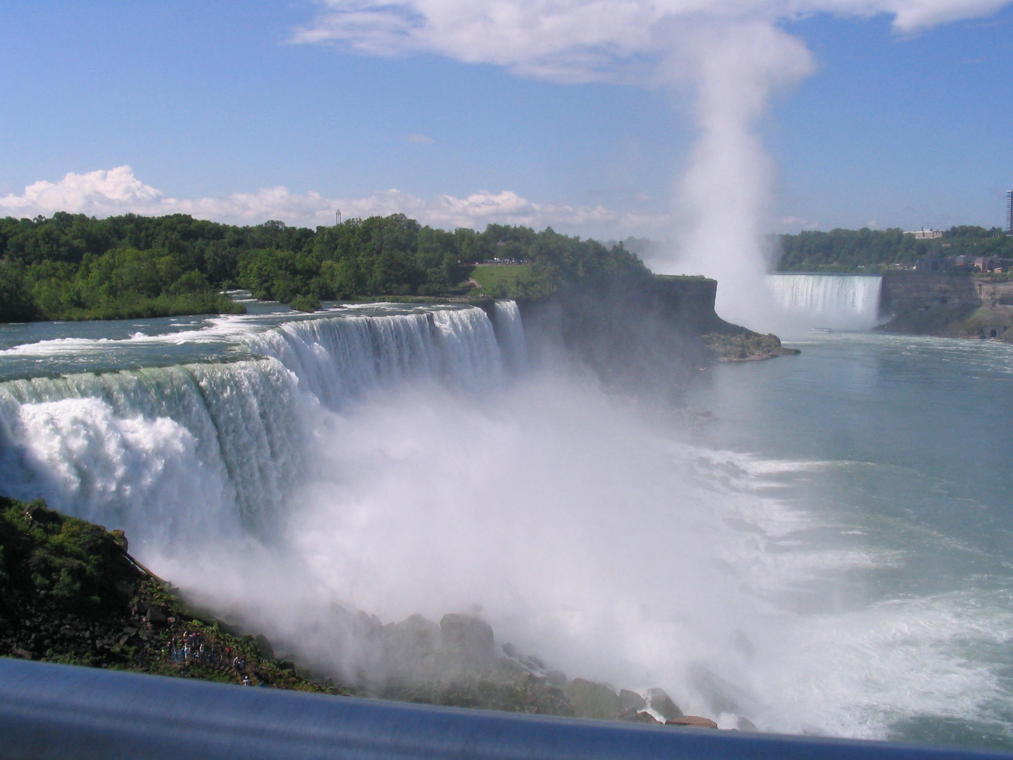
Thank You

