Slide 1
Compression Mechanisms in the Plasma Focus Pinch
S. Lee^{1,2,3,4}, S. H. Saw^{1,2}, Jalil Ali⁵
¹Institute for Plasma Focus Studies, 32 Oakpark Drive, Chadstone, VIC 3148, Australia
²Nilai University, 1, Persiaran Universiti, Putra Nilai, 71800 Nilai, Malaysia
³University of Malaya, Kuala Lumpur, Malaysia
⁴INTI International University, 71800 Nilai, Malaysia
⁵ Nanotechnology Research Alliance, Universiti Teknologi Malaysia, Johor, Malaysia

Slide 2
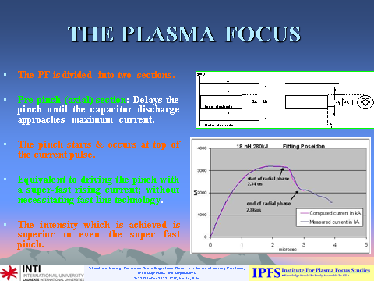

Slide 3
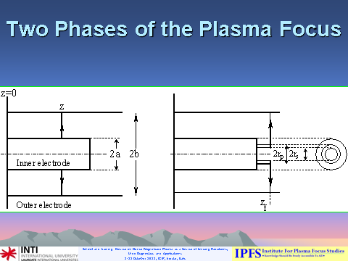

Slide 4
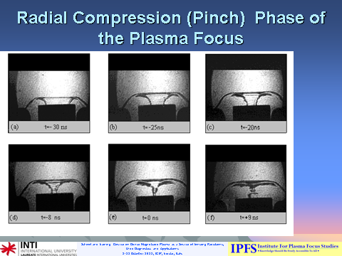

Slide 5
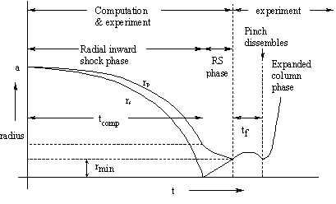
Modelling radial phases
Radius vs time trajectories :
radial inward shock phase when rs moves radially inwards,
reflected shock (RS) phase when the reflected shock moves radially outwards, until it hits the incoming piston rp leading to the start of the pinch phase (tf) and finally the expanded column phase.

Slide 6
Typical radial computed trajectories

Slide 7

From the first law of thermodynamics, the equation governing PF compression is:
Jalil Ali. The Enhancement of Pinch Compression-
A numerical Study.
MSc thesis. UM, Malaysia, 1986.

Slide 8
First two terms of the compression equation
Inward compression: dr_{p}/dt is negative.
dI/dt term is negative and this term opposes the compression.
low radiation plasmas : dQ/dt is negligible; net value of (the dI/dt and the dz_{f}/dt terms) determines the compression. The dI/dt term opposes the compression, it is dz_{f}/dt terms that provides the negative value of dr_{p}/dt needed for the inward compression.

Slide 9
A comparison: Ne vs D
The net value of these first two terms is:
-(1 /(γ-1)) [(γ/(γ+1))(r_{p}/z_{f}) (dz_{f}/dt) +(r_{p}/I) (dI/dt)]
In D- fully ionized in a PF pinch- f =3, γ = 5/3. This factor (1 /(γ-1)) has a value of 1.5.
Compare this to the case of Ne which is freely ionizing in a PF pinch with γ of 1.3. This factor (1 /(γ-1)) has a value of 3.3; more than twice the case of deuterium.
Thus in neon, the dynamic compression is more than in deuterium

Slide 10
More generally: Effect of specific heat ratio on compression
Effect of γ:
Consider γ as a measure of degree of freedom.
If an ensemble of particles at temperature T has one degree of freedom (f=1) then (1/2)kT of energy has to be provided per particle to raise its temperature by 1 degree K.
Thus if a gaseous ensemble has infinite degrees of freedom (ie f = infinity) then the gas will not heat up however much energy is provided. Such a gas is perfectly compressible; since it will not heat up and does not provide any opposing pressure to any compression pressure.
γ = (f+2)/f can be considered to be an index of compressibility.
If γ = 1, ie f = infinity, gas is perfectly compressible.
If γ = 2, ie f = 2 (minimum value of 2; case of fully ionized gas in a strong B field) gas is least compressible.

Slide 11
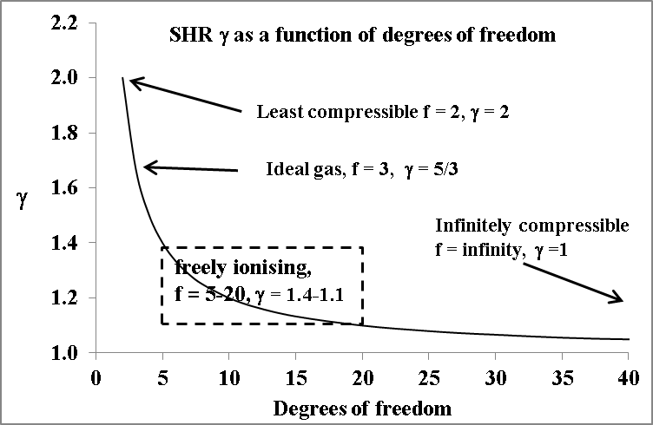
Specific heat ratio and compressibility regimes
Regimes of compressibility showing the least compressible (f = 2, γ = 2), ideal reference compression (f = 3, γ = 3), freely ionizing regime, SHR due to thermodynamics (exclude radiation losses) (f = 4-20, γ = 1.4 – 1.1) and infinitely compressible ( f = infinity, γ = 1)

Slide 12
Numerical experiments are run on NX2

Slide 13
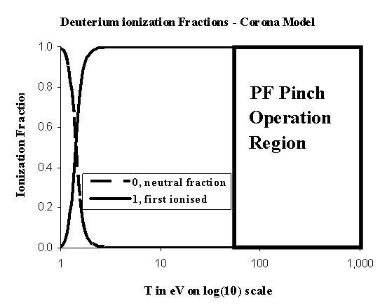
PF pinch temperature: 1-10 x10⁶ K or 100 eV to 1 keV;
Deuterium is fully ionized; SHR=1.6667 effectively f=3;

Slide 14
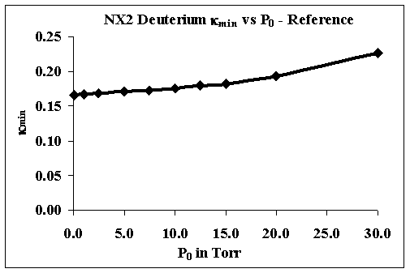
Deuterium, f = 3; negligible radiation; dQ/dt minimal effect; slightly opposes compression, minimum pinch radius ratio versus pressure- Reference compression,

Slide 15
From the first law of thermodynamics, the equation governing PF compression is:
D may be taken as reference plasma for PF compression
1. Thermodynamics: SHR γ, reflecting additional degrees of freedom due to ionization;
γ = (f+2)/f or f =2/(γ -1); For D: γ=5/3, dQ/dt~0
2. Nett emission power dQ/dt: reflecting emission power less joule heating- For D: dQ/dt~0 or slightly positive

Slide 16
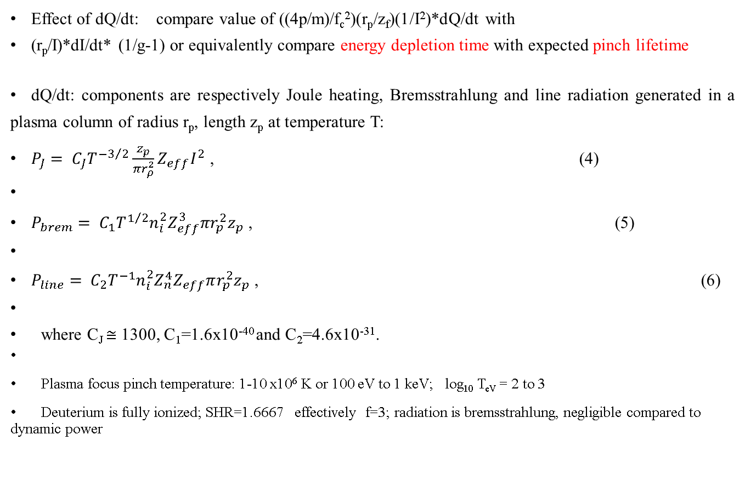
Effect of dQ/dt
Effect of dQ/dt: compare value of ((4p/m)/f_{c}²)(r_{p}/z_{f})(1/I²)*dQ/dt with
(r_{p}/I)*dI/dt* (1/g-1) or equivalently compare energy depletion time with expected pinch lifetime
dQ/dt: components are respectively Joule heating, Bremsstrahlung and line radiation generated in a plasma column of radius r_{p}, length z_{p} at temperature T:
$P_{J}= C_{J}T^{{−3}/2}\frac{z_{p}}{{πr}_{ρ}^{2}}Z_{eff}I^{2}$ , (4)
$P_{brem}= C_{1}T^{1/2}n_{i}^{2}Z_{eff}^{3}{πr}_{p}^{2}z_{p}$ , (5)
$P_{line}= C_{2}T^{−1}n_{i}^{2}Z_{n}^{4}Z_{eff}πr_{p}^{2}z_{p}$ , (6)
where C_{J} $≅$ 1300, C₁=1.6x10⁻⁴⁰ and C₂=4.6x10⁻³¹.
Plasma focus pinch temperature: 1-10 x10⁶ K or 100 eV to 1 keV; log₁₀ T_{eV} = 2 to 3
Deuterium is fully ionized; SHR=1.6667 effectively f=3; radiation is bremsstrahlung, negligible compared to dynamic power

Slide 17
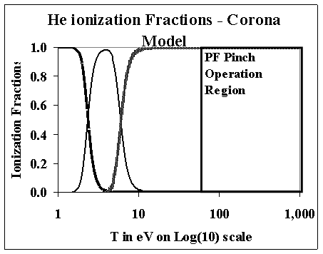
He is fully ionized; SHR= 1.6667 effectively f=3
Also negligible radiation- compression similar to D

Slide 18
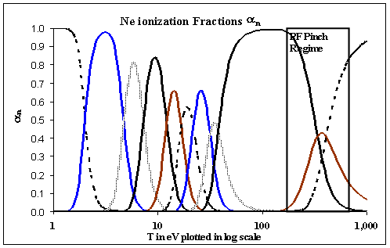
Ne is operated : 200 - 500 eV so that 8-th and 9th -ionized; H-like and He-like for characteristic Ne radiation. SHR = 1.3 -1.5 ; radiation is line, radiation power becoming significant compared to dynamic power and Joule heating power
Neon ionization versus temperature- showing typical pinch regime. Eleven traces represent 0, 1st , …… 10th ionization fractions from left to right as temperature increases.

Slide 19
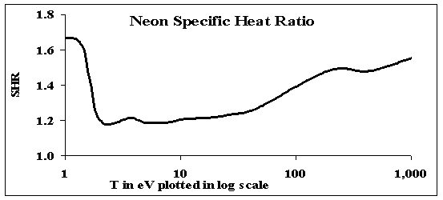
Neon: SHR (including ionization energy) vs temperature

Slide 20
NX2: Computations of pinch properties in neon as a function of pressure

Slide 21
NX2 in neon: Radius ratio vs P₀, showing thermodynamically enhanced (Th E) regime and radiation-enhanced (RE) regime.

Slide 22
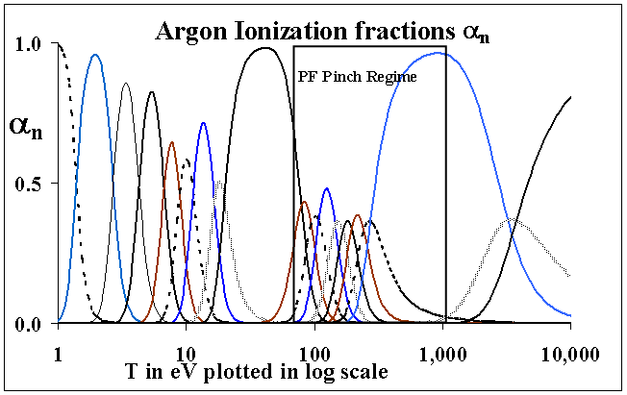
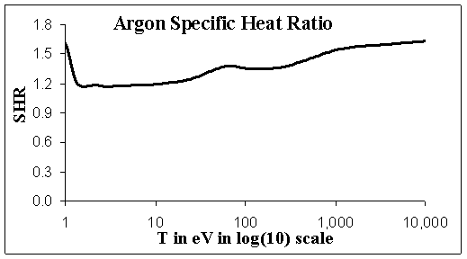
Ar freely ionizing region: SHR ~ 1.4 f~ 5 Z_{eff} ~ 10 - 16 ; radiation is line, radiation power dominant compared to dynamic and joule heating power

Slide 23
Ar- Properties as functions of pressure

Slide 24
Ar- Compression versus P₀

Slide 25
Kr freely ionizing region; SHR~ 1.3 – 1.4 f~ 5-7 Z_{eff} averages 20 ; radiation is line, radiation power is overwhelming compared to dynamic and joule heating power
Kr ionization versus temperature- showing pinch regime. Thirty-seven traces represent 0, 1st and 2nd … 36th ionization fractions from left to right as temperature increases.

Slide 26
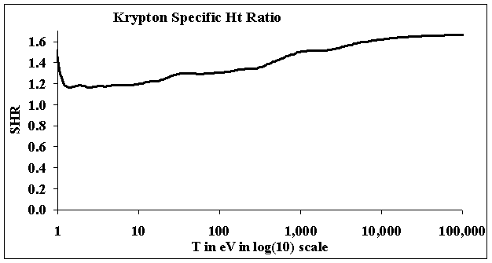

Slide 27
Kr- Properties as functions of pressure

Slide 28
Kr- Compression versus P₀

Slide 29
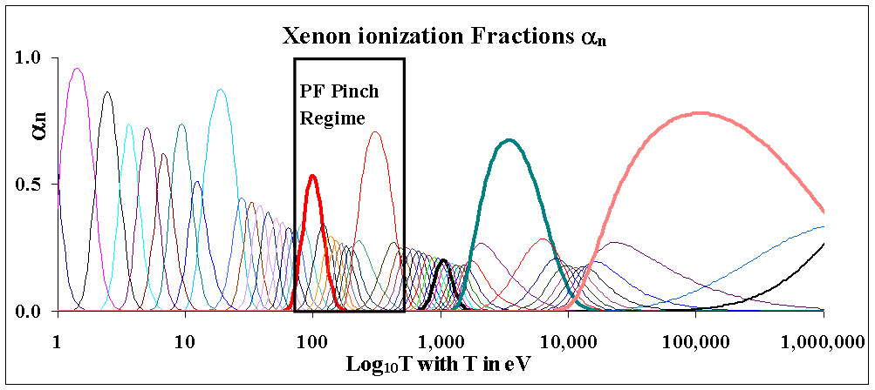
Xe freely ionizing SHR 1.3-1.4 f ~5-7 ; radiation is line, radiation power is overwhelming compared to dynamic and joule heating power
Xe: ionization versus temperature- showing pinch regime. Fifty-five traces represent 0, 1st and 2nd … 54th ionization fractions from left to right as temperature increases

Slide 30
Xe- Properties as functions of pressure

Slide 31
Kr- Compression versus P₀
Computed pinch radius ratio in NX2 operating in krypton, showing thermodynamically enhanced regime and radiative - collapse regime

Slide 32
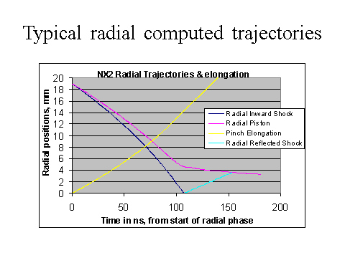
Experimental results: Measured radial dynamics on INTI PF at 12 kV, 0.5 Torr Kr (using fitted current technique)

Slide 33
Measured using current fitting technique

Slide 34
HED states in PF Pinch
Magnified: circuit current is replaced by pinch current, normalized by 102 kA, the P_{line} is normalized by 3.7 × 10¹² W; radius ratio k_{p}=r_{p}/a is multiplied by 20.. The pinch compresses to a radius of 0.0013 cm corresponding to a radius ratio (pinch radius normalized to anode radius) of 0.0014.
The radiative collapse is ended when plasma self-absorption attenuates the intense line radiation. The rebound of the pinch radius is also evident in Fig 3. The line radiation power leaving the plasma is also plotted (in normalized unit) to show its correlation to the trajectory in order to show the effect of the radiation on the compression.
This intense compression, reaches 3.7 × 10²⁶ ions m⁻³, which is 15 times atmospheric density (starting from less than 1/1000 of an atmospheric pressure).
The energy pumped into the pinch is 11% of stored capacitor energy being 250 J, whilst 41 J are radiated away in several ns, most of the radiation occurring in a tremendous burst of 50 ps at peak compression with a peak radiation power of almost 4 x10¹² W.
The energy density at peak compression is 4 x 10¹³ J m⁻³ or 40 kJ mm⁻³. Thus even in this small PF intense HED is achieved with immense radiation power.

Slide 35
Conclusions
In the dynamics of compression, thermodynamics is the main effect for D and He, very little effect from radiative collapse at typical PF temperatures
Neon is the transitional gas with both effects apparent
Ar: over most of its pressure range of operation, radiative collapse dominate
Kr and Xe: Radiative collapse pre-dominant
Future direction

Slide 36
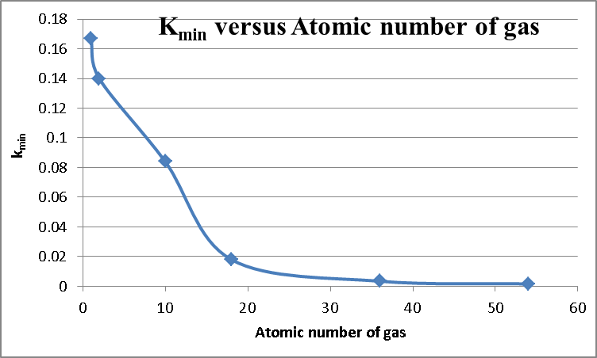
Scaling law for kmin
D | 1 | 0.167
He | 2 | 0.14
Ne | 10 | 0.084
Ar | 18 | 0.018
Kr | 36 | 0.0034
Xe | 54 | 0.0016

Slide 37

SHR including ionisation energies
in this expression ar is the rth ionisation fraction, U_{r} and U_{er} are the ionization and excitation energies per rth-ionised ion of mass m; R₀ is the Universal gas constant SI units and M is the molecular weight; D is the departure coefficient being the number of particles per original atom

Slide 38

Generalised SHR include thermodynamics and radiation
F = 8(π(γ-1)/μγ)²(r_{p}/z_{f})²(1/f_{c}²I⁴).

Slide 39
Generalised SHR include thermodynamics and radiation
Such a generalised treatment may be of use for standardising calculations; with a value of the generalised SHR reflecting both the thermodynamic as well as radiation energy content.

