Slide 1
From Beam-target to Thermonuclear Fusion in the Dense Plasma Focus Pinch: Energy throughput scaling
^{1,2,3,4}S Lee, ^{2,3}S H Saw
¹Physics Department, University of Malaya, 50603 Kuala Lumpur, Malaysia
²Institute for Plasma Focus Studies, 32 Oakpark Drive, Chadstone VIC3148, Australia
³Nilai University, 71800 Nilai, Malaysia
⁴INTI International University, 71800 Nilai, Malaysia

Slide 2
Outline of talk:
I: Background concepts:
Electromagnetic drive, MRN and typical speeds, Speed factor S.
Mach >> 1 driven plasmas, temperature vs speed
Cross-sections for nuclear fusion: beam-target and thermonuclear

Slide 3
Outline of talk:
II: DPF Fusion: Beam-target predominance: why? - Throughput scaling
Inductive voltages generate tens of keV, driving beam ions to 100 keV energy – optimum fusion x-section
Shock speed generates < 0.5 keV kinetic temperature; fusion x-section 10⁻¹³ times below optimum – negligibly small
Hence Beam-target fusion mode predominates
Throughput (Output/Input) Scaling to break-even Q =1
Breakeven point found through numerical experiments
Note: Discuss Gross PF pinch (scalable), NOT hot spots

Slide 4
Outline of talk:
III: Transitioning to thermonuclear mode
How?
Optimum conditions for neutron yield in thermonuclear mode
Throughput (Output/Input) Scaling to break-even Q =1
Breakeven point found through numerical experiments

Slide 5
Outline of talk:
IV: Comparison:
Beam-target (DPFQ1) breakeven point versus Thermonuclear breakeven point
Proposing a feasible test point DPF0.01
Conclusions

Slide 6
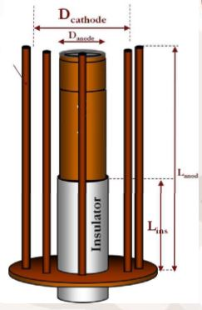
Some introductory slides:
DPF electrodes – (from Ali Abdou)

Slide 7
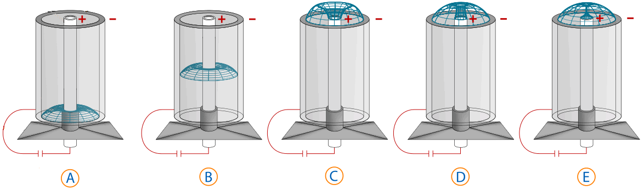
DPF dynamics – axial phase, radial phase – from internet

Slide 8
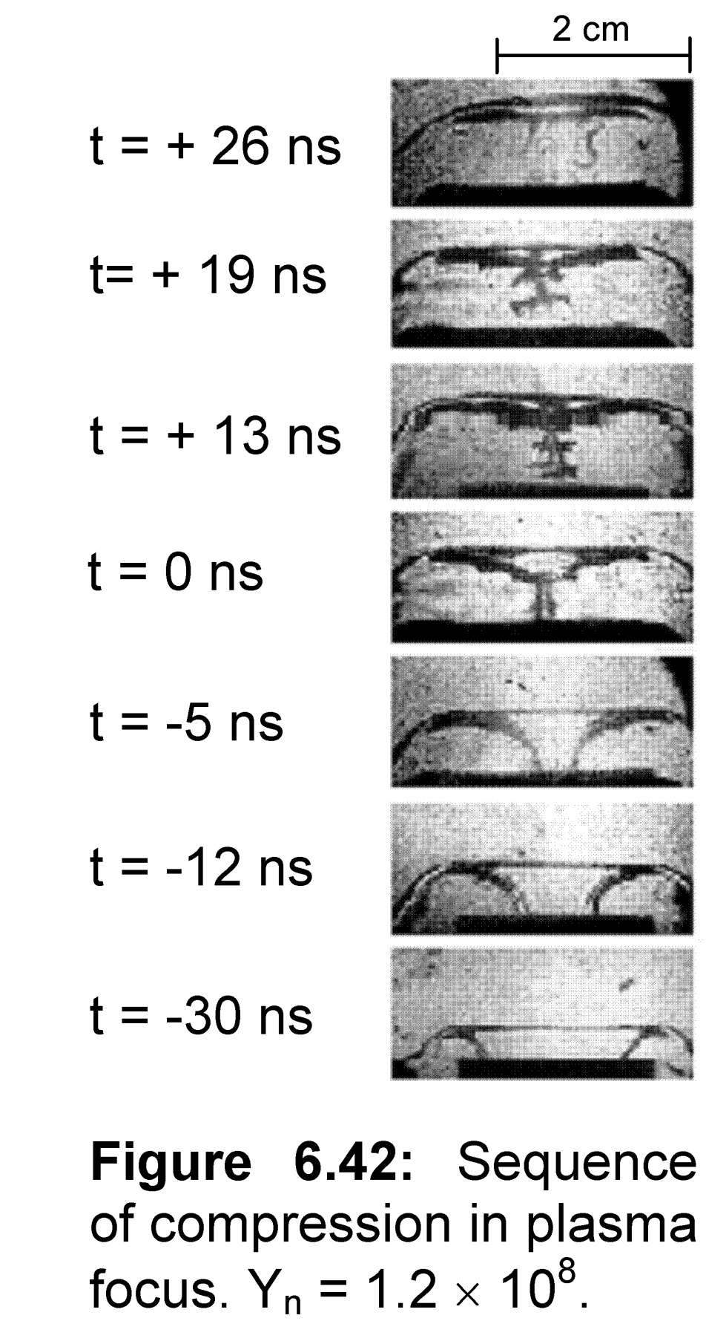
Radial dynamics – confirmed by our ns Shadowgraphs –
(from M Shahid Rafique, PhD thesis, NTU, Singapore [1])

Slide 9
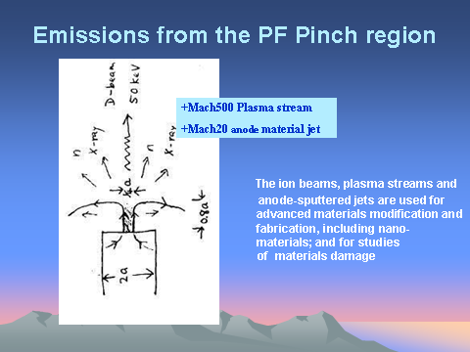
Among radiations from DPF pinch are the fusion neutrons- 50%-50% D-T has the best cross-section for nuclear fusion; producing 14.1 MeV neutrons

Slide 10
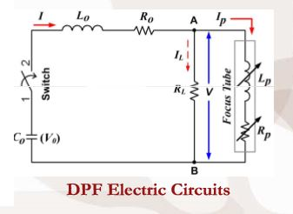
DPF circuit representation

Slide 11
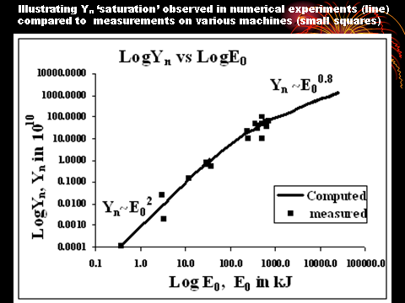
Initial hope: Y_{n} ~ E₀² [2],suggesting breakeven at hundreds MJ .
However dominance of dynamic resistance for very large capacitor banks causes current- scaling deterioration [3], leading to yield- scaling deterioration to Y_{n} ~ E₀^{0.8}– suggests no break-even unless capacitor voltages are greatly increased [4] aided by increase in pressure [4].

Slide 12
I: Some background concepts for DPF:
1. Electromagnetic drive:
Interaction of electric current and magnetic field (JXB) produces high plasma speeds and temperature. Electromagnetic drive is efficient when the magnetic Reynolds number M_{RN} is high.

Slide 13
2. Magnetic Reynold’s number M_{RN} and speed factor S:
For electromagnetic em drive to be efficient, the condition is that M_{RN} >>1.
For high Mach shock waves we have shown [5]
M_{RN} ~ v⁴; with transition point around 5 cm/μs for D-T plasma.
M_{RN} >>1 is fulfilled in the DPF because plasma speeds are highly supersonic.
For electromagnetic drive, the speed is governed by a fundamental factor S= (I/a) / ρ^{0.5}

Slide 14
Over whole range of existing DPF’s (sub kJ to MJ)
S ~ 70 – 200, practically constant [6]
S= (I/a) / ρ^{0.5}
Value of S: typically 100 (kA/cm) Torr^{0.5}
(I/a) : Typically 200 kA/cm
Operational pressure: Typically 4 Torr (~ 0.01 atm)

Slide 15
3. High Mach (Mach >> 1) shock waves:
A convenient unit of speed for electromagnetically driven systems is cm/μs. (1 cm/μs = 10⁴ m/μs ~ Mach 10 in D-T).
In DPF’s, speeds are typically 10 cm/μs and higher. Thus DPF plasma drives are characterized by Mach > 100 supersonic shock waves.
Shock wave systems are equi-partitioned with approximately equal amounts of energy in the thermal modes and the kinetic components.
The shock conservation equations enable the plasma temperature T to be computed [6a] from the shock speed v.
For a 50%-50% D-T shock system:
T = 2.8x10⁻⁵v²

Slide 16
4. Cross-sections for D-T nuclear fusion : applicable to Beam- (plasma) target:
10 keV σ is 10¹³ higher
than σ at 1 keV.
10 keV to peak σ at ~ 100 keV, another increase of 10³.
Optimum σ occurs at ~100 keV.
Higher beam energy σ drops.
1 MeV σ has dropped almost 100x
[7] S Glasstone and R H Lovberg, Controlled Thermonuclear Reactions. D Van Nostrand Company, New Jersey (1960)
[8] J.D.Huba. 2006 Plasma Formulary pg44 Http://wwwppd.nrl.navy.mil/nrlformulary/NRL_FORMULARY_07.pdf]

Slide 17
5. Cross-sections for nuclear fusion: Thermonuclear:
Relevant cross-section is the <σv> ie product of cross-section and particle speed v averaged over Maxwellian distribution
From 0.1 to 1 keV <σv> increases 10⁹.
From 1 to 10 keV <σv> increases 10⁴.
From 10 keV, the <σv> increases <10
to its peak value at 70 keV.
From <σv> point of view, good
operational point is around 70 keV
[7] [8]

Slide 18
II: Present-generation DPF (sub kJ to MJ) operate predominantly in beam-target mode: why?
All present DPF’s (sub kJ to MJ) operate with same speed: axial around 10 cm/μs and radial around 20 cm/μs [6].
This gives a temperature in D-T of ~ 0.3 x 10⁶ K for the axial phase plasma and ~ 1.2 x 10⁶ for the radial phase on axis shock; to about 2.4 million K in the stagnated plasma column on shock reflection on-axis.
The gross pinch temperature is typically < 0.5 keV (1 keV = 1.14 x 10⁷ K) – very low temperature from fusion point of view.
Resulting from highly supersonic piston action, inductive voltages (back EMF motor effect, if we recall) typically 20 – 40 kV are generated, producing 60 – 120 keV ions. These energies are near optimum from fusion point of view.
Thermonuclear yield: low; Beam – target yield: high
Advantage: low investment in plasma energy vs optimum beam energy

Slide 19
B-t fusion scaling: output fusion energy to input energy.
We ask the question: How much D-T fusion energy (from beam-target) do we get per unit energy needed to drive the DPF?
We first ask the question: How many D-T neutrons (from beam-target) do we get per unit pinch energy.

Slide 20
Modelling by the Lee code provides the number of beam-target neutrons [9-11] as follows:
Y_{b-t}= C_{n} n_{i} I_{pinch}²z_{p}²(ln(b/r_{p}))[σ/V_{max}^{1/2}]
pinch radius r_{p}, pinch length z_{p}, pinch ion density n_{i} driven by pinch current I_{pinch} ; with beam ion energy V_{max} and corresponding beam-target fusion cross-section σ.
Here all quantities are in SI units with V_{max} in keV and the constant C_{n} = 1.4 x 10⁷ (calibrated)

Slide 21
The pinch energy [12] at temperature T is
E_{pinch}= [kT/ (γ-1)] n_{i}(1+Z_{eff}) πr_{p}²z_{p}
k = Boltzmann constant, γ = specific heat ratio = 5/3 and Z_{eff} =1 (for fully ionized D-T plasma).
Assume an equilibrium pinch, equate the confining magnetic pressure to the hydrostatic plasma pressure. Thus:
I_{pinch}² = 2πx10⁷ n_{i}kT(1+Z_{eff})r_{p}²

Slide 22
Divide Y_{b-t} by E_{pinch}, replacing I_{pinch}² in Y_{b-t} by the RHS of Eq (4) we get the required number of beam-target neutrons per unit pinch energy.
Note: ((ln(b/r_{p})) ~ 2 and z_{p} ~ 1.4 a ([6] for fully ionized hollow anode DPF)
General scaling for number of D-T DPF beam-target neutrons
Y_{b-t} / E_{pinch} = 5 x 10¹⁴ n_{i} a [σ/V_{max}^{1/2}]
This general scaling stipulates that the number of beam-target neutrons depends on the pinch ion density, the anode radius ‘a’ and the energy of the D-T beam ions through the fraction [σ/V_{max}^{1/2}].

Slide 23
Optimising beam – target scaling by choosing optimum beam energy through factor [σ/V_{max}^{1/2}]
Optimum value of [σ/V_{max}^{1/2}] occurs at V_{max} = 115 keV with value 5 x 10⁻²⁹ m².
Note: broad flat maximum, in range of beam ion energy 90 – 120 keV

Slide 24
Operate the DPF at optimum deuteron beam energy around 100 keV then the scaling for Y_{b-t} / E_{pinch} is optimized:
(Y_{b-t} / E_{pinch})_{100keV} = 2.5 x 10⁻¹⁴ n_{i} a
A D-T neutron has energy of 14.1 MeV ie 2.26 x 10 ⁻¹² J ; also estimating that E_{pinch} ~10% of the stored energy E₀, then we have the ratio
Q_{100keV} = (E_{b-t} / E₀)_{100keV} = 6 x 10⁻²⁷ n_{i} a

Slide 25
Better than break- even
for Q > 1
6 x 10⁻²⁷ n_{i} a > 1
Example: ‘a’= 1 m then for Q>1
n_{i} > 1.7 x 10²⁶ m⁻³ (100 keV)
(ie 6 atm of fill pressure is sufficient for break-even).

Slide 26
Numerical experiments - disagree
In fact thousands of runs have been made using the Lee code [9,11] in DPF’s of meter-size anode radius at beam-target conditions (following present generation DPF’s with axial speed around 10 cm/μs) – over years!
Nothing approaching anywhere near break-even has been observed at such DPF sizes and densities; and even bigger sizes and densities!

Slide 27

Discrepancy- is due to condition of 100 keV beam ion energy, which is not met
V = V1 + V2
V = V1 + V21 V22
 | Tube | dI/dt*position | speed*I |  |  | Effective
 | Voltage kV | term | term | dz/dt term | drp/dt term | Beam ion
 | V | V1 | V2 | V21 | V22 | Energy keV
NX2 15kV | 25.1 | -10.6 | 35.7 | 17.1 | 18.6 | 75
PF1000 27kV | 25.7 | -29.8 | 55.5 | 29.1 | 26.4 | 77
PF1000 27kV RESF=0.1 | 57.4 | -65.6 | 123 | 62.9 | 59.7 | 172
25MJ 35kV | 62 | -285 | 347 | 185 | 162 | 186
162MJ 90kV | 106 | -484 | 590 | 308 | 282 | 318
16200MJ 900kV | 1460 | -6121 | 7580 | 3970 | 3610 | 4380

Slide 28
Scaled up DPF requires 500 MA. The dynamic impedance of 2mΩ requires bank voltage of 1 MV; Thus induced beam ion energy ~ 5 MeV
For b-t DPF’s the values of speeds are kept at low levels of 10 cm/μs for axial and 20 cm/μs for the radial phases. The speed factor
S = (I/a)/ ρ₀^{1/2} needs to be kept at around 100. Thus as ‘a’ increases, I increases proportionally; so with (I/a) = 200 kA per cm anode radius, we need 20 MA for 1 m anode radius. The increase in operational pressure to atm will require a further increase of current to around 500 MA.
Thus the scaled-up m-sized DPF will have induced voltages increased to multiple MV; way past optimum [σ/V_{max}^{1/2}]. Indeed at 10 MeV this cross-section parameter has dropped by 1000 times from optimum value.
These estimates provide a guide for numerical experiments for a scaled-up DPF, to obtain an operational point for a B-T device; although we know the beam ions will be far too energetic.

Slide 29
Beam-target numerical experiment
(1.2 MV, 5 atm) generating Q = 0.002
Lo | Co | b | a | zo | ro mOhm
20 | 10000 | 120 | 100 | 60 | 0.15
massf | currf | massfr | currfr | Model Parameters
0.08 | 0.7 | 0.2 | 0.7
Vo | Po | MW | A | At-1 mol-2 | Operational
1200 | 4000 | 5 | 1 | 2 | Parameters
E₀ | RESF | c=b/a | I_{peak} | T_{p} | v_{a} | v_{s} | v_{p} | r_{min} | z_{max} | pinch τ | V_{max} | n_{i} pinch
kJ |  |  | kA | 10^6 K | cm/μs | cm/μs | cm/μs | cm | cm | ns | kV | 10²³/m³
7.20E+06 | 0.11 | 1.20 | 3.5E+05 | 0.11 | 8.3 | 8.5 | 6.8 | 30.0 | 161.7 | 6527 | 1,337 | 1051
Y_{n} | EINP | SF | ID
10¹⁰ | % |  | kA/cm | E_{N} kJ | E_{N}/E₀ | Y_{th} | Y_{b-t} | Y_{n}
6.1E+08 | 43.4 | 55 | 3476 | 1.4E+04 | 0.002 | 5.0E-12 | 6.1E+18 | 6.1E+18
Beam ion energy 4 MeV; number of ions in beam = 1.3 x 10²²
[σ/V_{max}^{0.5}] is down from optimum value by almost 1000 times

Slide 30
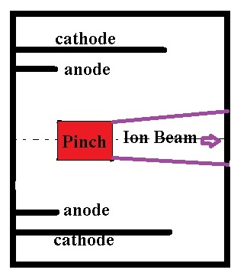
SIRIM estimates by M Akel [13] indicate 1 m path in 5 atm
D-T sufficient to slow Deuteron- Triton Beam to 100 keV.
In schematic shown below the ion beam will be moderated to 100 keV in its path (> 1m) before leaving the chamber.
In this schematic Q>1 enhancing the Lee Code calculation of Q = 0.002.

Slide 31
Discharge current waveform and radial trajectories of 1.2 MV, 5 atm, a = 1m; D-T DPF

Slide 32
III: Transitioning to thermonuclear mode
To operate the DPF pinch at thermonuclear conditions for D-T the pinch temperature needs to be increased from the sub-keV of present-day DPF’s to ~70 keV
at which the optimum thermalized cross-section <σv> for D-T fusion occurs.
This requires faster plasma speeds than presently used.
How fast?

Slide 33
III: Transitioning to thermonuclear mode - how?
How to get to such high temperature?
The primary mechanism in the DPF is the electromagnetic drive generating high plasma speeds. Thermonuclear regime is 50 times hotter; requires shock speed 7 times higher.
Radial shock speed needs to increase to 150 cm/μs.
Speed factor S needs to increase to 1000 (from present day 100)
Density is ~1000x higher. (as will be seen)
Hence current per unit anode radius need to increase to 60 MA/cm (from present-day 200 kA/cm) !!

Slide 34
Thermonuclear scaling: derive the ratio: Y_{th} / E_{pinch} at thermonuclear pinch conditions.
Y_{th} = 0.5 n_{i}² πr_{p}²z_{f} <σv> τ
where <σv> is the thermalised fusion cross section-velocity product corresponding to the plasma temperature [149], for the lifetime of the pinch τ.
Dividing this number by E_{pinch}:
Y_{th} / E_{pinch} = 0.17 <σv> /(kT)] n_{i} τ number of D-T neutrons per J of pinch energy.

Slide 35
General scaling of Q as function of n_{i}τ at pinch temperature T
E_{th}/E₀ = 240[<σv>/kT] n_{i} τ
where kT is in keV. Here estimate E_{pinch} = 0.1 E₀ and energy of 1 D-T neutron as 14.1 x 10³ keV.
Note the Q value is a function of (n_{i} τ)
and the fusion x-section parameter [<σv>/kT]

Slide 36
Optimum [<σv>/kT]

Slide 37
Selecting optimum operational temperature
From [<σv>/kT] curve, optimum occurs at T = 20 keV with value = 2.1 x 10⁻²³ m³s⁻¹(keV)⁻¹.
Such a concept was expressed in seminal form by Lawson who selected 25 keV
[14. https://en.wikipedia.org/wiki/Lawson_criterion]
[15.Lawson, J. D. (December 1955). Some Criteria for a Power producing thermonuclear reactor (PDF) (Technical report). Atomic Energy Research Establishment, Harwell, Berkshire, U. K.]

Slide 38
Scaling of Q as function of n_{i} τ at optimum temperature of 20 keV
E_{th}/E₀ = 5x 10⁻²¹ n_{i} τ
Fixing operation at this optimum temperature, the requirement for better than break-even ie E_{th}/E₀ >1 is
n_{i} τ > 2 x 10²⁰ m⁻³s 20 keV
This criterion applied specifically to the DPF is comparable to the well-known Lawson’s n_{i} τ criterion (n_{i} τ > 1.5 x 10²⁰). [14]

Slide 39
Example
For present-day DPF operating at T ~ 0.5 keV pinch duration is ~10-20 ns per cm ‘a’, governed by transit time of small disturbance speed across the pinch diameter.
At 20 keV the lifetime is around 2 ns per cm ‘a’.
For a = 1 m the lifetime τ is 200 ns.
For Q > 1, the requirement is n_{i} > 10²⁷; close to 50 atm
These estimates provide guidance for numerical experiments to find an operational point for Q>1.

Slide 40
Numerical experiments found an operational thermonuclear point for Q>1
L₀ | C₀ | b | a | z₀ | r₀ mΩ
18 | 7,000 | 160 | 155 | 13,500 | 0.1
massf | currf | massfr | currfr | Model Parameters
0.1 | 0.7 | 0.4 | 0.8
V₀ | P₀ | MW | A | At-1 mol-2 | Operational
800,000 | 55,000 | 5 | 1 | 2 | Parameters
E₀ | RESF | c=b/a | I_{peak} | T_{p} | v_{a} | v_{s} | v_{p} | r_{min} | z_{max} | pinch τ | V_{max} | n_{i} pinch
kJ |  |  | kA | 10^6 K | cm/μs | cm/μs | cm/μs | cm | cm | ns | kV | 10²³/m³
2.24E+12 | 0.062 | 1.032 | 6.2E+07 | 267 | 242 | 257 | 205 | 30.2 | 258.3 | 250.3 | 1.2E+07 | 6.8E+04
Y_{n} | EINP | SF | ID
 | % |  | kA/cm | E_{N} kJ | E_{N}/E₀ | Y_{th} | Y_{b-t} | Y_{n}
1.1E+27 | 45.7 | 1,719 | 4.0E+05 | 2.4E+12 | 1.09 | 1.1E+27 | 2.9E+22 | 1.1E+27
Number beam ions 1.7 x 10²⁴ number of ions in radial phase original space = 1.5 x 10²⁸

Slide 41
Numerical experiment with our standard code
The code found the following possible point of operation:
Capacitor bank, 7,000 μF, 800 MV;
DPF operating pressure: 70 atm. Anode is 13.5 m long, a= 1.55 m.
The annular channel for axial phase is 5 cm with c = b/a = 1.03. Such a small channel and radius ratio is necessary to reduce the dynamic impedance of the high shock speed; otherwise the necessary high value of current will require even higher operating voltage.
The pinch temperature is 23 keV; pinch ion density is 7 x 10²⁷ m⁻³, estimated duration of 250 ns.
Thus the nτ is 18 x 10²⁰. The D-T neutrons are thermonuclear (99.99%)
Yield of 1.1 x 10²⁷ carrying energy of 2.4x10¹⁵ J compared to a capacitor bank stored energy of 2.2 x10¹⁵ J,
Q almost 1.1.
The current waveform and radial dynamics and temperature profiles are shown in the following figures.

Slide 42
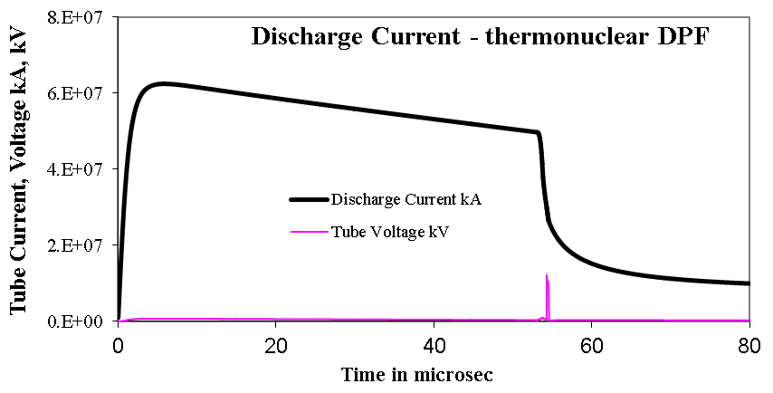
Thermonuclear DPF- current waveform

Slide 43
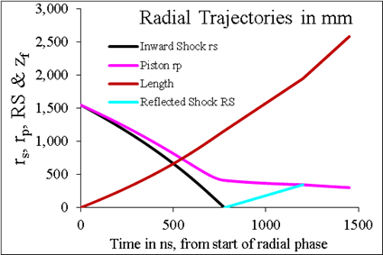
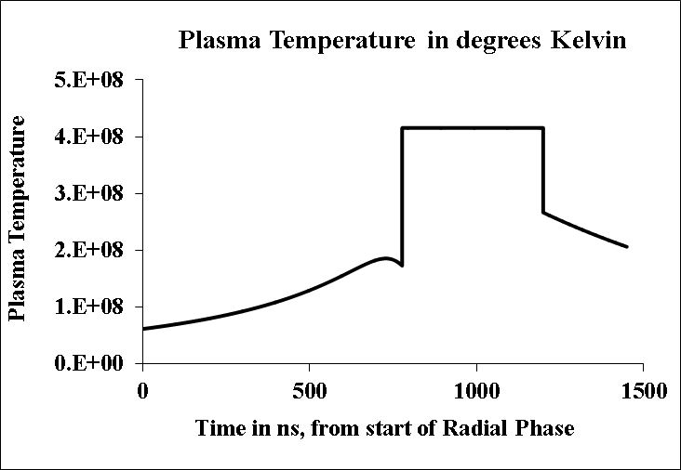
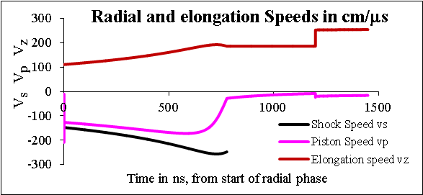
Thermonuclear DPF - Radial Dynamics and Temperature

Slide 44

IV: Summary: B-T vs Thermonuclear
D-T | E₀ | V₀ | P₀ | a | T | U | Y_{n} | Q | Effective Q
 | GJ | MV | Atm | m | keV | keV | At pinch |  | Ion path beyond pinch
B-T (DPFQ1) | 7.2 | 1.2 | 5.3 | 1 | 0.1 | 4.0E+03 | 6.0E+18 | 0.002 | ~1
Thermo-nuclear | 2.2E+06 | 800 | 72.3 | 1.6 | 23 | 1.2E+07 | 1.1E+27 | 1.1
The B-T shot has 1.3 x 10²² ions in the beam (unreacted as computed by the code). These 5 MeV D-T ions will undergo fusion reactions within the high pressure D-T gas to raise the value of Q to greater than 1.

Slide 45
Comparison: B-T vs Thermonuclear
The B-T point (DPFQ1) much less extreme; though still technically far away

Slide 46
DPFQ1 – technically too difficult
A technically feasible device could be attempted first – DPF0.01

Slide 47
Proposed B-t trial point – DPF0.01- technically feasible – to reach Q~0.01
Lo nH | Co μF | b cm | a cm | zo cm | ro mΩ
30 | 20 | 18 | 15 | 3 | 3
massf | currf | massfr | currfr
0.08 | 0.7 | 0.2 | 0.7
Vo kV | Po Torr | MW | A | At-1 mol-2
900 | 100 | 5 | 1 | 2
Note on High pressure DPF operation: ICDMP in its recent (September 2017) meeting has discussed plans to look at experimental feasibility of the concept of high pressure optimized operation of DPF

Slide 48

Numerical experiments- DPF0.01
Eo | RESF | c=b/a | I_{peak} | T_{p} | v_{a} | v_{s} | v_{p} | r_{min} | z_{max} | pinch τ | V_{max} | n_{i} pinch
kJ |  |  | kA | 10^6 | cm/μs | cm/μs | cm/μs | cm | cm | ns | kV | 10²³/m³
8.10E+03 | 0.08 | 1.20 | 1.8E+04 | 2.3 | 11.9 | 27.3 | 18.1 | 4.1 | 23.9 | 282 | 746 | 31.5
Y_{n} | EINP | SF | ID |  |  |  |  |  | N_{ion} in beam
 | % |  | kA/cm | E_{N} kJ | E_{N}/E₀ | Y_{th} | Y_{b-t} | Yn
6.6E+13 | 36.1 | 0.5 | 117 | 0.15 | 2E-05 | 4.5E+06 | 6.6E+13 | 6.6E+13 | 8.4E+18
Beam ion energy is 2.5 MeV, beyond optimum 100 keV
BS = reduce ion beam divergence, using pulsed magnetic field.
1 m long Target tube is filled with 10 atm D-T gas to interact with remnant ion beam, increase yield ~ 500x to reach Q~0.01 .
Molybdenum foil partition
[16.] hossein sadeghi, Reza Amrollahi et al , “High Efficiency Focus Neutron Generator” Plasma Phys Contr Fusion online 12 September 2017 • © 2017 IOP Publishing Ltd

Slide 49
Conclusion
Beam-target scaling at optimum beam ion energy of 100 keV suggests 1.2 MV 5 atm D-T DPF would suffice for breakeven at stored capacitor energy of 7 GJ. (DPFQ1)
For comparison scaling of thermonuclear DPF is obtained, guiding numerical experiments to operational point of 800 MV 70 atm, 23 keV [achieving Q = 1.2 at stored energy of 2 million GJ.]
Comparison of the two possible operational points shows that the Beam-target Q~1 point is 700 times lower in operational voltage, 300,000 times lower in capacitor energy, 14 times lower in operational pressure than the thermonuclear Q ~ 1 operational point.
The Beam-target operational point (DPFQ1) is much closer to present-day DPF in every operational parameter than the thermonuclear breakeven point.
A present-day technologically feasible point: DPF0.01: 900 kV (8 MJ) 100 Torr with Q ~ 0.01 is proposed for initial test- (incorporates a fusion booster 10 atm D-T target tube).
This presentation deals with gross DPF pinch (scalable); have not discussed structures within the pinch (such as hot spots) which could modify gross scaling.

Slide 50
References
1. Muhammad Shahid Rafique. Compression Dynamics and Radiation Emission from a Deuterium Plasma Focus. PhD Thesis (2000) NTU, Singapore
2. A. Bernard, H. Bruzzone, P. Choi, H. Chuaqui, V. Gribkov, J. Herrera, K. Hirano, A. Krejei, S. Lee, C. Luo, F. Mezzetti, M. Sadowski, H. Schmidt, K. Ware, C. S. Wong, and V. Zoita, “Scientific status of plasma focus research,” J. Moscow Phys. Soc., vol. 8, no. 2, pp. 93–170, 1998
3. S. Lee, "Neutron yield in plasma focus: A fundamental cause," Applied Physics Letters, vol. 95, no. 151503, 2009.
4. S. Lee, "Current and neutron scaling for megajoule plasma focus machines," Plasma Physics and Controlled Fusion, vol. 50, no. 10, p. 105005, 2008
5. S. Lee, S.H. Saw, Abdelmagid A. Elfetouri, A.M. Shengher, E.O. Shummaki and N.A. Hassan. Magnetic Reynolds Number and Current Sheath Structure. J. Fiz. Mal, Malaysia (1991), 12: 25-29.
6. S.Lee & A.Serban. Dimensions & Lifetime of Plasma Focus Pinch. IEEE Trans Plasma Science. USA (1996) 24, 1101-1105.
6a. S Lee and S H Saw. Course on Plasma Focus Numerical Experiments Manual 200 pages . Joint ICTP-IAEA Workshop on Dense Magnetized Plasmas and Plasma Diagnostics, 15-26 November 2010, Trieste, Italy- Course on Plasma Focus Numerical Experiments Manual 200 pages http://indico.ictp.it/event/a09172/session/46/contribution/28/material/1/0.pdf
7. S Glasstone and R H Lovberg, Controlled Thermonuclear Reactions. D Van Nostrand Company, New Jersey (1960)
8. J.D.Huba. 2006 Plasma Formulary pg44 Http://wwwppd.nrl.navy.mil/nrlformulary/NRL_FORMULARY_07.pdf]9. Lee S. Radiative Dense 9. Plasma Focus Computation Package: RADPF. http://www.plasmafocus.net/IPFS/modelpackage/File1RADPF.htm
10. S. Lee and S. H. Saw, "Pinch current limitation effect in plasma focus," Applied Physics Letters, vol. 92, no. 2, p. 021503, 2008
11. S. Lee, "Plasma Focus Radiative Model: Review of the Lee Model Code," Journal of Fusion Energy, vol. 33, no. 4, pp. 319-335, 2014
S Lee, S H Saw, M Akel, H-J Kunze, P Kubes, and M Paduch. Conditions for Radiative Cooling and Collapse in Plasma Focus illustrated with Numerical Experiments on the PF1000. IEEE Trans Plasma Sci. Volume: 44 (2) , 165 – 173 (2016) DOI: 10.1109/TPS.2015.2497269
M Akel, private correspondence, October 2017
14. https://en.wikipedia.org/wiki/Lawson_criterion
15 Lawson, J. D. (December 1955). Some Criteria for a Power producing thermonuclear reactor (PDF) (Technical report). Atomic Energy Research Establishment, Harwell, Berkshire, U. K.
16. hossein sadeghi, Reza Amrollahi et al , “High Efficiency Focus Neutron Generator” Plasma Phys Contr Fusion online 12 September 2017 • © 2017 IOP Publishing Ltd

