Slide 1


The current-voltage characteristics of the plasma focus – a deeper look
S H Saw & S Lee
Nilai University, Malaysia
IPFS, Melbourne, Australia

Slide 2
Abstract
A capacitor bank discharges a sinusoidal current, lightly damped by unavoidable circuit resistance.
When powering a plasma focus PF, the current waveform is further damped by the axial motion typically during the rising part of the current.
The radial phase, with severe rate of change of inductance due to a rapidly collapsing current sheet to small radius, is so severely damped over a short period near the current peak that the waveform shows the signature current dip.
Corresponding to the inductively-caused current dip is a sharp voltage spike which rises to a peak value greater than the charging voltage.
These features are adequately described by circuit equations coupled to appropriate equations of motion.
The loading effect of different gases due to differences in mass, differences in compressibility and differences in radiation also produces differences in the current and voltage waveforms, particularly the current dip and voltage spike.
These differences could be subtle or dramatic, as are demonstrated in this paper.

Slide 3
Capacitor _{Bank} Discharge: into a short circuit
L-C-R circuit, all fixed values
With bank parameters L₀, C₀, r₀ charged to V₀ discharges with damped sinusoidal characteristics:
T=2π(L₀C₀)^{0.5}
I₀=V₀/(L₀/C₀)^{0.5}

Slide 4
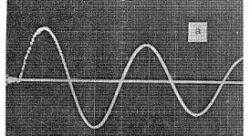
A MegaAmpere discharge current waveform- UM bank short-circuited at 20 kV - 1972

Slide 5
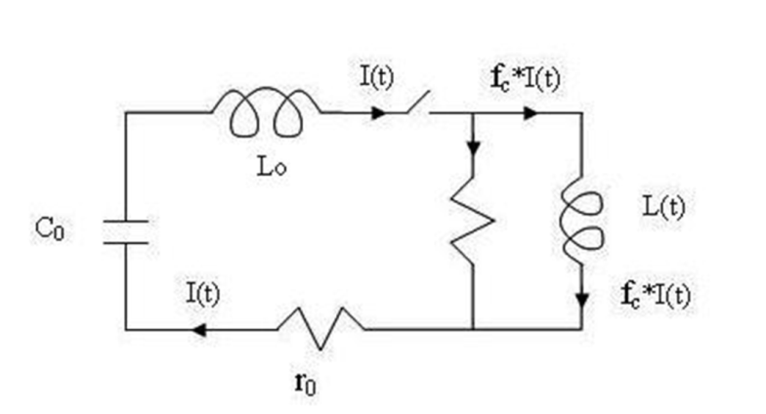
Capacitor bank discharged into DPF
L-C-R circuit with L(t)

Slide 6
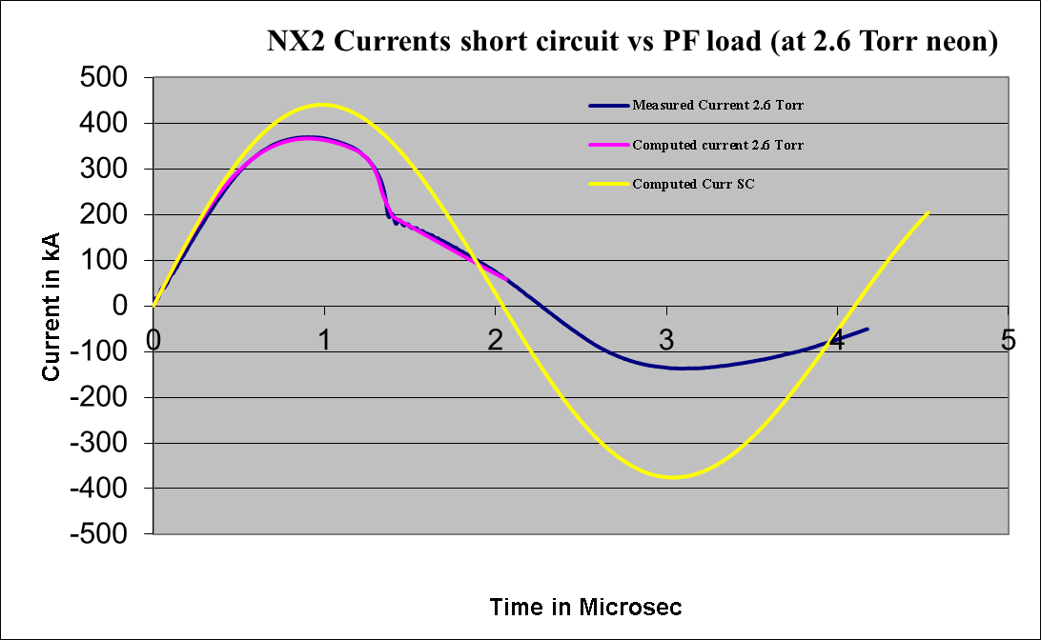
Capacitor bank no load (short-circuited) versus Capacitor bank into PF load.

Slide 7
Axial phase current and voltage:
(comments on the slide before this one)
Into a DPF load, the current maintains its mainly sinusoidal current, but now distorted.
The time scale is now increased (with distortion) and the peak current is decreased.
The effect of the axial phase dynamics is seen in comparing the short-circuited current trace and the measured (or computed) current trace from the start of current to around 1.1 μs.
The increased flattening and depression of the DPF current is due to the increasing inductance of the axial phase tube as the axial current sheet speeds towards the end of the coaxial tube. The reduced value of the peak current is due to the ‘motor’ back emf effect produced by the IdL/dt term of the tube voltage d(φ)/dt.

Slide 8

Axial phase rate of change of current:

Slide 9
Radial phase equation for dI/dt:
The radial phase experiences severe rate of change of inductance due to a rapidly collapsing current sheet to small radius.
The current is so severely damped over a short period near the current peak that the waveform goes into the sharp dip.

Slide 10

Axial phase tube voltage:
dL/dt is proportional to the axial speed dz/dt
Tube voltage V in the axial phase is primarily due the axial phase current sheet speed.
This primary component is moderated by the dI/dt term. This can be seen from the comparison of the axial phase voltage and the axial phase current sheet speed.
It can further be understood through the concept of the motor effect.
For example towards the end of the axial phase, the axial speed of the current sheet at a high nearly constant speed of 10 cm/us whereas dI/dt is almost zero.
Then the dominant term fcI dL/dt = fc (mu/2p)(lnc) I dz/dt ~ 5kV for the case of I=350 kA.

Slide 11
Comparing Tube voltage with axial position and axial speed, during axial phase

Slide 12

Radial phase equation for tube voltage:
(Showing the equation and labelling the components V₁, V₂ and further labelling the sub-components of V₂ as v₂₁ and V₂₂)
V = V₁ + V₂
V = V₁ + V₂₁ V₂₂

Slide 13
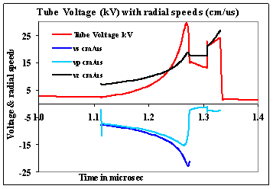
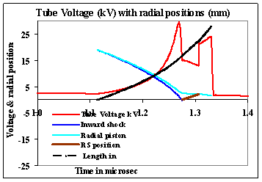
Showing the magnitudes of v_{s}, v_{p} (dr_{p}/dt) and v_{z} (dz_{f}/dt)

Slide 14
(commenting on the slides above)
The tube voltage at the time of the radial phase is induced by the second term in the tube voltage equation and ameliorated in reaction by the first term. This second term is the product of the current I and current sheet speed; with one component being the elongation speed and the other component being the radial speed multiplied by the factor z_{f}/r_{p}.

Slide 15
The tube voltage and dependence on the components V₁ and V₂
 | Tube | dI/dt*position | speed*I | (dz_{f}/dt)*I | (dr_{p}/dt)*I | Effective
 | Voltage kV | Term kV | Term V | Term kV | Term kV | Beam ion
 | V | V₁ | V₂ | V₂₁ | V₂₂ | Energy keV
NX2 15kV | 25.1 | -10.6 | 35.7 | 17.1 | 18.6 | 75
PF1000 27kV | 25.7 | -29.8 | 55.5 | 29.1 | 26.4 | 77
PF1000 27kV RESF=0.1 | 57.0 | -65.6 | 122.6 | 62.9 | 59.7 | 171
Note that the radial speed multiplier (z_{f}/r_{p}) becomes very large if the current sheet gets close to the axis, particularly in the case of radiatively enhanced pinches, when r_{p} can become even 0.01 of the typical r_{p}.

Slide 16
Effect of thermodynamics and radiation
The effects of thermodynamics and radiation are more easily discussed firstly in terms of the effects on the dynamics, which in turn affect the current and voltage traces, through the dynamics.
In a gas (plasma) which is being heated to high temperatures, the dissociation and ionisation adds to the degrees of freedom of the gas. This changes the compressibility of the plasma and affects the dynamics. This effect may be summed up by the specific heat ratio (SHR) g. The shock speed in our code is affected through the value of g in the following shock speed equation.

Slide 17

Radial shock speed equation
Thermodynamics is accounted for through the specific heat ratio γ in this equation

Slide 18

The effect of radiation is coupled into the pinch phase piston dynamics by the following equation:
where dQ/dt is the total power gain/loss of the plasma column. In the standard code, joule heating (adding a positive component to dQ/dt), bremsstrahlung, line and recombination radiation (adding negative components to dQ/dt) are incorporated into dQ/dt.

Slide 19
Radiation-coupled dynamics
By this coupling of radiation into the dynamics equation, if, for example, the radiation loss dQ/dt is severe, this would lead to a large value of dr_{p}/dt inwards. In the extreme case, this leads to radiation collapse [51], with r_{p} going rapidly to such small values that the plasma becomes opaque to the outgoing radiation, thus stopping the radiation loss.
This radiation collapse occurs at a critical current of 1.6 MA (the Pease-Braginski current) for deuterium [144, 145]. For gases such as Ne or Ar, because of intense line radiation, the critical current is reduced to even below 100 kA, depending on the plasma temperature [51, 146].

Slide 20
The effects of thermodynamics on the dynamics
The code is run with neon parameters except that the value of g is fixed at g=5/3 (as though neon plasma were a perfect gas through all its range of temperature during axial and radial phases) and effective charge z_{eff} of 0. Results are recorded. Under these conditions, radiation is negligible. (See trace 1; no thermodynamics and no radiation)
The code is run again with everything the same as the earlier step, except that the values of g and z_{eff} are calculated as they vary with temperature. For this step the code is modified so no radiation is emitted. (See trace 2; with thermodynamics but no radiation).
Finally the code is restored back to its standard form, with properly calculated values of g and radiation and also radiation absorption. (See trace 3; with thermodynamics and radiation).

Slide 21
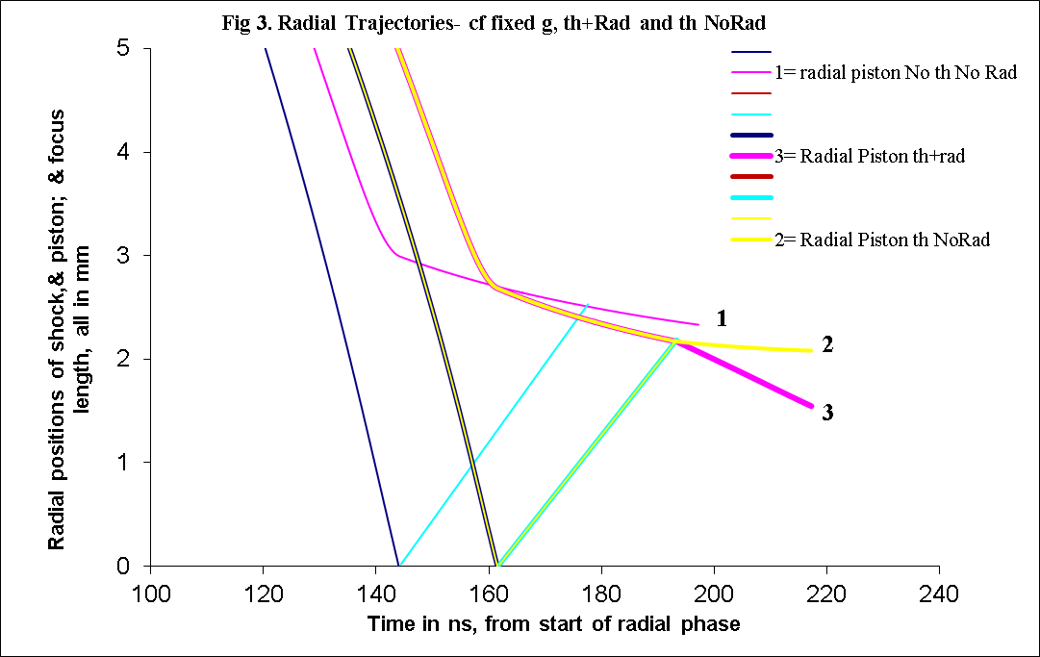
Results (Neon) show effects of thermodynamics and radiation
(traces 1= no thermodynamics ie treated as perfect gas;
2 = with thermodynamics, no radiation,
3 = actual ie with thermodynamics and radiation)
Effects of thermodynamics are subtle, effects of radiation are significant.

Slide 22
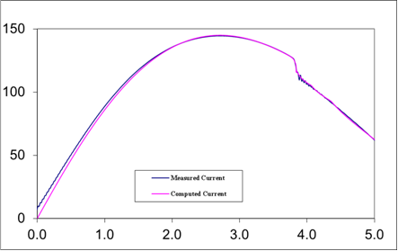
A more dramatic example: radiative collapse in Kr, measured in the INTI PF on the basis of a current measurement
Fig 1. Fitting the computed current trace to the measured current trace of INTI PF at 12 kV 0.5 Torr Kr (shot 631). (Note the two curves have a close fit. Without radiation, the current (not shown) has a much smaller dip.

Slide 23
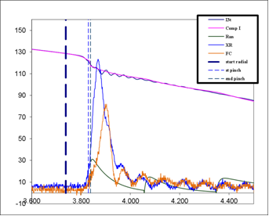
Expanding the current trace to show the region of the dip
Fig 1a Expanded view of the fitting

Slide 24
The fitting to the measured current waveform gives the radial trajectory revealing strong radiative collapse to very small radius
Having fitted the computed current trace to the measured current trace, the resulting radial trajectory indicates strong radiative collapse to very small radius, as shown in the following Figure. The radial trajectory hypothetically without radiation is also computed and shown for comparison.

Slide 25
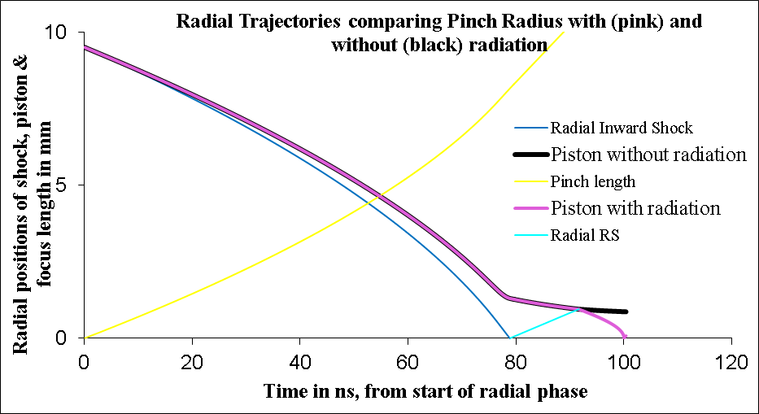
Comparing radial trajectory with radiation (purple) and (hypothetically) without radiation (black)

Slide 26
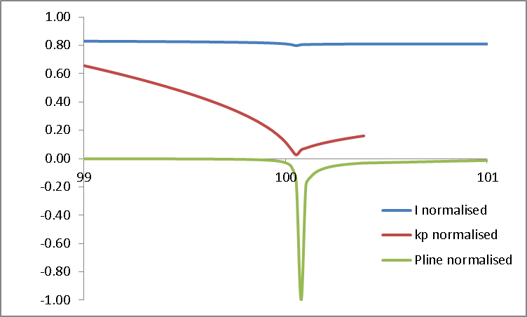
Expanding the time scale to show details of radiative collapse region

Slide 27
From a measured current waveform, the parameters of the radiative collapse are derived.
The peak compression region is magnified and shown in the above figure.
The current values are normalized by 145 kA, the P_{line} is normalized by 3.7x10¹² W and the radius ratio k_{p}=r_{p}/a is multiplied by 20.
The pinch compresses to a radius of 0.0013 cm corresponding to a radius ratio (pinch radius normalized to anode radius) of 0.0014. T
The radiative collapse is ended when plasma self-absorption attenuates the intense line radiation. The rebound of the pinch radius is also evident in Fig 3.
The line radiation leaving the plasma is also plotted (in normalized unit) to show its correlation to the trajectory in order to show the effect of the radiation on the compression.
This intense compression, despite the low mass swept in factor of f_{mr}= 0.11, reaches 3.7 x 10²⁶ ions m⁻³, which is 15 times atmospheric density (starting from less than 1/1000 of an atmospheric pressure).
The energy pumped into the pinch is 250 J whilst 41 J are radiated away in several ns, most of the radiation occurring in in a tremendous burst of 50 ps at peak compression with a peak radiation power of almost 4 x10¹² W.
The energy density at peak compression is 4 x 10¹³ J m⁻³ or 40 kJ mm⁻³.
Thus from a measured current waveform in this Kr discharge, the parameters of this intense HED is measured showing the high density achieved .

Slide 28
All this information from just one measured current waveform

Slide 29
Conclusion
A capacitor bank generates a damped sinusoidal current when discharged into a shorty-circuit.
When powering a plasma focus PF, the topping part of the current waveform is further damped and flattened by the axial motion of the current sheet.
The radial phase, with severe rate of change of inductance due to a rapidly collapsing current sheet, is severely damped over a short period near the current peak. The waveform shows the signature current dip.
Corresponding to the inductively-caused current dip is a sharp voltage spike which rises to a peak value greater than the charging voltage.
This paper discuss the details of these effects.
The subtle loading effect due to compressibility effects of non-perfect gas are also shown in a neon discharge, as are significant effects on the dynamics of radiation.
Finally from just a measured current waveform, the dramatic radiative collapse of the Kr pinch is demonstrated. The parameters of the High Energy Density (HED) state are deduced and presented, demonstrating a density compression of 15,000 times caused by a 4TW burst of radiation .

Slide 30
References
[1] S Lee and S H Saw. Course on Plasma Focus Numerical Experiments Manual 200 pages . Joint ICTP-IAEA Workshop on Dense Magnetized Plasmas and Plasma Diagnostics, 15-26 November 2010, Trieste, Italy- Course on Plasma Focus Numerical Experiments Manual 200 pages. Pg24 http://indico.ictp.it/event/a09172/session/46/contribution/28/material/1/0.pdf
[2] S. Lee, "Plasma Focus Radiative Model: Review of the Lee Model Code," Journal of Fusion Energy, vol. 33, no. 4, pp. 319-335, 2014.
[3] Lee S. Radiative Dense Plasma Focus Computation Package: RADPF. http://www.plasmafocus.net/IPFS/modelpackage/File1RADPF.htm
[4] S. Lee, S. H. Saw, Jalil Ali, "Numerical Experiments on Radiative Cooling and Collapse in Plasma Focus Operated in Krypton," Journal of Fusion Energy, vol. 32, no. 1, pp. 42-49, 2012.
[5] Akel and S. Lee. Radiative Collapse in Plasma Focus Operated with Heavy Noble Gases; J. Fusion Energ (2013) 32:111-116; DOI 10.1007/s10894-012-9535-3
[6] S Lee, S H Saw, M Akel, H-J Kunze, P Kubes, and M Paduch. Conditions for Radiative Cooling and Collapse in Plasma Focus illustrated with Numerical Experiments on the PF1000. IEEE Trans Plasma Sci. Volume: 44 (2) , 165 – 173 (2016) DOI: 10.1109/TPS.2015.2497269
[7] S. Lee, Radius ratio of argon pinches. Australian Journal Physics, 3, .891–895 (1983)
[8] Akel, M., Ismael, S., Lee, S, S H Saw, H J Kunze. Effects of Power Terms and Thermodynamics on the Contraction of Pinch Radius in Plasma Focus Devices Using the Lee ModelJ Fusion Energ (2016) 35: 807. https://doi.org/10.1007/s10894-016-0108-8
[9] Pease, R. Procs Phys Soc. 70 (1957) 11.
[10] Braginskii, S. Zh Eksp Teor Fiz 33 (1957) 645.
[11] Koshelev K. And Pereira N., J Appl. Phys. 69 (1991) 21-44
[12] S. H. Saw, S. Lee, Measurement of Radiative Collapse in 2.2 kJ PF: Achieving High Energy Density (HED) Conditions in a Small Plasma Focus, J Fusion Energ (2016) 35:702–708, DOI 10.1007/s10894-016-0095-9

