Slide 1
Dual Plasma Focus- 160 kJ DuPF – Concept, Design & Installation
S H Saw^{1,2}, V Damedih¹ and S Lee^{1,2,3}
¹Inti International University, Nilai Malaysia
²Institute for Plasma Focus Studies, Melbourne, KL, Singapore
³University of Malaya, KL, Malaysia

Slide 2
Introduction 1/2
Typically PF’s are operated for intense compression in time-matched fast focus mode FFM.
However for materials deposition, it is advantageous to reduce intensity; using the focusing not for explosive radiation but for storage and transformation of energy into uniform streaming plasma, in slow focus mode SFM.
Numerical experiments are carried out on plasma ion beams FIB and fast plasma streams FIB from the PF showing that a low-voltage, high-energy PF has big advantages as a source of FIB and FPS in the SFM. to produce a long uniform pulse for materials fabrication.

Slide 3
Introduction 2/2
Using available capacitors, a 160 kJ device was designed to operate in FFM with one set and in SFM with another set of electrodes
Detailed engineering designs were completed using SolidWorks software.
Parts were manufactured in a cost-effective venture with Iranian-Turkish collaboration.
These parts have now been received.
Installation of the 160 kJ DuPF has begun.
In SFM configuration, this device will be the biggest PF devoted to materials research.

Slide 4
Concept 1/2
PF Typical operation: time-matched regime- radial phase starts near peak current- maximum energy pumped into radial shock waves and compression,- large inductive voltages, high temperatures and copious multi-radiations.- Fast Focus Mode (FFM)
Targets in front of anode bombarded by bursts of fast ion beams (FIB) and post-pinch fast plasma streams (FPS) followed by materials exploded off the anode by relativistic electron beams (REB).
As operational pressure P₀ is increased beyond time-matched regime, dynamics slows, the min pinch radius ratio k_{min} increases, peak inductive voltages V_{max} decreases, FIB reduces in energy per ion U, in beam power flow P_{FIB} and in damage factor D_{FIB}, as operation moves away from FFM into Slow Focus Mode (SFM).
This is the same pattern for D₂, He, N₂ and Ne; but for the highest radiative gases Ar, Kr and Xe, radiative collapse becomes dominant past the time-matched point and the pressures of highest V_{max}, P_{FIB} and D_{FIB} shift to higher P₀.

Slide 5
Concept 2/2
In all gases and in all machines, as P₀ is increased further, comes a point (slowest SFM point) where compression is so weak that outgoing reflected shock barely reaches the incoming piston- the focus pinch barely forms.
This SSFM point: k_{min} is largest ( >twice that of FFM); V_{max}, P_{FIB} and D_{FIB} are lowest and great reduction of anode boil-offs due to reduction of REB’s.
However energy carried in fast plasma stream FPS is highest for case of H₂ in the INTI PF- also at or near highest levels in all gases and in all machines.
Operation near this SSFM point reduces ion beam damage and anode materials/impurities on-target - Target interacts primarily with FPS.
The above is surmised from results using our RADPF FIB code.
Recent laboratory experiments with targets in INTI PF confirm that:
SFM regime- bigger area of more uniform target interaction.
SFM operation should produce better results in the production of nano-materials such as carbon nano-tubes on a graphite substrate.

Slide 6
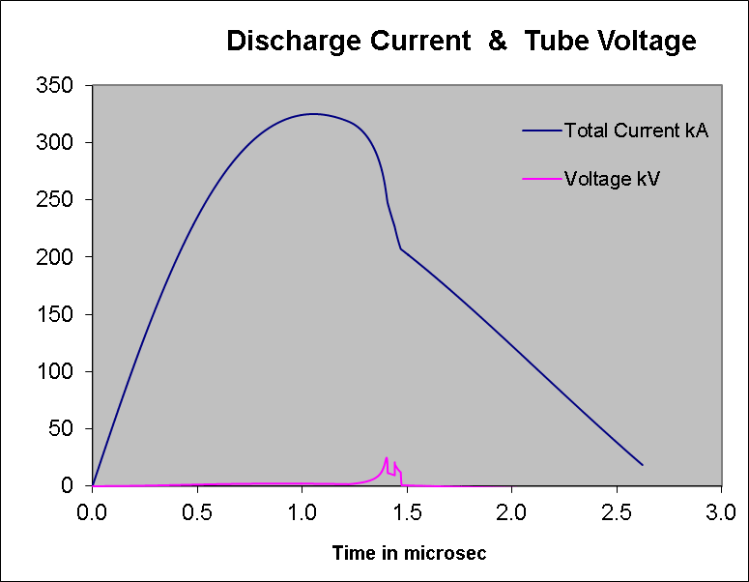
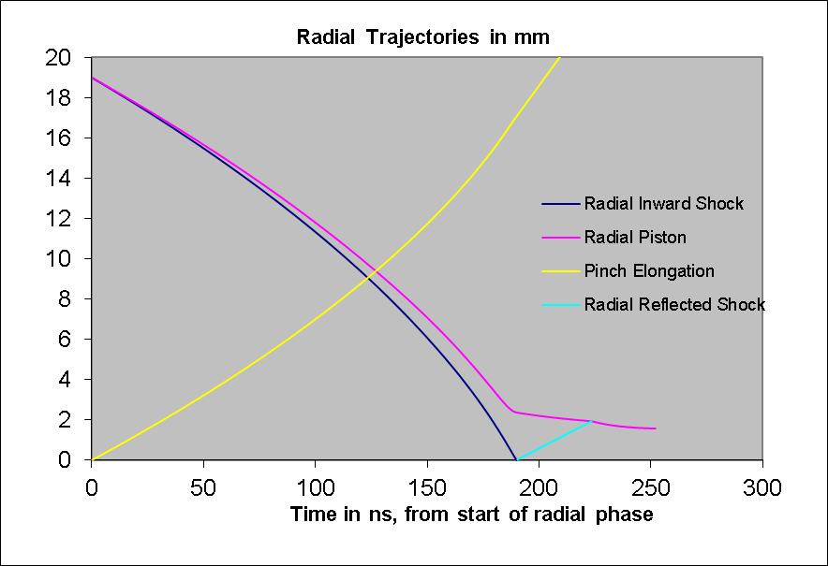
PF operated near time-matched-FFM

Slide 7
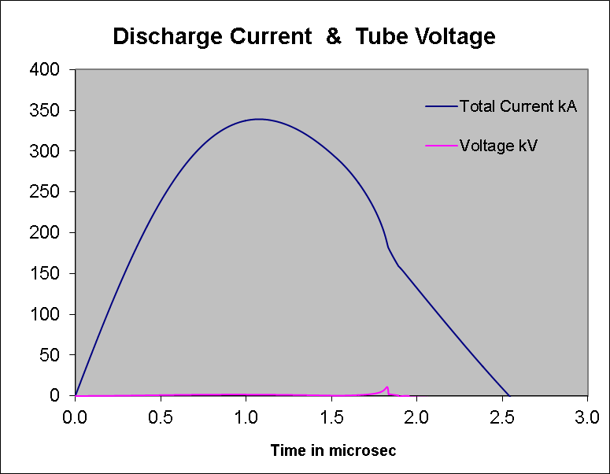
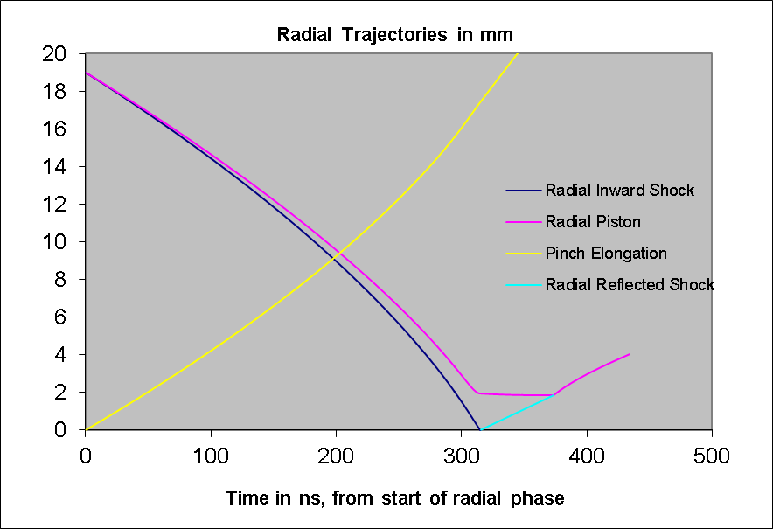
PF operated at higher pressure- SFM

Slide 8
Design of DuPF
DuPF uses two interchangeable electrodes enabling it to be optimized for both Slow Pinch Mode (SFM) and Fast Pinch Mode (FFM); the latter using a speed factor (SF) of more than 70 kA cm⁻¹ Torr^{-0.5} for FFM in deuterium and the former with SF of less than half that value for SFM.
Starting with available 6 ×450 µF capacitors rated at 11kV, numerical experiments indicate safe operation at 9 kV, 6 Torr deuterium with FFM anode of 5 cm radius; producing intense ion beam and streaming plasma pulses which would be useful for studies of potential fusion reactor wall materials.
Operating at 5 kV, at 10 Torr deuterium with SFM anode of 10 cm radius leads to long- duration, large-area uniform flow which could be more suitable for synthesis of nano-materials. Also numerical experiments show that DuPF can be applied as a pulsed neutron source in FFM state even in more than 20 Torr deuterium gas.

Slide 9
Table 1. Tube, Model and Operational parameters of DuPF in FFM
Tube Parameter | Lo=50 nH | Co=2700 µF | b=8 cm | a=5 cm | Z_{o}=70 cm | r₀=1 mΩ
Model Parameters | Massf=0.1 | Currf=0.7 | Massfr=0.2 | Currfr=0.7
Operational Parameters | V₀=9 kV | P₀=6 Torr (Deuterium)

Slide 10
Table 2. Tube, Model and Operational parameters of DuPF in SFM
Tube Parameter | Lo=50 nH | Co=2700 µF | b=15 cm | a=10 cm | Z_{o}=70 cm | r₀=1 mΩ
Model Parameters | Massf=0.1 | Currf=0.7 | Massfr=0.2 | Currfr=0.7
Operational Parameters | V₀=5 kV | P₀=10 Torr (Deuterium)

Slide 11
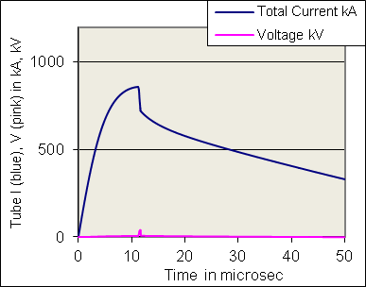
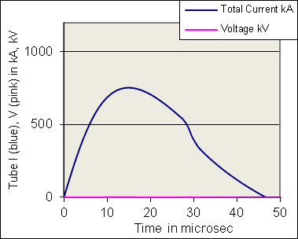
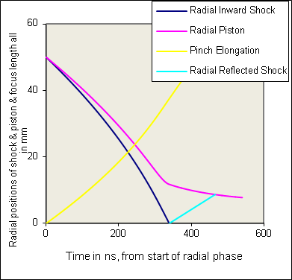
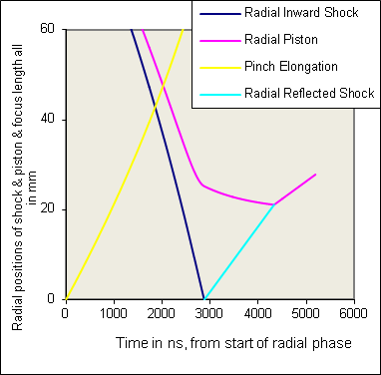
Computed discharge current for DuPF: FFM, 6 Torr D (Left). SFM, 10 Torr D (Right) Computed radial trajectories for DuPF: FFM, 6 Torr D (Left). SFM, 10 Torr D (Right)

Slide 12
Table 3. Comparative table of FFM and SFM of DuPF
Parameter | FFM | SFM
b (cm) | 8 | 15
a (cm) | 5 | 10
c | 1.6 | 1.5
z₀ (cm) | 70 | 70
P (Torr) | 6 | 10
V₀ (kV) | 9 | 5
I_{peak} (kA) | 858 | 753
I_{pinch} (kA) | 523 | 243
v_{a} (cm/ms) | 9.4 | 3.2
v_{s} (cm/ms) | 21.3 | 4.5
v_{p} (cm/ms) | 15.3 | 3.4
(c²-1)/lnc | 3.32 | 3.08
Bank surge imp (mW) | 4.3 | 4.3
Rdyn axial (mW) | 4.4 | 1.3

Slide 13
I/a (kA/cm) | 172 | 75
SF (kA/cm/Torr^{0.5}) | 70 | 24
FIB ion energy (keV) | 104 | 7
FIB beam energy (kJ) | 2.10 | 0.99
FIB energy flux (W m⁻²) | 1.5E+14 | 4.7E+11
FIB damage ftr (Wm⁻²s^{0.5}) | 4.1E+10 | 4.4E+08
PS energy (J) | 9965 | 6451
PS speed exit (cm/µs) | 25 | 2
Plasma Footprint radius (mm) | 7.85 | 27.1
J_{b} flux ions (m²s⁻¹) | 8.9E+27 | 4.1E+26
Fluence ions (m⁻²) | 6.7E+20 | 3.5E+20
EINP | 13 % | 25%
EINP1 wrk on pnch (J) | 14170 | 8437
Ion Current (kA) | 270.8 | 159.9
Current Density (A m⁻²) | 1.4E+09 | 6.6E+07
Numb ions per shot | 1.3E+17 | 8.6E+17

Slide 14
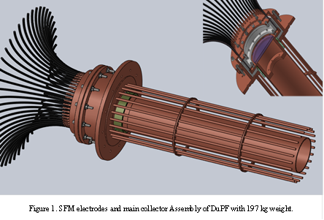
Design Drawings- SFM electrodes and main collector Assembly of DuPF with 197 kg weight

Slide 15
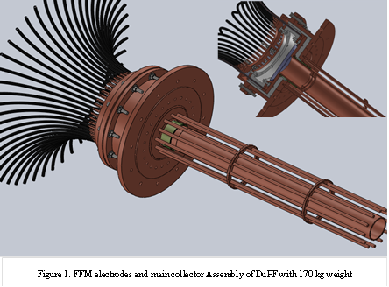
FFM electrodes and main collector Assembly of DuPF with 170 kg weight

Slide 16
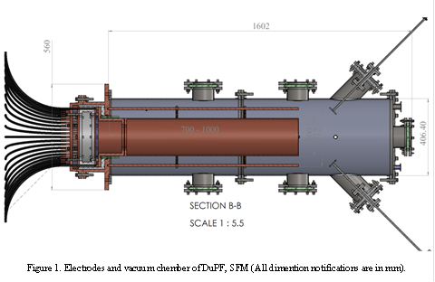
DuPF with SFM Configuration

Slide 17
Fabrication & Cost
Vahid

Slide 18
Installation

Slide 19
Testing

Slide 20
Proposed Projects

