Slide 1
CPR’s Research Projects & Collaborations – Way Forward
S H Saw^{1,2}, and S Lee^{1,2,3}
¹Inti International University, Nilai Malaysia
²Institute for Plasma Focus Studies, Melbourne, KL, Singapore
³University of Malaya, KL, Malaysia

Slide 2
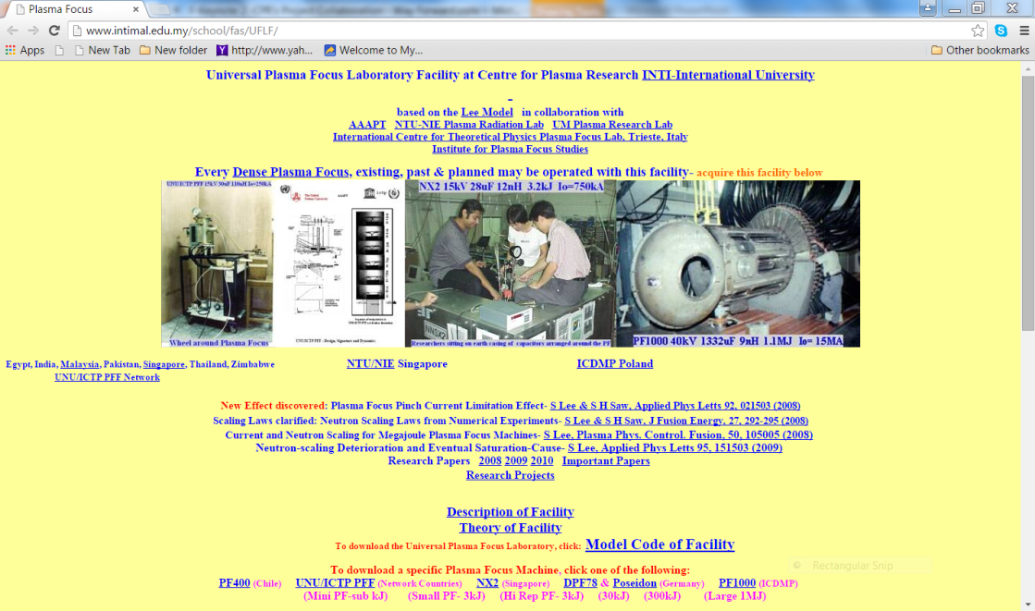
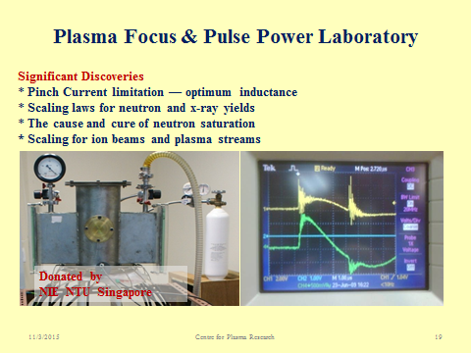
Introduction 1/2
The Centre for Plasma Research at INTI International University was conceived in July 2007 and set up in November 2007 with the hosting of the Universal Plasma Focus Laboratory Facility (UPFLF) and in January 2009 the installation of INTI PF, a 3 kJ plasma focus machine donated (in 2008) to INTI IU by Nanyang Technological University (Plasma Sources and Application Centre, a part of Natural Sciences and Science Education Academic Group)
National Institute of Education)

Slide 3
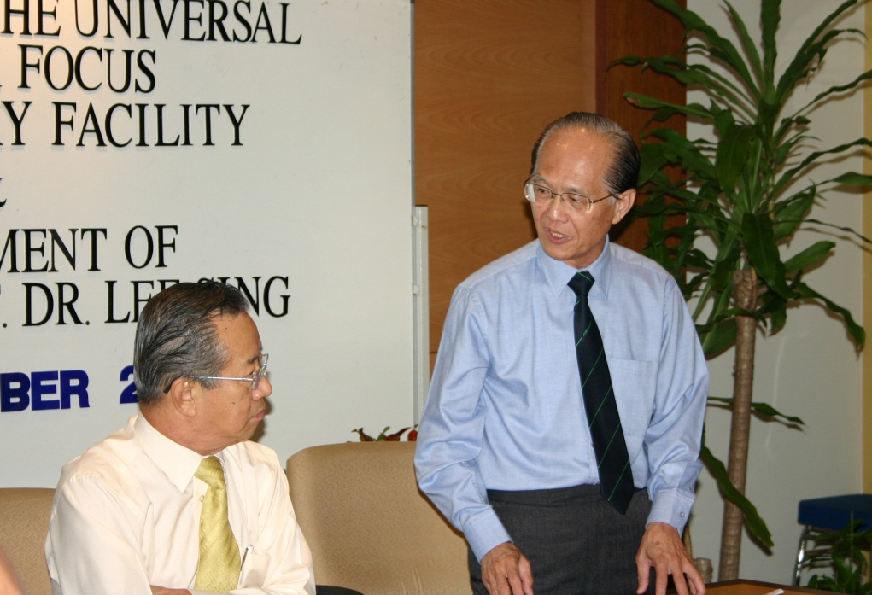
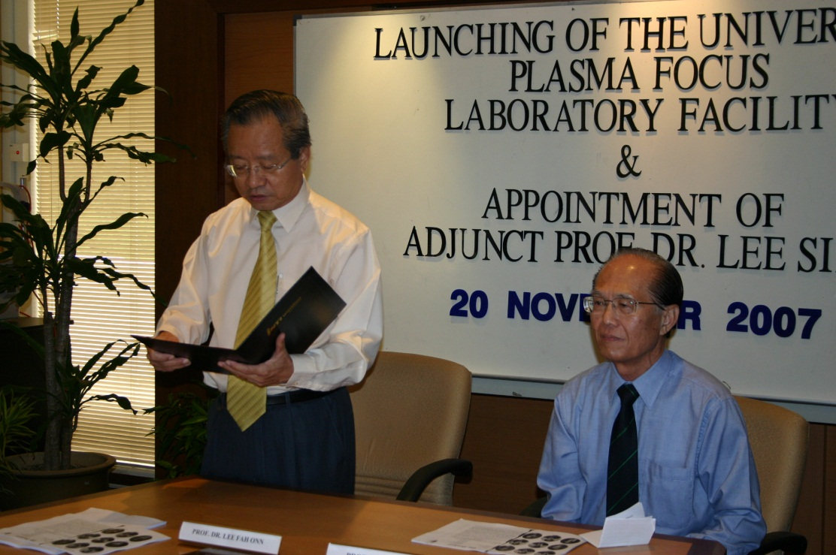
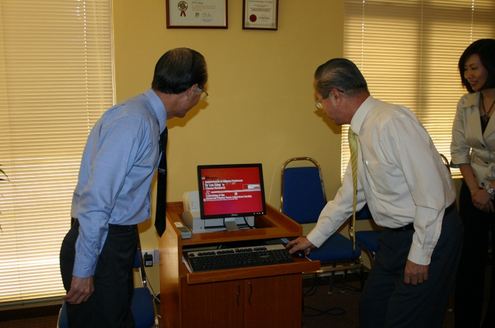
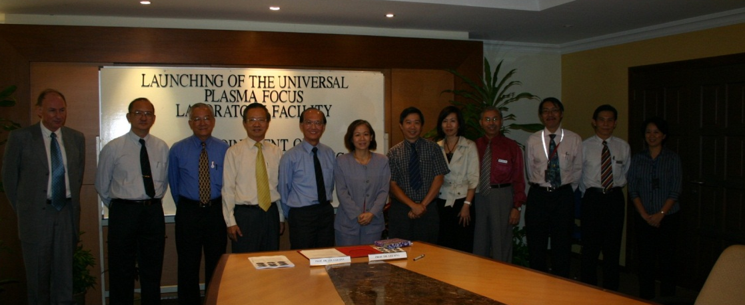
Appointment of Adjunct Professor Dr. Lee Sing – November 2007

Slide 4
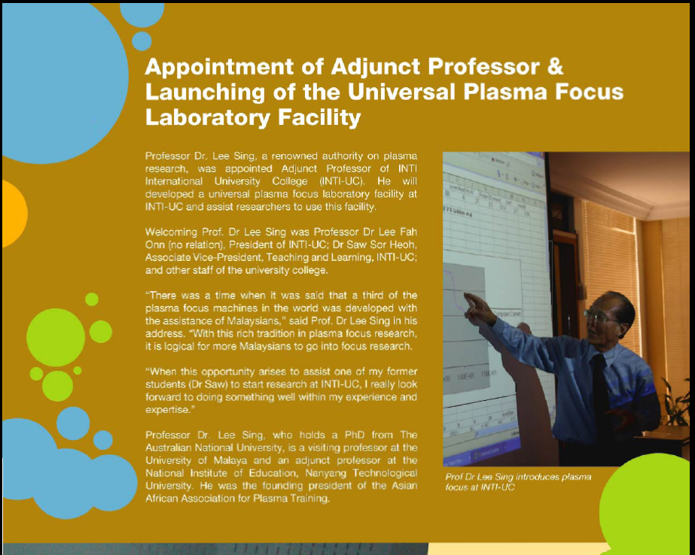
Launching of the Universal Plasma Focus Laboratory

Slide 5
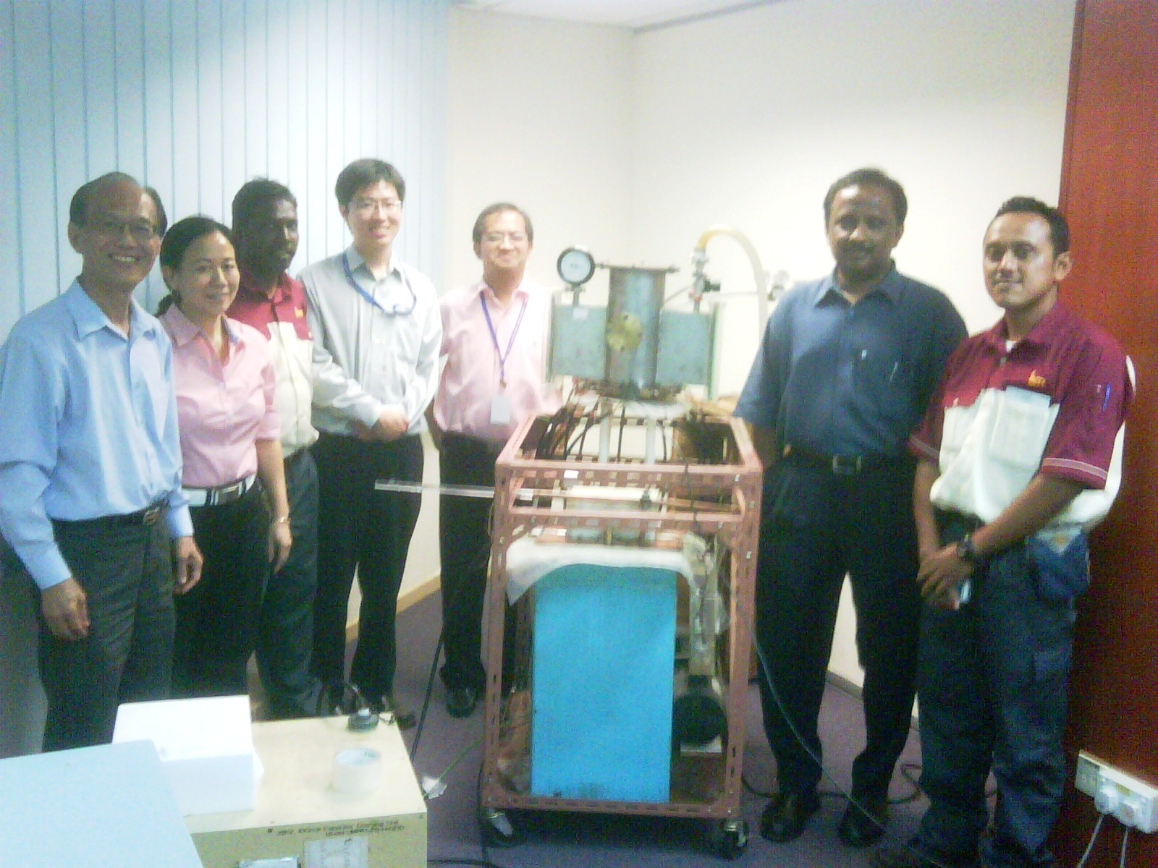
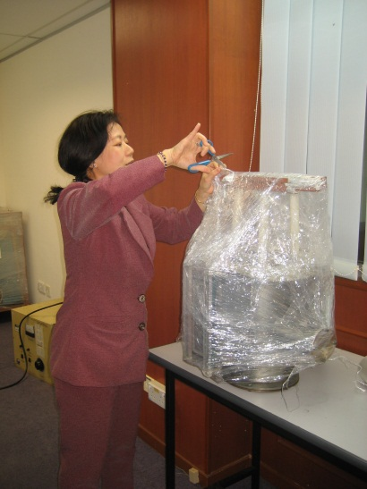
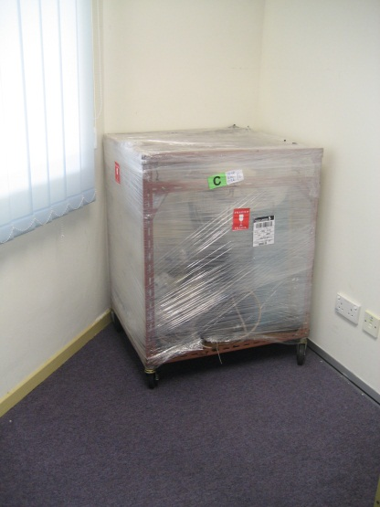
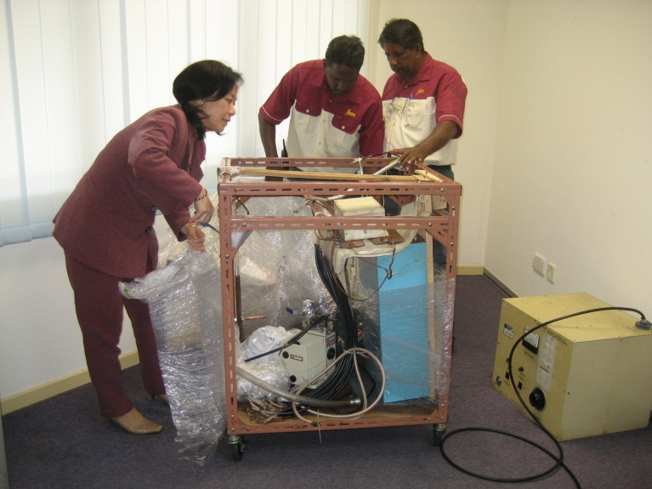
INTI PF from NIE-NTU Singapore
Group Photo taken after successful 1st shot – 23 June 2009

Slide 6
Introduction 2/2
Since then many series of Laboratory Experiments have been conducting using INTI PF.
Many series of Numerical Experiments using UPFLF have since been successfully carried out on INTI PF and plasma focus machines in Argentina, Germany, USA, Chile, Malaysia, Singapore, Russia, China, Pakistan, India, Estonia, Italy, Iran, Syria and the International Centre for Dense Magnetised Plasmas (ICDMP), Poland.
This has resulted in in more than 170 papers, including 84 published papers most in top level ISI physics journals such as Applied Phys Lett, Phys of Plasmas, IEEE Trans Plasma Sci, J Fusion Energy, J Applied Phys, and 53 plenary/keynote/ review lectures at international conferences.

Slide 7
CPR Research Facilities
Universal Plasma Focus Laboratory Facility at Centre for Plasma Research INTI International University
3kJ INTI Plasma Focus Machine (a UNU/ICTP Plasma Focus Facility) – donated by Nanyang Technological University Singapore
  Current Measurement System
  Voltage Measurement System
  Magnetic field Measurement System
  SXR Measurement System
  Faraday cup Measurement System
  Time of Flight (TOF) Measurement System

Slide 8
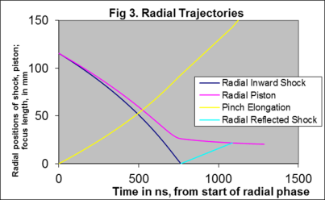
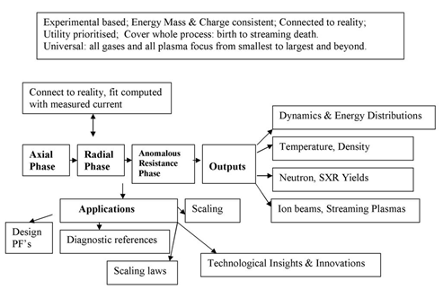
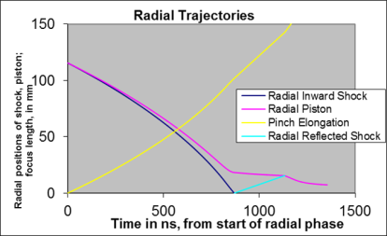
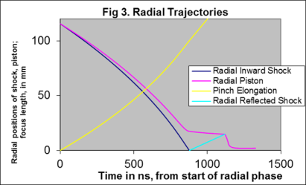
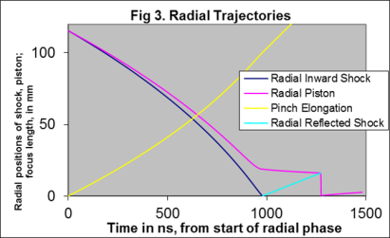
Illustrate R C in D,Ne,Ar
Universal Plasma Focus Laboratory Facility
Most powerful simulation model for PF, most widely used internationally.
200 scientists trained in 9 international workshops.
Frontier Papers: PF limitation effects Appl. Phys. Lett. 92, 021503 (2008)
Global PF scaling laws J Fusion Energy 27 292-295 (2008), Phys Plasmas (2012, 13)
Overcoming existing scaling deficiencies - Appl Phys Letts - 95, 51503(2009)
Radiative Cooling and Collapse-J Fusion Energ (2013), Phys Plasmas (2015)

Slide 9
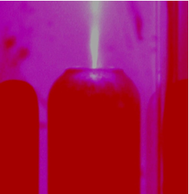
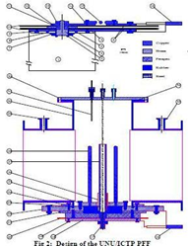
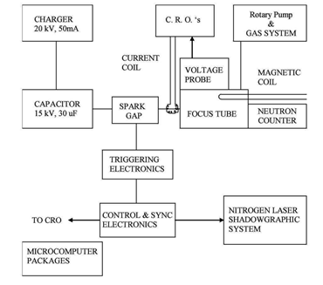
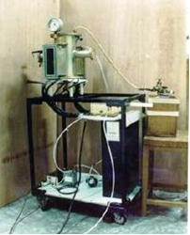
INTI PF – 3kJ

Slide 10
Diagnostics Systems
Current Measurement System
Voltage Measurement System
Magnetic field Measurement System
SXR Measurement System
Faraday Cup Measurement System
Time of Flight Measurement System

Slide 11
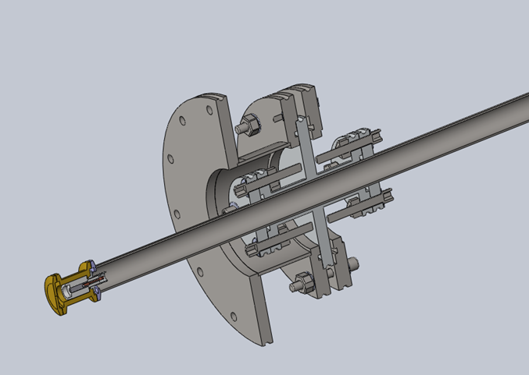
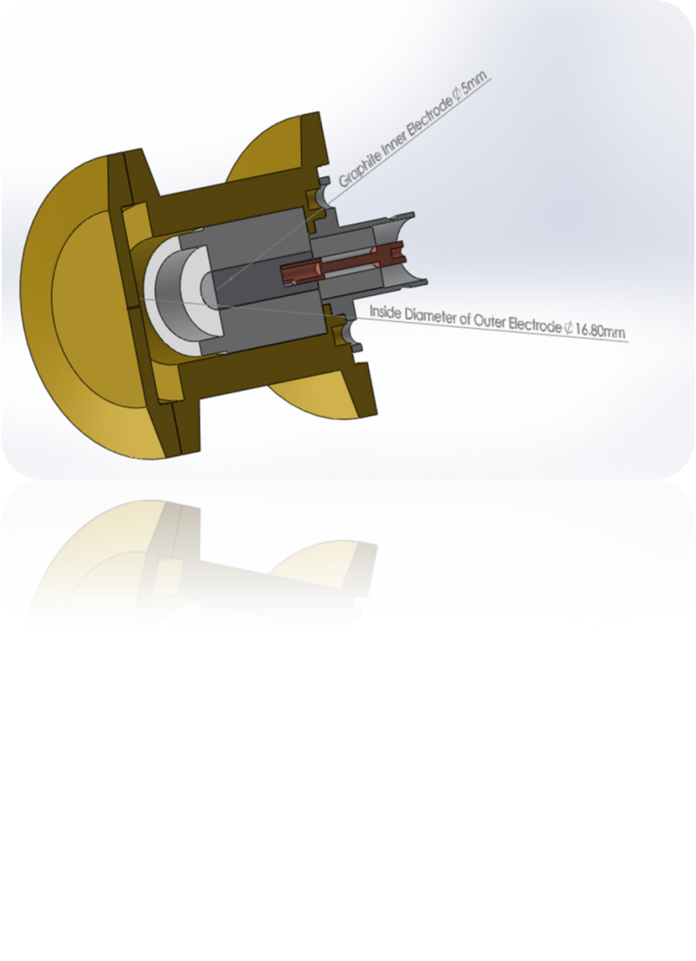
INTI PF FC Drawing
This is an adjustable faraday cup. The distance between faraday Cup to plasma focus anode tip is adjustable by means of a stainless steel tube from outside of the vacuum chamber.

Slide 12
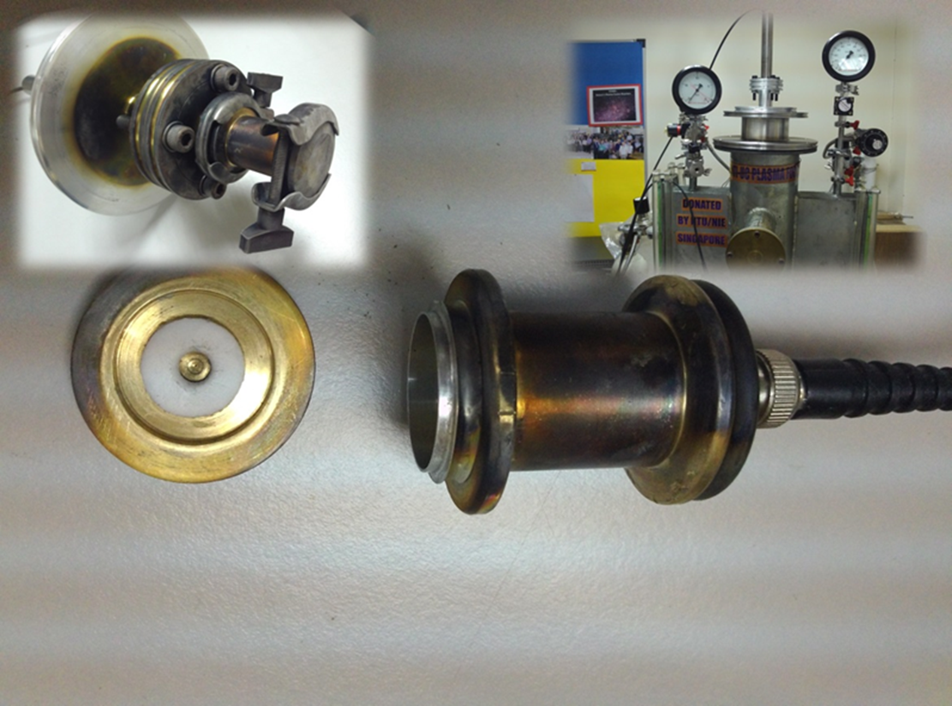
INTI PF FC Construction

Slide 13
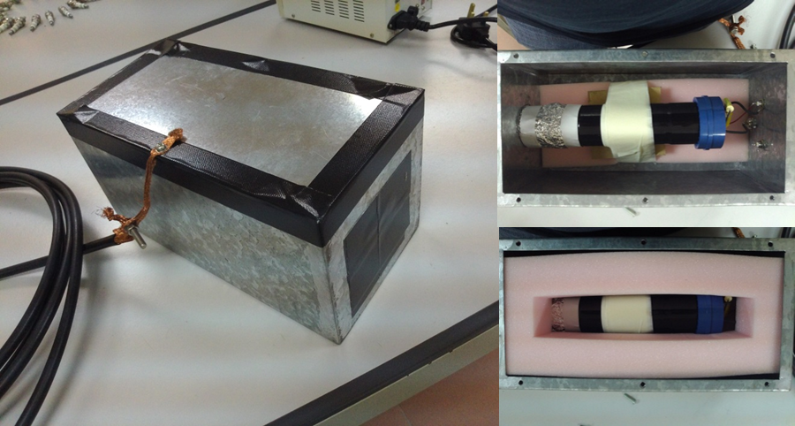
Photomultiplier-Scintillator System for INTI PF

Slide 14
Photomultiplier-Scintillator System for INTI PF

Slide 15
New Research Facilities
3kJ INTI Plasma Focus Facility for Nitriding of Materials – INTI IU construction in-progress
160 kJ Dual PF for materials synthesis and damage research – Patent in-progress

Slide 16
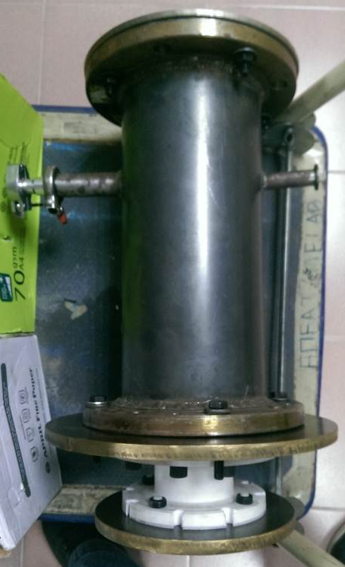
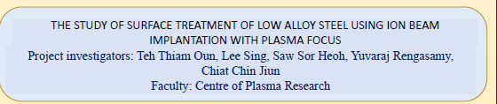
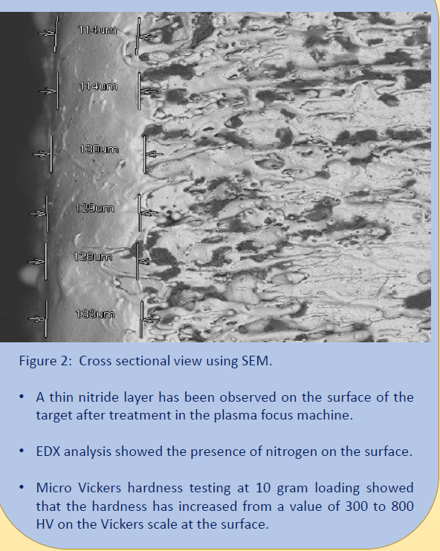
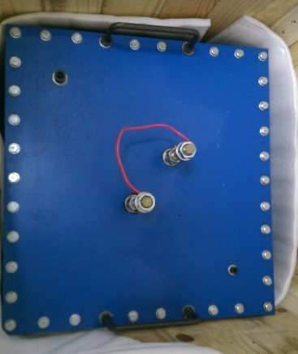
INTI PF2 – Nitriding Application
  30 µF, 15 kV capacitor from Azad University, Tehran, Iran

Slide 17
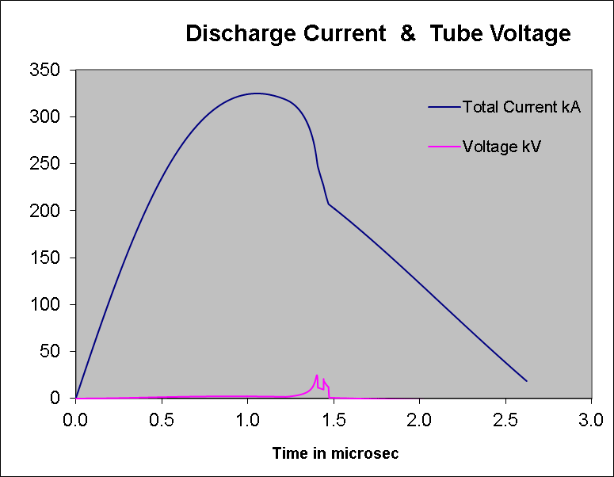
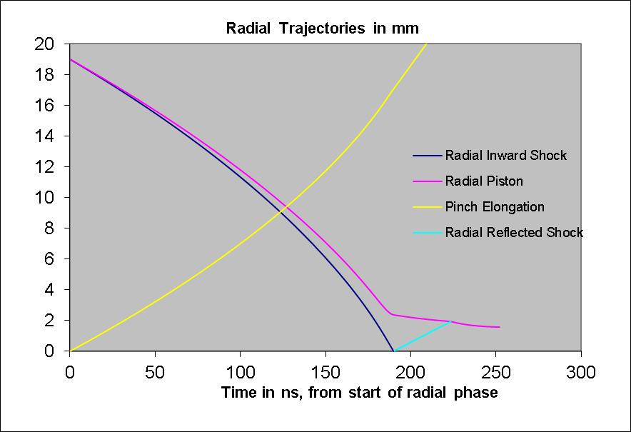
New concept: SFM vs FFM:
PF operated near time-matched-FFM

Slide 18
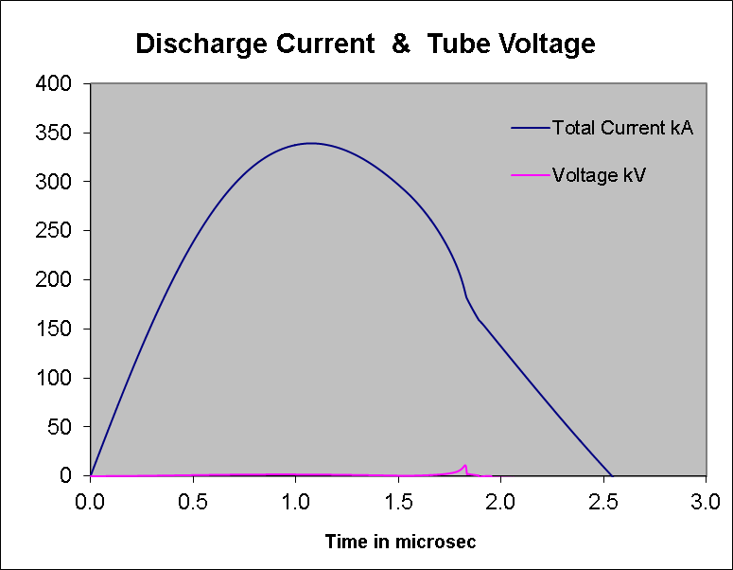
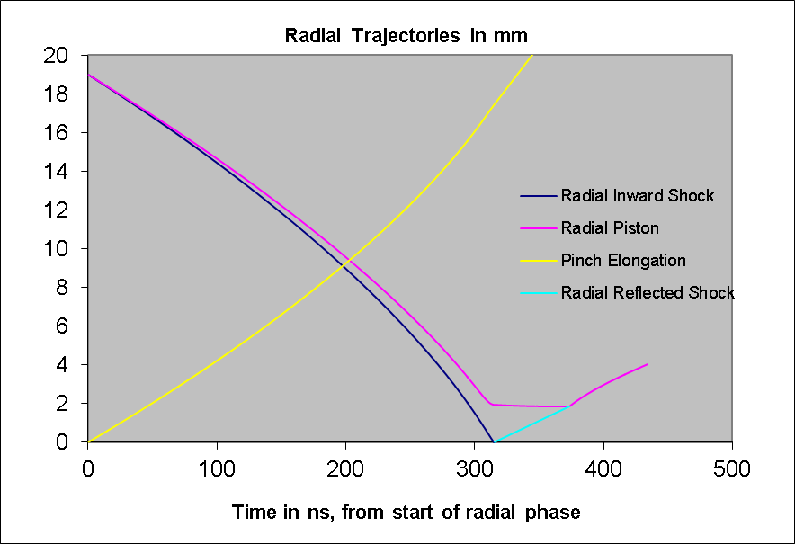
PF operated at higher pressure- SFM

Slide 19
DuPF- PF operating in dual mode
One set of capacitors
One set of electrodes- FFM
A second set of electrodes - SFM

Slide 20
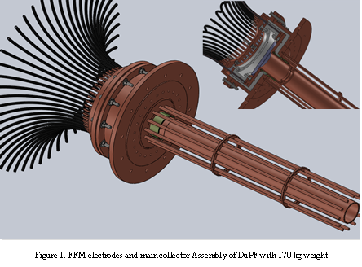
FFM electrodes and main collector Assembly of DuPF with 170 kg weight

Slide 21
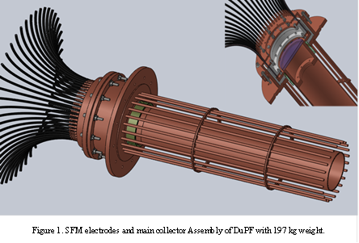
Design Drawings- SFM electrodes and main collector Assembly of DuPF with 197 kg weight

Slide 22
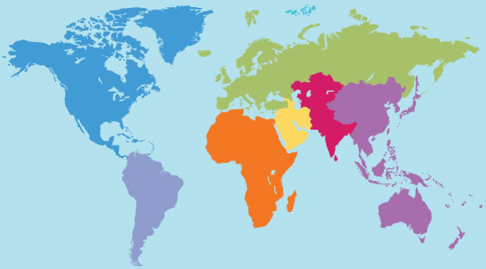
















International Collaboration
Australia Singapore Italy Syria Austria Kansas State
Iran Chile Bulgaria Nepal Turkey Serbia Saudi Arabia

Slide 23
International Collaborating Partners
Institute for Plasma Focus Studies (IPFS), Melbourne, Australia; KL, Malaysia and Singapore.
Nanyang Technological University, National Institute of Education, Singapore
Kansas State University, Department of Mechanical & Nuclear Engineering, USA
International Centre for Theoretical Physics, Plasma Focus Laboratory, Trieste, Italy
Syrian Atomic Energy Commission, Damascus, Syria
Comision Chilena de Energie Nuclear, Santiago, Chile
International Centre for Dense Magnetised Plasmas, Warsaw, Poland
Asian African Association for Plasma Training
Turkish Science and Research Foundation, Ankara, Turkey
International Atomic Energy Agency (IAEA), Vienna, Austria
Azad University, Plasma Physics Research Center (PPRC), Science & Research Campus, Tehran, Iran
Sofia University, Faculty of Physics, Sofia, Bulgaria
Department of Natural Sciences, Kathmandu University, Dhulikhel, Nepal
Central Department of Physics, Tribhuvan University, Kathmandu, Nepal
Institute of Experimental Physics V, Ruhr-University Bochum, Germany
Czech Technical University, Prague, Czech Republic
Plasma Physics Laboratory, University of Saskatchewan, Canada
at

Slide 24
Founder:
International Conference on Plasma Computation/Sciences & Applications
1st IWPCA2008(Malaysia)
2nd ICPSA2009(Singapore)
3rd ICPSA2010 (China)
4th ICPSA2011(Iran)
5th ICPSA2012(Bangkok)
6th ICPSA2013(Singapore)
7th ICPSA2014(Nepal)
8th ICPSA2015(Iran)
9th ICPSA2016 (Malaysia-UTM)

Slide 25
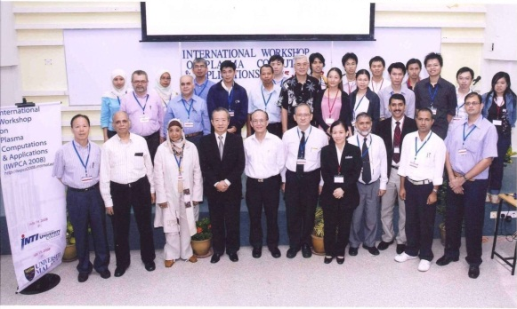
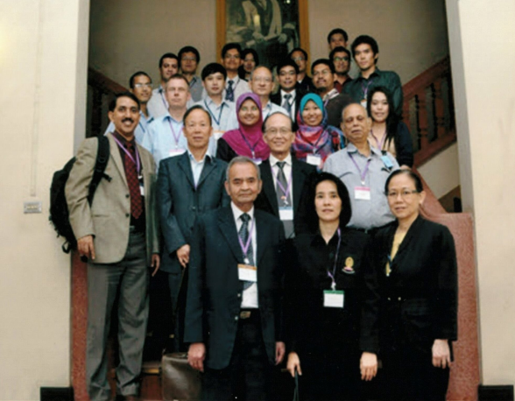
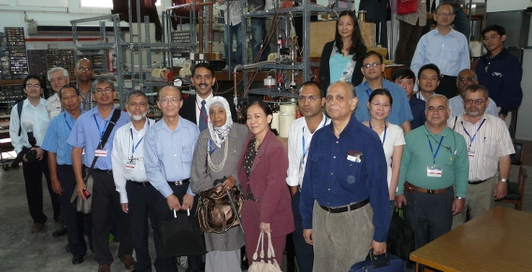
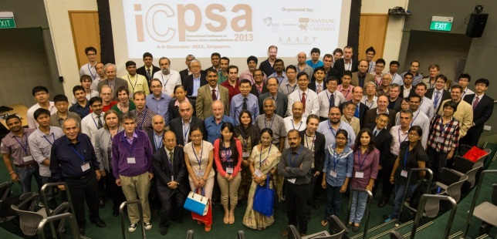
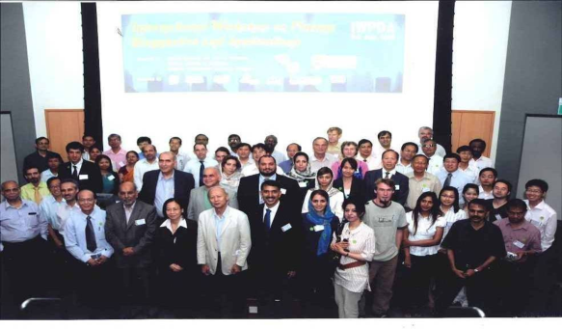
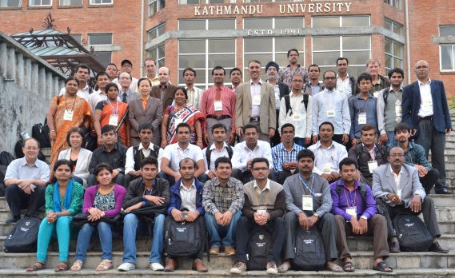
International Workshop on Plasma Computations & Applications (IWPDA 2008)
(INTI UC & UM)

Slide 26
Initiate:
Numerical Workshop on Plasma Focus Computation
Internet Course 2008(Malaysia)
NEW PF NURER 2010 (Turkey)
NEWPF ICTP 2010, 2012 (Italy)
NEWPF KSU 2011 (US)
NEW PF ITAP 2012 (Turkey)
NEWPF 2013, 2014(Kathmandu)
Host:
IAEA 2nd CRP Meeting2013 (Malaysia & Singapore)

Slide 27

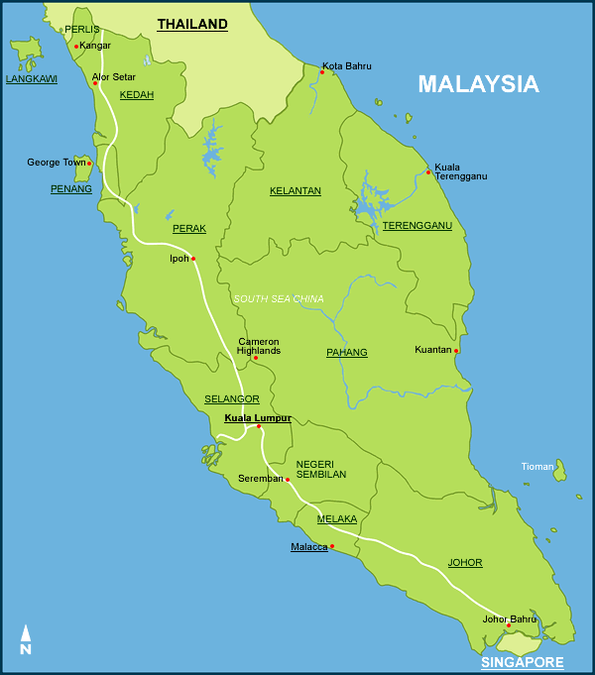





Regional Collaboration
2
3
5
1
4

Slide 28
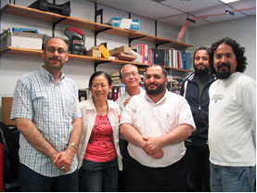
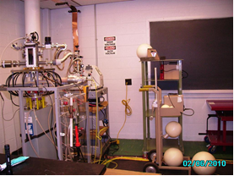
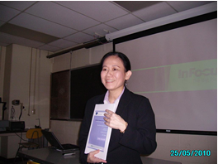
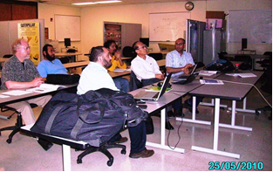
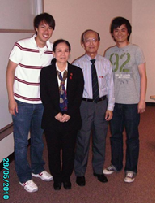
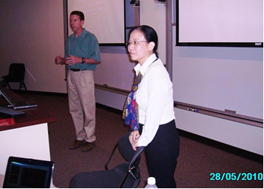
Kansas State University (KSU)
& University of Nebraska-Lincoln (UNL)

Slide 29
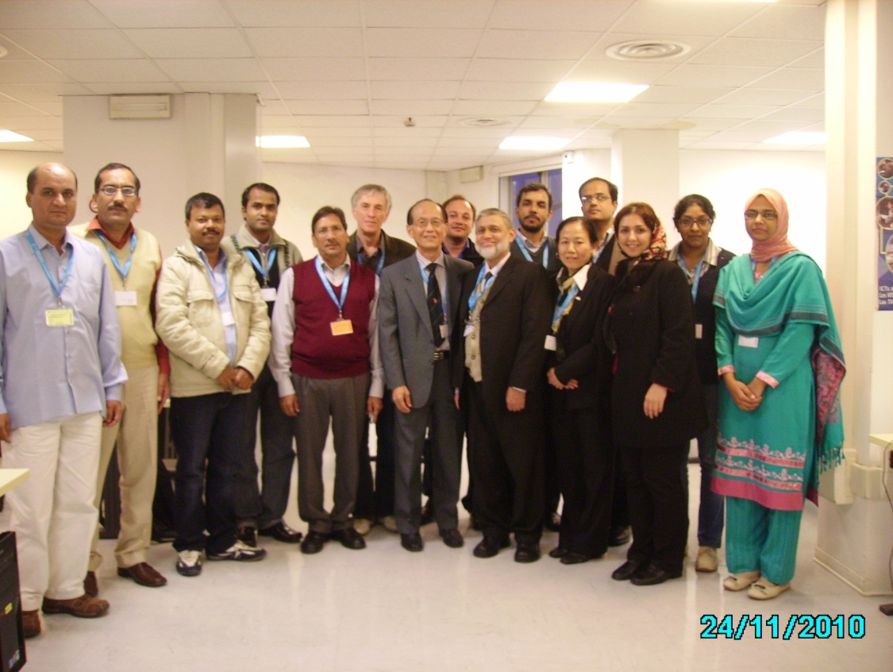
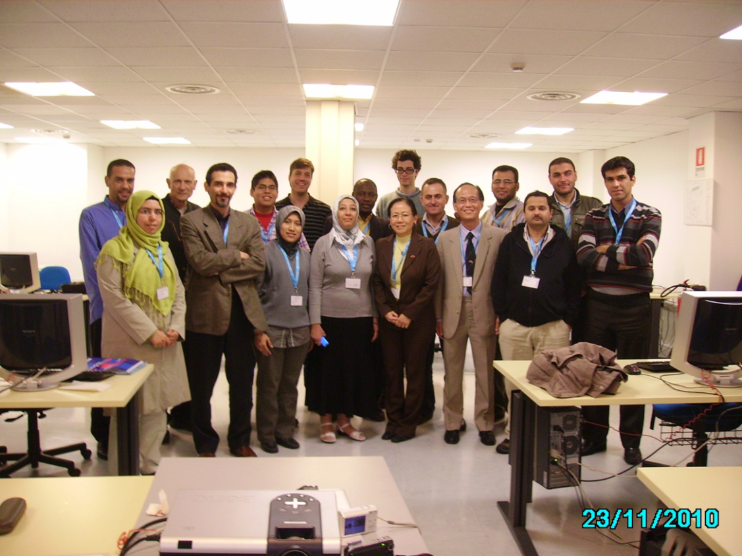
IAEA-ICTP Workshop on Dense Magnetized Plasmas and Plasma Diagnostics
Trieste Italy 15-26 November 2010.

Slide 30

Seminar on Plasma Focus Experiments (SPFE 2010) 27 August

Slide 31

Seminar on Plasma Focus Experiments (SPFE 2011)
1 July

Slide 32

Seminar on Plasma Focus Experiments (SPFE 2012) 12 July

Slide 33



UTM-Jazan University Summer Programme at
INTI International University
8th – 12th July 2013

Slide 34






Centre for Plasma Research Open Day
17th June 2014

Slide 35







Conference on Plasma Focus Experiments (SPFE 2014)
20 June

Slide 36







Slide 37






1st Research Presentation on Plasma Focus Experiments & New Applications with MNA & UTM 20th November 2014

Slide 38
Key projects and collaboration
IAEA CRP - Investigation of Fusion-Relevant Pulses from Plasma Focus Devices-Scaling and Properties - 15 countries
MOE-FRGS - Development and construction of a Dual Mode 160 kJ Plasma Focus for Advanced Materials - NTU
INTI IU MG -Optimisation of radiations yields from Plasma focus using Lee Model Code –NTU, UTM, SAEC, KU etc
4) Radiative Collapse – SAEC, Bochum U, Czech TU, ICDMP, UTM

Slide 39


IAEA CRP - Investigation of Fusion-Relevant Pulses from Plasma Focus Devices-Scaling and Properties - 15 countries

Slide 40



Slide 41



Slide 42

Newly formed collaboration on Radiative Collapse- Malaysia, Australia, Singapore, Syria , Germany, Czech Republic, Poland: Paper accepted to be published in IEEE TPS 2016

Slide 43

Radiative Collapse in Plasma Focus

Slide 44


Slide 45

Observed Radiative collapse in INTI PF

Slide 46
Radiative collapse in INTI PF
This intense compression, reaches 3.7 × 10²⁶ ions m⁻³, 15 times atmospheric density (ambient: < 1/1000 atmosphere)
30 J are radiated away in ps.
Peak radiation power:- 4 × 10¹² W (4 TW).
The energy density reaches 4 × 10¹³ J m⁻³ (40 kJ mm⁻³).
Even in this small PF intense HED is achieved with immense radiation power.

Slide 47
FFM electrodes and main collector Assembly of DuPF with 170 kg weight

Slide 48
Design Drawings- SFM electrodes and main collector Assembly of DuPF with 197 kg weight

Slide 49

Dual PF – 160 kJ

Slide 50
Advanced Materials Unit
High Temperature Superconductors
Hardening of Materials
Synthesis of Advanced Materials

Slide 51


Slide 52

DuPF Paper

Slide 53

Scaling laws papers

Slide 54

Optimisation papers

Slide 55


Radiative Collapse Papers- Warsaw, Prague

Slide 56
Way forward
DuPF: SFM research on materials, FIB & FPS
High Energy Density using Radiative Collapse
High Temperature Superconductor & Other Advanced Materials
Advanced materials research in PF HED environment linked to our advanced materials laboratory

Slide 57

DuPF with SFM Configuration

Slide 58
160kJ DuPF, 2D View

